Slide 1
New York State Maternal Mortality and Morbidity
Marilyn Kacica, MD, MPH
Medical Director Division of Family Health

Slide 2
Presentation Overview
Surveillance
Maternal Mortality Review (MMR) in New York State (NYS)
Maternal mortality
Severe maternal morbidity
Disparities
Action
Guideline summary and resource development
New York State Perinatal Quality Collaborative (NYSPQC)
Promoting well woman care
Partnership for Maternal Health (PMH) Campaign
NYS Infant Mortality Collaborative Improvement & Innovation Network
Perinatal regionalization
Maternal Mortality Review Board
Governor Cuomo’s comprehensive initiative

Slide 3
Surveillance

Slide 4
Maternal Mortality
US ranks 47th in the world behind all other developed nations in maternal mortality
2010: NY ranks 46th among 50 states with a rate of 18.9
Center, N.W.s.L., Health Care Making the Grade on Women's Health: A National and State by State Report Card. 2010.
Available from: http://hrc.nwlc.org/status-indicators/maternal-mortality-rate-100000
2016: NY ranks 30th with a rate of 20.9
Explore Maternal Mortality in New York | 2016 Health of Women and Children Report. 2017;
Available from: http://www.americashealthrankings.org/explore/2016-health-of-women-and-children-report/measure/maternal_mortality/state/NY.

Slide 5
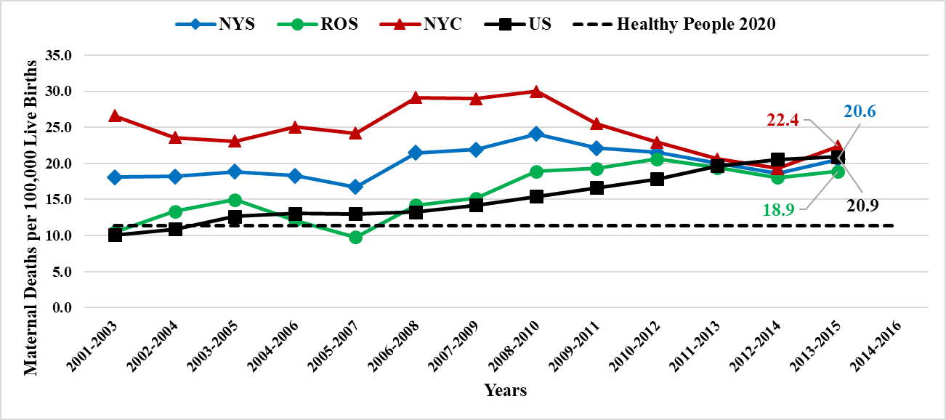
Trends in Maternal Mortality as Reported in Vital Records*
*Causes of death from death records A34, O00-O95,O98-O99.
2000-2014 data from NY Vital Records. 2015 NY and national data from CDC Wonder database.

Slide 6
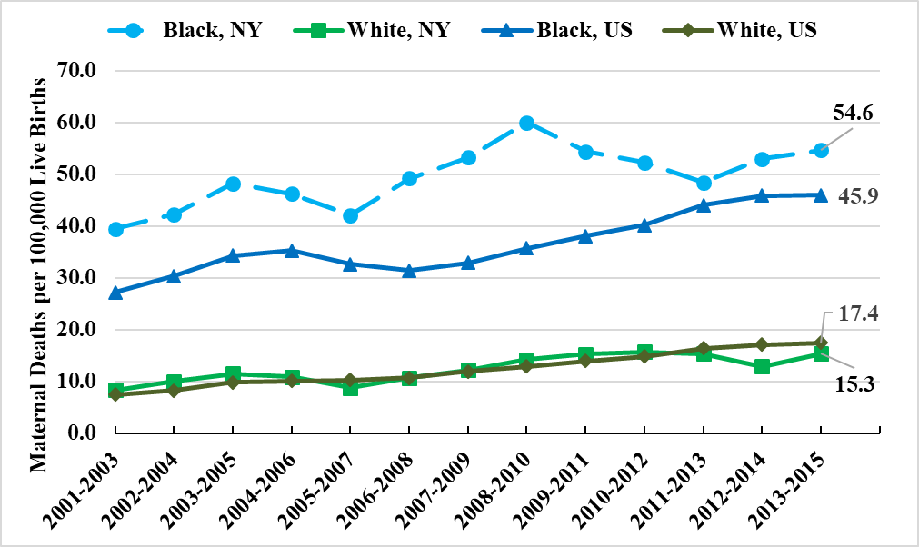
Trends in Maternal Mortality as Reported in Vital Records* by Race
*Causes of death from death records A34, O00-O95,O98-O99.
National maternal mortality trends derived from CDC Wonder Database available at https://wonder.cdc.gov/

Slide 7
NYS Maternal Deaths: MMR vs Vital Statistics 2013
 | Number in MMR | Number in Vital Statistics | Maternal Mortality Rate Comparison: MMR vs Vital Statistics | Black to white Ratios: MMR vs Vital Statistics
Total | 23 | 42 | 9.8 vs 17.9
Black mothers | 8 | 19 | 19.6 vs 46.6 | 2.6 vs 3.4
White mothers | 11 | 20 | 7.6 vs 13.9

Slide 8
Maternal Mortality Disparities in NYS
Racial disparities in maternal deaths are significant
The Black to White mortality ratio peaked in 2006 at 6 to 1
Decreased to 5 to 1 in 2009
Continued to decrease to reach 3.4 to 1 in 2013
Decreased to 2.8 to 1 in 2015

Slide 9
Maternal Mortality Review Initiative
Convened a multidisciplinary committee in 2010
Comprehensive population based examination of maternal mortality
Recommendations for focus and participation in education, developing materials, and quality improvement

Slide 10
MMR Case Identification
Standard surveillance
Review of female deaths linked to a live birth with a year or less between the two events
Enhanced surveillance
Examination of female death records not linked to a live birth certificate
That occurred within a year after a hospitalization with an indication of pregnancy
OR with an obstetric cause of death or pregnancy indicated on death certificate
New York Patient Occurrence Reporting and Tracking System (NYPORTS)

Slide 11
Prenatally-Identified Risk Factors
Pregnancy-related Deaths
Risk Factors | Percent of women with the risk factor
 | 2006-2008 | 2012-2013
Hematologic | 19% | 26%
Cardiac | 13% | 18%
Hypertension | 17% | 18%
Pulmonary | 9% | 18%
Endocrine | 8% | 16%
Psychiatric disorder | 5% | 11%
Increase over time in identified risk factors
Data source: NYS Maternal Mortality Review

Slide 12
Maternal Mortality Review Cohorts, 2012-2014
 | 2012 | 2013 | 2014* | Total
Pregnancy-related | 32 | 30 | 27 | 89
Pregnancy associated, not related | 45 | 59 | 43 | 147
Total | 77 | 89 | 69 | 235
Data source: NYS Maternal Mortality Review
*2014 not complete

Slide 13
Maternal Mortality in New York State
What changed over time in maternal mortality:
Black and White mothers contribute equally to the pregnancy-related cohort
17% of live births are born to Black mothers
An increasing majority of pregnancy-related deaths were covered by Medicaid
Fewer pregnancy-related deaths due to hypertensive disorders
Injury (substance abuse and suicide) is the leading cause of death among pregnancy-associated not related deaths

Slide 14
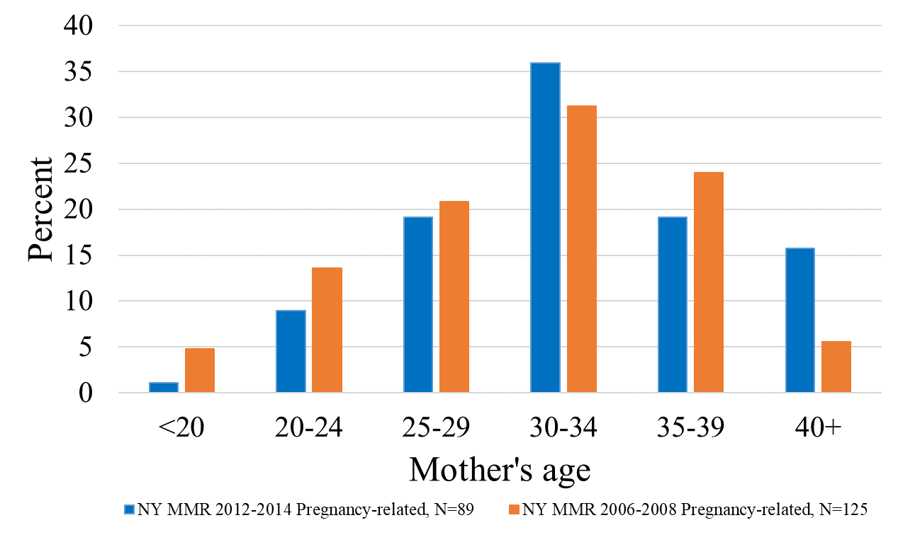
Pregnancy-Related Deaths by Mother’s Age 2006-2008 and 2012-2014
Data source: NYS Maternal Mortality Review

Slide 15
Pregnancy-Related Deaths by Pre-Pregnancy Weight Status, 2006-2008 and 2012-2014
Unhealthy pre-pregnancy weight status
Obese, BMI≥ 30
2006-2008: 30% (n=38)
2012-2014: 51% (n=45)
Data source: NYS Maternal Mortality Review

Slide 16
Pregnancy-Related Deaths by Race
2006-2008 and 2012-2013
Data source: NYS Maternal Mortality Review

Slide 17
Pregnancy-Related Deaths by Education 2006-2008 and 2012-2014
Data source: NYS Maternal Mortality Review

Slide 18
Maternal Demographics
 | 2006-2008 | 2012-2014
Primary Language: English | 63% | 69%
Marital Status: Single Married | 48% 48% | 53% 44%
Insurance: Medicaid | 45% | 64%
Parity: First time mothers One previous live birth 2 or more previous births Unknown | 30% 26% 33% 12% | 30% 17% 37% 16%
Data source: NYS Maternal Mortality Review

Slide 19
Prenatal History
Prenatal care utilization 2006-2008 2012-2014
Adequate prenatal care 25% 30%
Intermediate 27% 25%
Intensive 6% 6%
Inadequate 8% 6%
No prenatal care 10% 4%
Unknown 24% 29%
Data source: NYS Maternal Mortality Review

Slide 20
Timing of Death
Most of the pregnancy-related deaths occurred within a week of the end of the pregnancy.
2006-2008: 92/125, 74%
2012-2014: 58/89, 65%
 | 2006-2008 | 2012-2014
Antepartum | 15 (12%) | 12 (13%)
During labor or delivery | 11 (9%) | 3 (3%)
Within a day of delivery | 40 (32%) | 27 (30%)
First week after delivery | 27 (22%) | 16 (18%)
1-6 weeks postpartum | 25 (20%) | 16 (18%)
43 days to 1 year | 7 (6%) | 13 (15%)
Data source: NYS Maternal Mortality Review

Slide 21
Intrapartum Medical History
 | 2006-2008 | 2012-2014
Hospital of delivery or TOP: Level 3 Regional Perinatal Center | 46% 30% | 28% 36%
Type of Delivery:
C-Sections: Emergent Unscheduled non-emergent Elective scheduled Peri or postmortem | 63% 32% 14% 10% 7% | 66% 34% 13% 12% 7%
Normal spontaneous vaginal deliveries | 17% | 19%
Undelivered | 12% | 7%
Other | 6% | 8%
Data source: NYS Maternal Mortality Review

Slide 22
Cause of Death by Maternal Mortality Review Cohort
Cause of Death | 2006-2008 % (n) (N=125) | 2012-2014 % (n) (N=89)
Hemorrhage | 23% (n=29) | 16% (n=14)
Hypertensive disorders | 23% (n=29) | 7% (n=6)
Embolism (not cerebral) | 17% (n=21) | 25% (n=22)
Cardiovascular conditions | 10% (n=12) | 7% (n=6)
Infection | 3% (n=4) | 17% (n=15)
Cardiomyopathy | 2% (n=2) | 11% (n=6)
Data source: NYS Maternal Mortality Review

Slide 23
Cause of Death by Maternal Mortality Review Cohort
Cause of Death | 2006-2008 % (n) (N=125) | 2012-2014 % (n) (N=89)
Cardiac arrest/failure | 3% (n=4) | 2% (n=2)
Hematopoietic (sickle cell, thalassemia, ITP) | 2% (n=3) | 2% (n=2)
Intracerebral hemorrhage (not associated with PIH) | 4% (n=5) | 5% (n=4)
Pulmonary problems | 2% (n=3) | 3% (n=3)
Neurologic/neurovascular problems | 2% (n=3) | 3% (n=3)
Other | 8% (n=10) | 2% (n=2)
Data source: NYS Maternal Mortality Review

Slide 24
Provider-Identified Prenatal Risk Factors Pregnancy-Related Deaths
Number of risk factors (%) | Number of cases 2006-2008 (%) | Number of cases 2012-2013 (%)
0 | 45 (36%) | 9 (14.5%)
1 | 40 (32%) | 18 (29.0%)
2 | 23 (18%) | 15 (24.2%)
3 or more | 8 (14%) | 20 (32.3%)
Data source: NYS Maternal Mortality Review

Slide 25
Causes of Death Among Pregnancy-Associated Deaths
(n=147)
Maternal Mortality
Reviews, 2012-2014
Injury 52% (n=77)
Cancer 10% (n=14)
Infection 5% (n=7)
Cardiac arrhythmia 5% (n=8)
Unknown 4% (n=6)
Pulmonary problems 5% (n=8)
Cardiomyopathy 2% (n=3)
Cardiovascular problems 3% (n=4)
Other 14% (n=20)
Data source: NYS Maternal Mortality Review

Slide 26
Pregnancy-Associated Deaths - Injury
Maternal Mortality
Reviews, 2012-2014
Injury (n=77)
Substance abuse 30% (n=23)
Suicide 17% (n=13)
MVA 22% (n=17)
Homicide 15% (n=15)
Undetermined injury 12% (n=9)
Data source: NYS Maternal Mortality Review

Slide 27
Maternal Mortality in New York State
Pregnancy-related deaths | NYS MMR 2006-2008 | NYS MMR 2012-2014
Race disparities: Deaths per 100,000 live births | 48.9 Black 14.5 Hispanic 6.9 White | 34.0 Black 9.0 Hispanic 6.6 White
Pre-pregnancy weight: overweight or obese | 15% overweight 30% obese | 9% overweight 51% obese
Low Income | 45% Medicaid | 64% Medicaid
Method of delivery: C-section | 63% | 66%
Education: | 14% high school graduate 11% some college, no degree | 24% high school graduate 11% some college, no degree
Data source: NYS Maternal Mortality Review

Slide 28
Severe Maternal Morbidity (SMM)
“Severe maternal morbidity can be thought of as unintended outcomes of the process of labor and delivery that result in significant short-term or long-term consequences to a woman’s health.”

Slide 29
SMM by Method of Delivery, New York State, 2008-2014
Cesarean deliveries
All deliveries
Vaginal deliveries
Lazariu V, Nguyen T, McNutt L-A, Jeffrey J, Kacica M (2017) Severe maternal morbidity: A population-based study of an expanded measure and associated factors. PLoS ONE 12(8): e0182343. https://doi.org/10.1371/journal.pone.0182343

Slide 30
SMM and Race/Ethnicity
15% of live births are born to Black, non-Hispanic mothers.
27% of women experiencing SMM during delivery are Black, non-Hispanic
23% of live births are born to Hispanic mothers
29% of women with SMM during delivery are Hispanic
Black non-Hispanic women more likely to experience SMM during delivery
Most of the disparity is among cesarean births

Slide 31
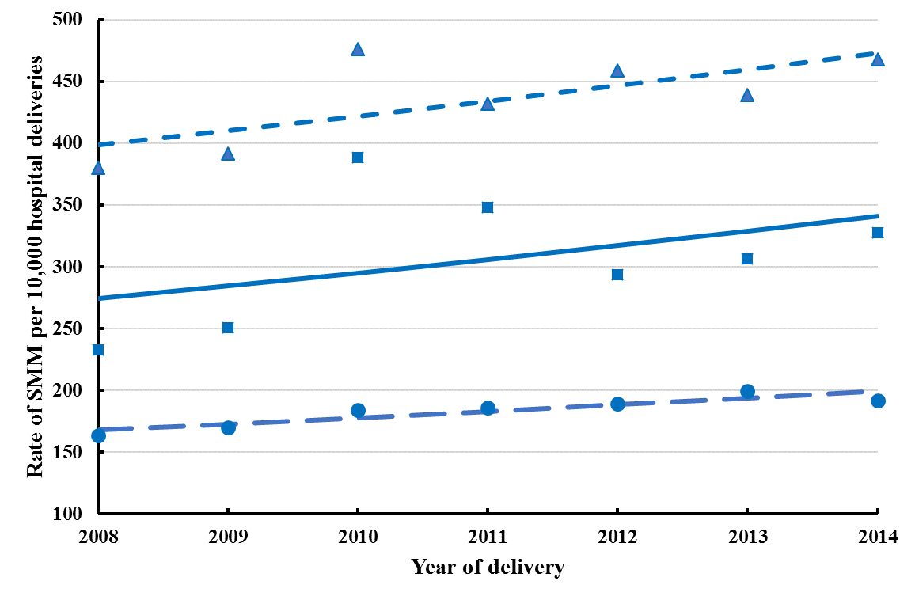
SMM by Race/Ethnicity, New York State, 2008-2014
Black, non-Hispanic
Hispanic
White, non-Hispanic

Slide 32
Action

Slide 33
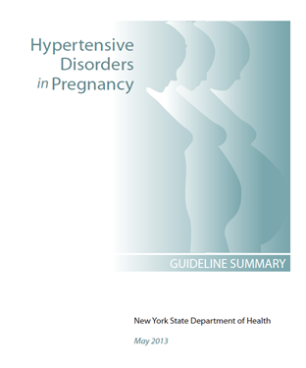
NYS MMR Translation to Action
Hypertensive Disorders in Pregnancy Guideline Summary released in 2013
Posted on NYSDOH and NYSPQC websites and widely disseminated to hospitals across state
http://www.health.ny.gov/professionals/patients/women.htm

Slide 34
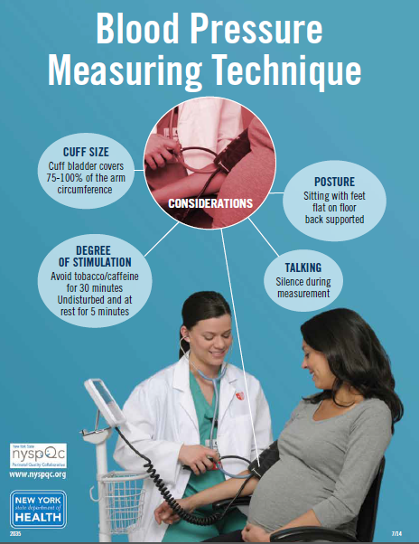
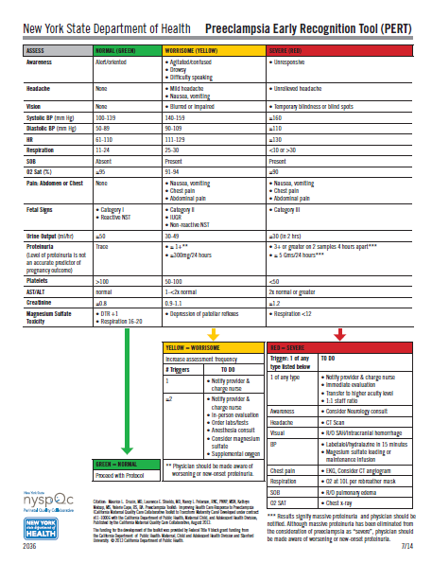
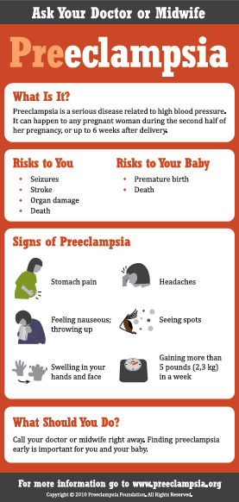
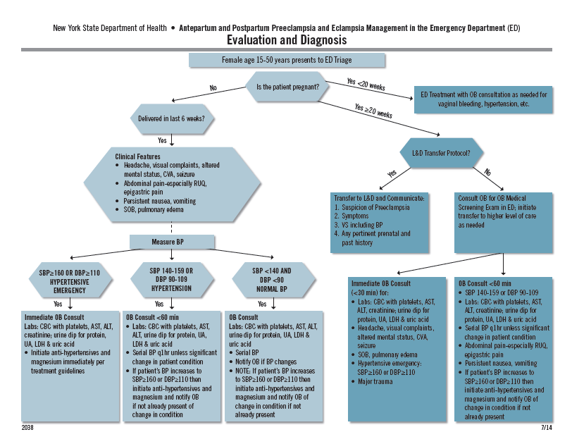
Resources Developed from Guidelines

Slide 35
New York State Perinatal Quality Collaborative (NYSPQC)
The NYSPQC aims to provide the best and safest care for women and infants in NYS by collaborating with birthing hospitals, perinatal care providers, professional organizations and other key stakeholders to prevent and minimize harm through the translation of evidence-based guidelines to clinical practice.
Notes:
An initiative led by the NYSDOH Division of Family Health.

Slide 36
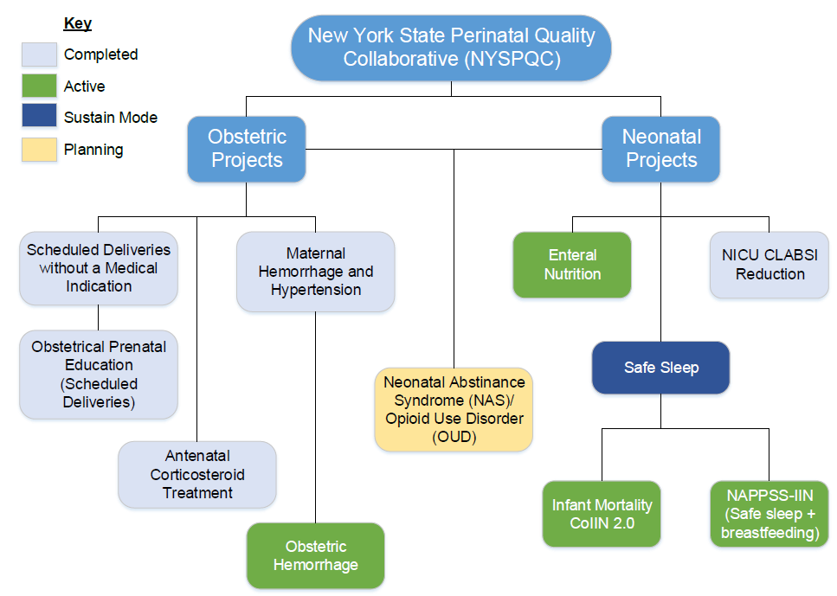
Notes:
Obstetric Hemorrhage - The NYSDOH NYSPQC is leading this project in collaboration with the American Congress of Obstetricians and Gynecologists (ACOG) District II, Greater New York Hospital Association, and Healthcare Association of New York State.
OUD/NAS - This project is being undertaken as a collaboration of the NYSDOH NYSPQC and ACOG District II, as part of the national Alliance for Innovation in Maternal Health (AIM).

Slide 37
Promoting Well Woman Care
Certain medical conditions, personal behaviors, psychosocial risks, and environmental exposures associated with negative pregnancy outcomes can be identified and modified before conception through clinical interventions.
Chronic conditions contribute to increased maternal mortality rates in NYS
Every Woman, Every Time.
Discuss reproductive plans
Prescribe contraception, if appropriate
Address risk factors and chronic conditions that could compromise maternal health

Slide 38
Partnership for Maternal Health
Goal: promote equity in maternal health outcomes within at-risk populations, to reduce ethnic and economic disparities, and preventable maternal mortality and morbidity in NYS.
Collaboration among public health organizations, professional societies, hospital associations, and providers

Slide 39
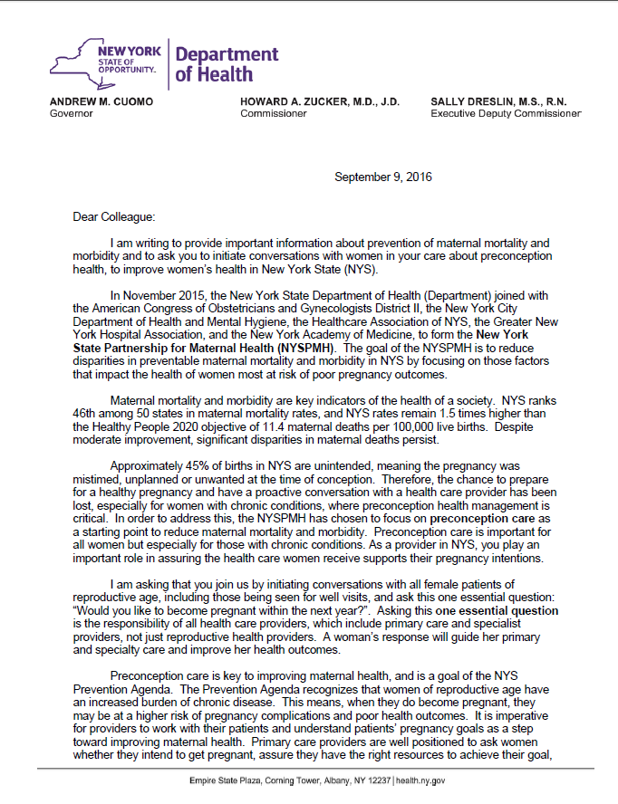
Promoting Well Woman Care
DOH Commissioner, Dr. Howard Zucker sent a “Dear Colleague” letter recognizing well woman care as key to improving maternal health:
Recognized the formation of the New York State Partnership for Maternal Health
Asked all clinicians to initiate conversations with all female patients of reproductive age : “Would you like to become pregnant within the next year?”
Identified resources to support their practice- “Before and Beyond” CME-accredited educational modules developed by the National Preconception Health and Health Care Initiative
Notes:
Kris

Slide 40
Partnership for Maternal Health
Currently developing a multi-pronged provider education campaign
Creating webinar for continuing education credits on well woman care targeting all health care providers
Available for CMEs in Summer 2018
Develop educational pieces for email lists/newsletters
Design material for offices on pregnancy intendedness and contraception
Notes:
Expand partners
Primary Care Providers
Emergency Room Providers
Specialists
Licensed Midwives
Nurses
Include other DOH initiatives
Health Homes
DSRIP
APC

Slide 41
NYS Infant Mortality Collaborative Improvement & Innovation Network (NYS IM CoIIN)
Through NYS’s work on the national CoIIN to reduce infant mortality (IM CoIIN), the NYSDOH facilitated three initiatives, which have:
Engaged six MICHCs and three FQHCs across the state to work collaboratively on goals such as:
Improving birth spacing/intention by increasing adherence to the post-partum visit, and increasing selection and use of an effective contraceptive method; and
Improving the integration of evidence-based preconception messages into routine preventive care services.
Would you like to become pregnant in the next year?
Notes:
Successes to date as a result of the NYS IM-CoIIN:
Among MICHCs participating in the initiatives there has been:
An increase from 76.2% to 77.3% in providing information to clients about the importance of the postpartum visit;
An increase from 76.2% to 81.8% in providing information to clients about effective contraception methods; and
The percent of clients selecting an effective contraception method in the prenatal period increased from 38.9% to 52.9%.
Among FQHCs participating in the initiatives:
100% of clients have been asked about pregnancy intention in 2016; up from 75.2% in 2015 (a 33% improvement); and
In 2016, 8.0% clients received or were referred for a highly effective/LARC method; up from 3.2% of clients in 2015.

Slide 42
Perinatal Regionalization
A comprehensive, coordinated geographically structured system of care organized around a series of Regional Perinatal Centers (RPCs), each supporting and providing clinical expertise, education and quality improvement to a group of affiliate hospitals.
Notes:
Wendy

Slide 43
Perinatal Regionalization
To ensure that women and their babies will have ready access to the services they need through:
Ensuring access to an expert health care team
Ensuring high quality, comprehensive care for women and babies
Maximizing resources of the various facilities across the state – centralizes technology
Allows for ongoing quality improvement to better ensure quality services across all levels of perinatal care
Notes:
Regional Perinatal Center – critical role
Level III provides care to high risk women and newborns
Level II provides care for moderately complicated women and newborns.
Level I provides basic care to women and newborns and does not provide NICU services
Birthing centers provide care to low-risk women and newborns who require a stay of less than 24 hours after birth.

Slide 44
Maternal Mortality Review Board
Priority of the Council on Women and Girls
A multidisciplinary review of each maternal death
A more complete assessment of:
Causes of death
Factors leading to death
Preventability
Opportunities for intervention
Translate trends and issues to action
Collaborate to develop Issue Briefs, Grand Rounds
Quality improvement projects
Working collaboratively with partners (NYSDOH, ACOG, GNYHA, HANYS, RPCs)
Issue maternal mortality report
Notes:
Christa

Slide 45
Governor Cuomo’s Initiative Maternal Mortality and Reduce Racial Disparities
Taskforce on Maternal Mortality and Disparate Racial Outcomes
Establish Maternal Mortality Review Board
Best Practice Summit with Hospitals and OB-GYNs
Pilot the Expansion of Medicaid Coverage for Doulas
Support Centering Pregnancy Demonstrations
Require Continuing Medical Education and Curriculum Development
Expand the New York State Perinatal Quality Collaborative
Launch Commissioner Listening Sessions
Press Release April 23, 2018. Governor Cuomo Announces Comprehensive Initiative to Target Maternal
Mortality and Reduce Racial Disparities in Outcomes

Slide 46
Maternal Mortality in New York
https://www.health.ny.gov/community/adults/women/docs/maternal_mortality_review_2006-2008.pdf
https://www.health.ny.gov/community/adults/women/docs/maternal_mortality_review_2012-2013.pdf
Notes:
Marilyn

