Slide 1
Perinatal Care and Value-Based Payments in New York State’s Medicaid Program
Douglas Fish, MD; Medical Director
Office of Health Insurance Programs
June 2018

Slide 2
Delivery System Reform Incentive Payment (DSRIP) Program Objectives
May 2018
DSRIP Program was built on the CMS and State goals of the Triple Aim:
Improving quality of care
Improving health
Reducing costs
25 Performing Provider Systems (PPS) were recognized by New York to lead Medicaid’s health care transformation efforts.
https://www.health.ny.gov/health_care/medicaid/redesign/dsrip/
Notes:
Accessed 5 May 2016. (Need to add triple aim citation)

Slide 3
How DSRIP & Value Based Payment Programs (VBP) Relate
3
DSRIP: Restructuring effort to prepare for future success in changing environment
Old world:
Fee-For-Service
Individual provider was anchor for financing and quality measurement
Volume over Value
New world:
VBP arrangements
Integrated care services for patients are anchor for financing and quality measurement
Value over Volume
2013
2014
2015
2016
2017
2018
2019
2020

Slide 4
How is VBP Different from the Current Payment Structure?
1) Efficiency component - A target budget is set at the beginning of the year, against which costs (expenditures) are reconciled at the end of the year.
Services may be reimbursed as fee-for-service as they are now, or as a per member per month (PMPM) prospective payment.
2) Quality component - A percentage of performance measures on the attributed population (those included in the arrangement) must be passed to share in any savings (or to determine the percentage of losses that must be made up).
Source: New York State Department of Health Medicaid Redesign Team. A Path Towards Value Based Payment, New York State Roadmap for Medicaid Payment Reform. NYS DOH VBP website (Link) June 2016 updated version approved by CMS March 2017.

Slide 5
Target Budget Setting Components are Flexible
The State does not mandate a specific methodology to be used to calculate a target budget for an arrangement. However, contracts should specify that a target budget will be used.
The VBP Roadmap outlines a recommended, but not required, method to establish a target budget.
Baseline Setting
Trend Determination
Risk Adjustment
Performance Adjustment
Guideline: Historic claims data
3 year look back. Recent years are weighted more.
Guideline: Growth Trend
1 year look back weighted evenly by two factors:
VBP contractor specific growth trend (50%)
regional growth rate (50%)
Guideline: Performance Adjustments
(Efficiency / Quality)
Adjustment to target budget with combined range of -6% to 6% for quality and efficiency.
Guideline: Risk Adjustment Factor
TCGP = 3M CRG methodology
Subpopulations = risk adjustment methodology used for Plan rate setting
Bundles of Care (IPC, Maternity) = Altarum’s episode severity adjustment

Slide 6
Upside and Down Side (risk-sharing) Arrangements (Guideline)
While VBP encourages efficiency, quality is paramount!
No savings will be earned without meeting minimum quality thresholds.
NY State Medicaid’s CMS-approved VBP Roadmap recommends that 50% of Pay-for-Performance (P4P) measures should be “passed” to qualify for any shared savings or to determine the proportion of any losses to be shared.
Other measures are required to be reported (Pay-for-Reporting (P4R)), but are not used for performance payments.
Source: New York State Department of Health Medicaid Redesign Team. A Path Towards Value Based Payment, New York State Roadmap for Medicaid Payment Reform. NYS DOH VBP website (Link) June 2016 updated version approved by CMS March 2017.

Slide 7
VBP Levels in New York State
No financial risk to providers in Upside Only arrangements (Level1)
In addition to choosing which integrated services to focus on, the MCOs and contractors can choose different levels of Value Based Payments:
Level 0 VBP | Level 1 VBP | Level 2 VBP | Level 3 VBP
FFS with bonus and/or withhold based on quality scores | FFS with upside-only shared savings available when outcome scores are sufficient | FFS with risk sharing (upside available when outcome scores are sufficient) | Prospective capitation PMPM or Bundle (with outcome-based component)
FFS Payments | FFS Payments | FFS Payments | Prospective total budget payments
No Risk Sharing | ↑ Upside Only | Upside & ↓ Downside Risk | ↑ Upside & ↓ Downside Risk

Slide 8
VBP Transformation: Overall Goals and Timeline
Goal: To improve population and individual health outcomes by creating a sustainable system through integrated care coordination and rewarding high value care delivery.
New York State (NYS) Payment Reform
VBP Pilots
Towards 80-90% of Value Based Payments to Providers
Today
2017 | 2018 | 2019 | 2020
April 2017
April 2018
April 2019
April 2020
Performing Provider Systems (PPS) requested to submit growth plan outlining path to 80-90% VBP
> 10% of total Managed Care Organization (MCO) expenditure in Level 1 VBP or above
> 50% of total MCO expenditure in Level 1 VBP or above.
> 15% of total payments contracted in Level 2 or higher *
80-90% of total MCO expenditure in Level 1 VBP or above
> 35% of total payments contracted in Level 2 or higher *
* For goals relating to VBP level 2 and higher, calculation excludes partial capitation plans such as MLTC from this minimum target.

Slide 9
Maternity Care and VBP

Slide 10
VBP Arrangement Types
TCGP
There is no single path towards Value Based Payments. Rather, there are a variety of options from which MCOs and providers can jointly choose:
Maternity Care
Arrangement Types
Total Care for the General Population (TCGP): All costs and outcomes for care, excluding MLTC, HARP, HIV/AIDS, and I/DD* subpopulations.
Episodes of Care
Maternity Care: Episodes associated with pregnancies, including delivery and first month of life of newborn and up to 60 days post-discharge for the mother
Integrated Primary Care (IPC) All costs and outcomes associated with primary care, sick care, and a set of 14 chronic conditions selected due to high volume and/or costs.
Total Care for Special Needs Subpopulations: Costs and outcomes of total care for all members within a subpopulation exclusive of TCGP.
HARP: For those with Serious Mental Illness or Substance Use Disorders
HIV/AIDS
Managed Long Term Care (MLTC)
I/DD*
IPC
HARP
HIV/AIDS
MLTC
I/DD*
VBP Contractors can contract TCGP as well as Subpopulations as appropriate; nothing mandates that the Roadmap-defined arrangement types must be handled in standalone contracts.
*Total Care for the I/DD Subpopulation will be available as an arrangement when the population is moved to managed care.
Acronyms: MLTC = Managed Long Term Care; HARP = Health and Recovery Plans; I/DD = Intellectually/Developmentally Disabled

Slide 11
Total Care for the General Population Goal: Improve population health through enhancing the quality of the total spectrum of care.
Maximum impact for health systems focusing on both population health and streamlining specialty and inpatient care
Most women, including pregnant women, will be in a Total Care arrangement.
All patients attributed to the arrangement, not just the patients a provider services, are included in TCGP.
Providers will likely need to invest in care coordination, referral patterns and discharge management.
In this arrangement, the VBP Contractor (Provider entity) assumes responsibility for the care of the entire attributed population. Members attributed to this arrangement cannot be covered by a different arrangement.
Total Population
Subpopulations*
Total Care for General Population
*Note: VBP Contractors and MCOs are free to add one or more subpopulations to their TCGP contracts.

Slide 12
The Maternity Care Arrangement represents three component including
1) prenatal care, 2) delivery and postpartum care, and 3) newborn care.

Slide 13
Maternity Care Arrangement - Stakeholder Concerns
No Maternity Care VBP arrangement adopters as of yet
Attribution concerns (For which patients am I responsible?)
Multiple providers of care throughout episodes
VBP Pilots had to commit to moving to Level 2 (shared risk) in Year 2 of Pilot program.
Moving to Level 2 or 3 is not otherwise a requirement for VBP
Level 4 NICU care being included in the arrangement
Understanding of stop-loss provision

Slide 14
2018 Maternity Care VBP Quality Measure Set Category 1 Measures
Measure Name | Measure Steward | NQF Measure Identifier | Classification | Rationale for Change
Contraceptive Care – Postpartum Women | United States Office of Population Affairs | 2902 | Cat 1 P4R
C-Section for Nulliparous Singleton Term Vertex (NSTV) | The Joint Commission | 0471 | Cat 1 P4R
Frequency of Ongoing Prenatal Care | NCQA | 1391 (lost endorsement) | Cat 1 P4P Removed from Measure Set | Measure retired by NCQA
Incidence of Episiotomy [% of Vaginal Deliveries With Episiotomy] | Christiana Care Health System | 0470 | Cat 1 P4R
Low Birth Weight [Live births weighing less than 2,500 grams (preterm v. full term)] | AHRQ | 0278 | Cat 1 P4R
Percentage of Babies Who Were Exclusively Fed with Breast Milk During Stay | TJC | 0480 | Cat 1 P4R
Percentage of Preterm Births. | NYS | Not endorsed | Cat 1 P4R
Prenatal & Postpartum Care (PPC) —Timeliness of Prenatal Care & Postpartum Visits | NCQA | 1517 (lost NQF endorsement) | Cat 1 P4P
^{IPC} Preventive Care and Screening: Screening for Clinical Depression and Follow-Up Plan | CMS | 0418 | Cat 1 P4R
^{IPC} Measure is also part of TCGP/ IPC Measure Set
Red: Indicates measure change from 2017 Purple: Indicates a Pay-for-Performance (P4P) measure. Acronyms: TJC: The Joint Commission, NCQA: National Committee for Quality Assurance, AHRQ: Agency for Healthcare Research and Quality, CMS: Centers for Medicare and Medicaid Services; NQF: National Quality Forum, P4R: Pay-for-Reporting

Slide 15
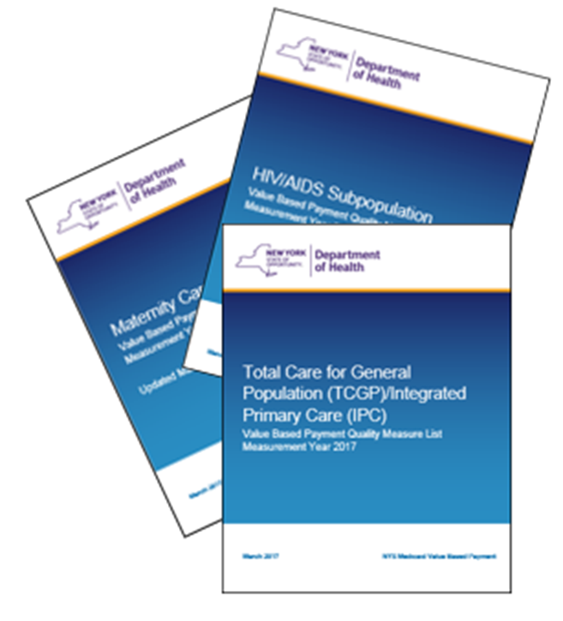
Annual Update Cycle
Final VBP Arrangement Measure Sets and Reporting Guidance
The VBP Quality Measure Sets for each arrangement will be finalized and posted to the NYS DOH VBP website by the end of October of the year preceding the measurement year and have been published for Measurement Year 2018. (Link)
The VBP Measure Specification and Reporting Manual will be released alongside the Quality Assurance Reporting Requirements (QARR) Manual in October of the measurement year and has been published for Measurement Year 2017. (Link)

Slide 16
Thank you!
Please send questions and feedback to:
vbp@health.ny.gov
douglas.fish@health.ny.gov
16

Slide 17
June 2018
17
Appendix
Maternity Care Arrangement
Category 2 Measures for 2018

Slide 18
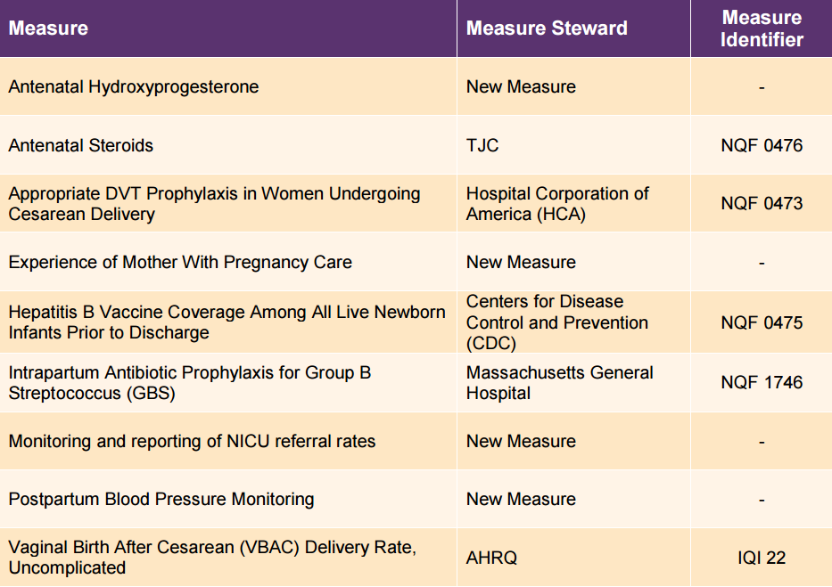
2018 Maternity Care Category 2 Measures
18

