Slide 1
Prenatal & Perinatal Care & Pediatrics
A Good Fit with the New Payment Systems
VBP, P4P, Integrated MMC
Elie Ward, MSW
Director of Policy & Advocacy
NYS American Academy of Pediatrics

Slide 2
Population Health
Requires Practice to take Responsibility for Health of Families in Practice
Expects Treatment of the Dyad, Mom & Baby and in some cases Triad, including second caregiver if appropriate
Integrated Care Includes the New Morbidities of Pregnancy and Healthy Births
Practices Measured and Paid on Health of Families in their practice…Healthy Parents = Healthy Babies

Slide 3
Current Recommended Screenings All Accepted as Part of Health Care
Smoking Cessation
Depression Screening
Substance Abuse Screening
Folic Acid Discussion & Recommendation
These discussions are relevant in all primary care settings, Family Practice, Pediatrics, Ob/Gyn, Internists

Slide 4
New Perspective on Care
“If we are serious about improving birth outcomes and reducing disparities, we’ve got to start taking care of women before pregnancy…when she’s a baby inside her mother’s womb, an infant, and then a child, an adolescent and really taking care of women and families across their life course.”
– Michael Lu, MD, Neonatologist
Geffen School of Medicine, UCLA

Slide 5
Every Woman Every Time
All health care providers serving women of reproductive age play an important role
Every patient encounter is an opportunity to discuss pregnancy intendedness and current health
Well woman care is important for all, but crucial for those with chronic conditions who would like to become pregnant

Slide 6
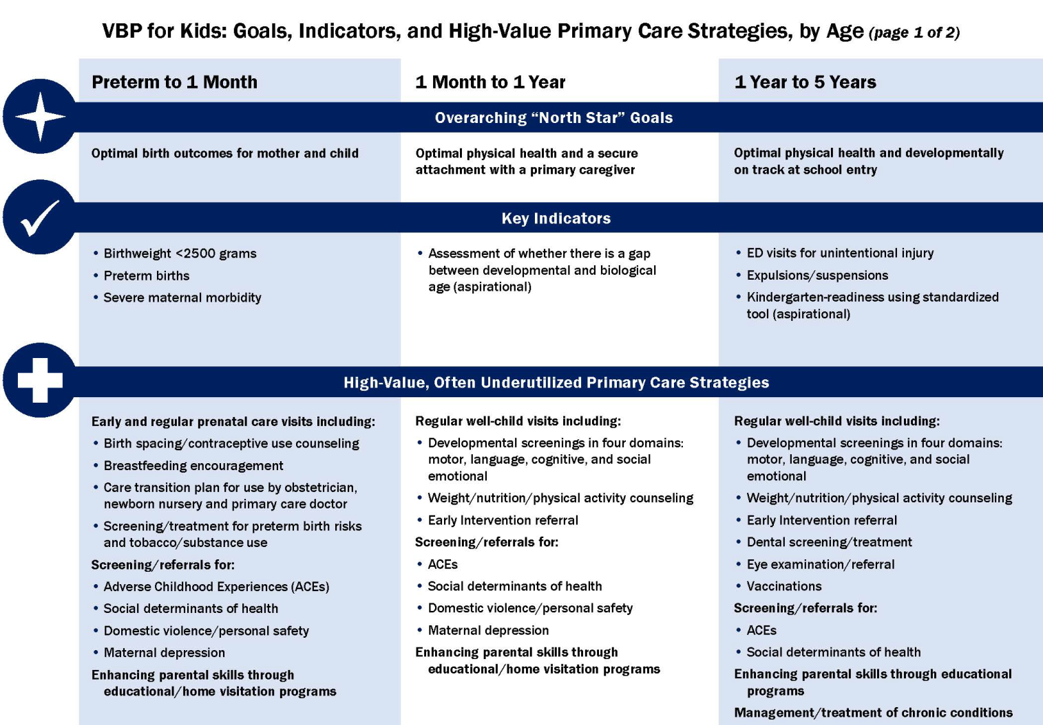
Children’s VBP Proposals

Slide 7
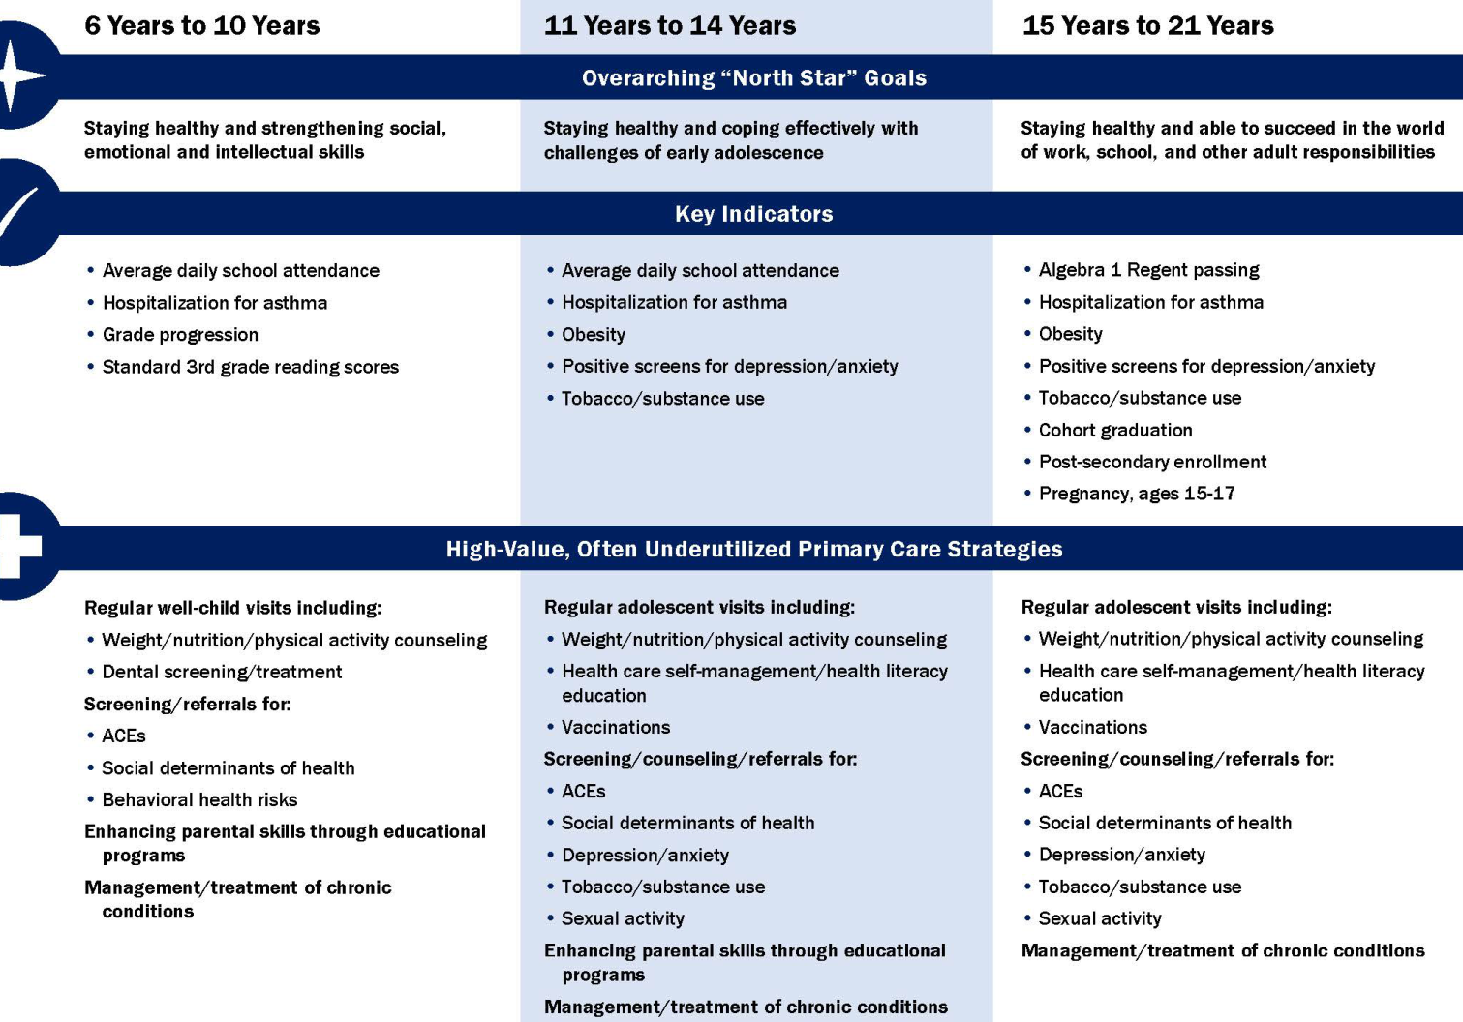
Children’s VBP Proposals

Slide 8
Why This Matters
NYS has committed to have 80-90% of all Medicaid Managed Care in VBP contracts by 2020
Understanding What VBP means to your practice/program will make a significant difference in your chances to position your practice/program to thrive , no matter the size
Recognizing the Requirements of a Good VBP Arrangement Now Puts your practice/program in a stronger position going forward

Slide 9
NYS Moves to PCMH Upper Levels
The State is exploring creating a NYS specific PCMH measure
There are specifics related to Children
There are specifics related to Healthy Women and Healthy Pregnancies
In the near future all primary care practices working the Medicaid program will have to be at least a level 3 to enter VBP, and to get incentive payments from the state.
The Bar is being raised

Slide 10
First 1,000 Days & VBP
Top 10 First 1,000 Days pilots include three pregnancy, prenatal and post natal health integration programs
All recognize connection between health pregnancy and healthy birth
All recognize vital importance of maternal mental health
All recognize value of healthy environment for Mom and baby
All support dyad assessments and therapy

Slide 11
First 1,000 Days Top Ten
Braided Funding for Early Childhood Mental Health
Statewide Home Visiting
Create a Preventive Pediatric Clinical Advisory Group
Expand Centering Pregnancy
Promote Early Literacy through Local Strategies
Require Managed Care Plans to have a Kids Quality Agenda
New York State Developmental Inventory Upon Kindergarten
Pilot and Evaluate Peer Family Navigators in Multiple Settings
Parent/Caregiver Diagnosis as Eligibility Criteria for Dyadic Therapy
Data System Development for Cross-Sector Referrals

Slide 12
What First 1,000 Days Reflects
Recognition that prenatal and postnatal care & pediatrics must be practiced as population health
Prenatal, Perinatal Care & Pediatrics are all “family” & “community” practices
VBP forces integrated care
The Social Determinants of Health are Central to Good Practice
VBP & APC will forge new ways of practice and new ways to drive payment

Slide 13
The VBP in Prenatal, Postnatal Care & Pediatrics
Focuses on importance of Maternal Health in Multiple Domains
Provides practical and concrete options for assessment referral &/or treatment to Address Maternal Health Challenges
Offers a VBP formula for increased payment
Builds Strength into Current Practice
Reflects Bright Futures Principles, Goals & Objectives for Pediatric Care in the 21st Century

Slide 14
Achieving Readiness for VBP/APC
One step practices & programs can take now to put them in a better position to establish a Value Based Contract Relationship with Insurers is recognize the new realities
Integrate Infant/Mother Care supporting the concept of addressing the Dyad to insure health for Mom & Baby
Accept that we cannot have healthy babies w/o having healthy Moms.
Concretize the stated partnership between prenatal care & pediatrics describes as parent/pediatrician for the health of the child/family

Slide 15
Conclusion
VBP, P4P and APC are coming in the next few years
Opting to incorporate the concepts on integrated population health into care is a reasonable first step for practices/programs that must move forward toward the new payment models
Seeing Moms frequently before birth for prenatal care and during a baby’s first year of life in pediatrics offers an opportunity to address significant negative impacts on the lives and Moms and babies, an opportunity practices can and should take.

