Slide 1
Addressing Disparities in Donor Milk Availability: Medicaid Reimbursement, Use, Billing and Coding
Julie Bouchet-Horwitz, FNP-BC, IBCLC
Executive Director
Susan Vierczhalek, MD, FAAP, IBCLC
Medical Director
June 7, 2018

Slide 2
Disclosures
Director of NYMB
Accept insurance payments from insurance companies
Susan: Medical Director NYMB, chair NYSBC

Slide 3
Objectives
Describe the importance of PDHM for preterm infants
Understand the role of advocacy for insurance reimbursement
Describe procedures for using donor milk in the hospital
Identify procedures to code and bill for PDHM

Slide 4
Mothers’ Own Milk and Preterm Infants
Dose-dependent reduction in the risk, incidence and severity of:
Necrotizing enterocolitis (NEC)
Late Onset Sepsis (LOS)
Bronchopulmonary Dysplasia (BPD)
Retinopathy of Prematurity (ROP)
Neurodevelopmental problems at 20 months
Rehospitalization after NICU discharge
Meier et al, Diet and Nutrition in Critical Care, 2015

Slide 5
Formula vs. Donor Milk for Preterm or Low Birth Weight Infants
Evidence Review: nine trials, 1070 infants
Formula increases the risk, incidence, severity of NEC
DHM has no impact on other morbidities including LOS, BPD, ROP and neurodevelopmental outcomes
DHM associated with slower growth rates compared to MOM or formula
Quigley et al, The Cochrane Collaboration, 2014

Slide 6
Supplemental DHM compared with Formula for Preterm or Low Birth Weight Infants
Significant reductions in medical and surgical NEC if supplemented with DHM
1 in 33 infants fed formula develop NEC
Number needed to treat = 6
Schanler et al, Pediatrics, 2005
Sullivan et al, J Pediatr, 2010
Christofalo et al, Breastfeeding Med, 2013

Slide 7
Costs of necrotizing enterocolitis and cost-effectiveness of exclusively human milk-based products in extremely premature infants
2011 costs above the average for extremely premature infants:
$74,004 for medical NEC
$198,040 for surgical NEC
Premature infants fed with 100% human-milk based products:
Hospitalization reduced 3.9 days per infant
Direct savings $8,167.17 per infant
Ganapathy V, Hay JW, Kim JH. Costs of necrotizing enterocolitis and cost-effectiveness of exclusively human milk-based products in feeding extremely premature infants. Breastfeed Med. 2012 Feb;7(1):29-37.

Slide 8
Outcomes and Costs of Surgical Treatments of Necrotizing Enterocolitis
1375 infants with surgical NEC between 1999 and 2007 in CA
699 – propensity-score matched infants
Peritoneal drainage - n = 101
$276, 076
56% mortality
Peritoneal drainage f/b laparotomy, n = 172
$398,173
35% mortality
laparotomy, n = 426
$341, 911
29% mortality
Stey A, Barnert ES, Tseng CH, Keeler E, Needleman J, Leng M, Kelley-Quon LI, Shew SB. Outcomes and costs of surgical treatments of necrotizing enterocolitis. Pediatrics. 2015 May;135(5):e1190-7.
Notes:
propensity score matching (PSM) is a statistical matching technique that attempts to estimate the effect of a treatment, policy, or other intervention by accounting for the covariates that predict receiving the treatment. PSM attempts to reduce the bias due to confounding variables that could be found in an estimate of the treatment effect obtained from simply comparing outcomes among units that received the treatment versus those that did not.

Slide 9
Cost Effectiveness
For every $1 spent on donor milk, $11 are saved ³:
Reduced hospital stay, reduced sepsis and NEC
Reduced feeding intolerance and TPN
Reduced long term morbidities
Arnold LD. The cost-effectiveness of using banked donor milk in the neonatal intensive care unit: prevention of necrotizing enterocolitis. J Hum Lact. 2002 May;18(2):172-7.

Slide 10
Estimated Cost of Using DHM
$45 will feed a VLBW infant for the first week of life
$150 each week thereafter
Cost is less if mother provides some of her own milk
HMBANA fees: about $5.00 per ounce (17c/ml)

Slide 11
Preterm Birth Disparities 2016
8.7% preterm births in NYS
12.3% preterm births to black mothers
March of Dimes, 2017

Slide 12
NYS Breastfeeding Rates
Initiation rates:
80.8% black mothers; 83.3% white mothers
Exclusive through 6months:
11.9% black mothers; 22.6% white mothers
Duration through 12 months
23.6%black mothers; 36.9% white mothers

Slide 13
DHM and Breastfeeding
Use of DHM in hospitals has been associated with increased breastfeeding rates
When hospital breastfeeding rates increase, they increase for all ethnic, racial and socioeconomic groups including those with low BF rates

Slide 14
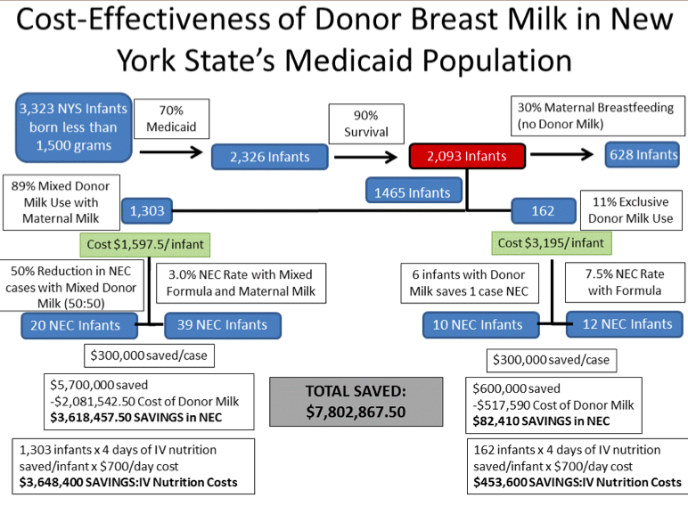

Slide 15
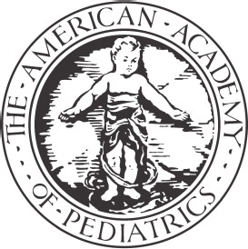
AAP Policy Statement
“The potent benefits of human milk are such that all preterm infants should receive human milk….if the mother’s milk is unavailable despite significant lactation support, pasteurized donor milk should be used.”
AAP Breastfeeding and the Use of Human Milk –
Policy Statement 2012
Notes:
Check year

Slide 16
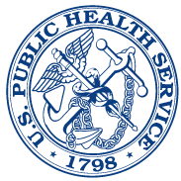
Surgeon General’s Call to Action 2011
“Human milk is vital to the survival of vulnerable neonates. . . “
Develop a national strategy to efficiently and effectively address the issues involved in providing DHM to vulnerable infant populations.

Slide 17
DHM Use in NYS Maternity Hospitals
Medically effective
Cost effective
Impact on health disparities
AAP recommendations
Why is it not offered in all hospitals?

Slide 18
Advocacy for Insurance Reimbursement
Team includes NYS AAP, NYMB, medical, nursing, experts
Medical Evidence Summary
Cost analysis
Meetings with assembly and senate sponsors, NYSDOH and Medicaid officials

Slide 19
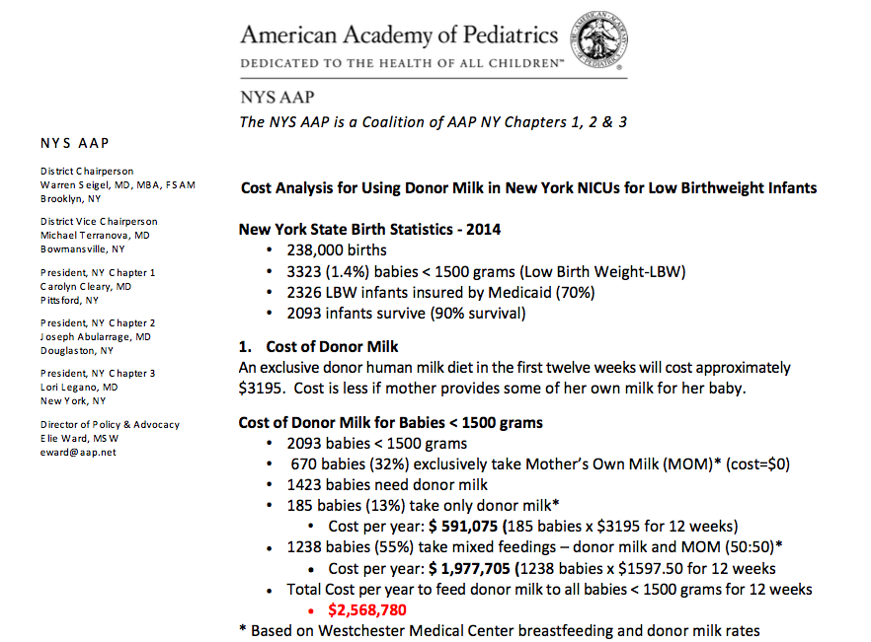

Slide 20
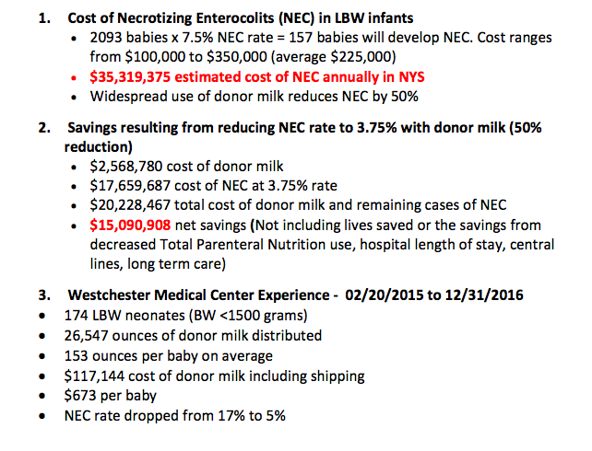

Slide 21
Public Support
Shared personal stories
Social media outreach
Supporters’ calls, emails to public officials
Petition on Change.org
Press conferences
Recognized senate and assembly sponsors as “Breastfeeding Champions”

Slide 22
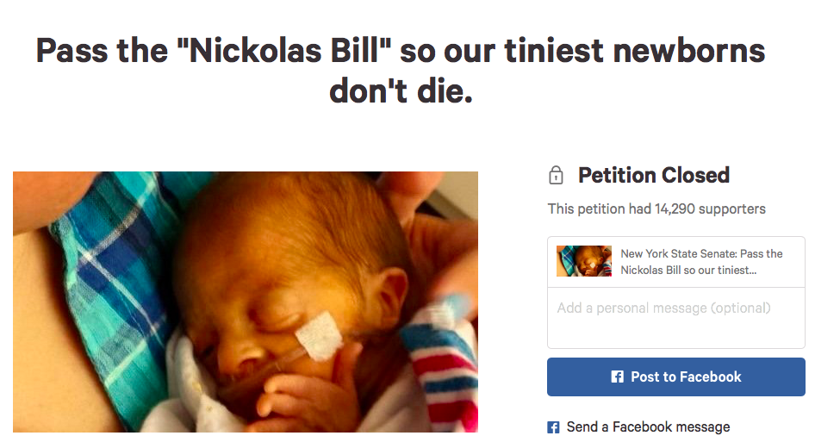

Slide 23
Senate and Assembly Bill
NY State Senate Bill S6583B
Assembly Bill A9353C
Passed both houses
Bill vetoed by governor
Support for concept, passed through budget

Slide 24
Press Conference for PDHM in Budget

Slide 25
NY Medicaid Coverage for DHM
Implemented Feb 15, 2017
Covers:
Inpatients
Documented weight < 1500 grams
Congenital or Acquired GI Conditions
Other conditions with physician order

Slide 26
New York
2017 - Inpatients
< 1500 grams birth weight
Acquired or congenital condition
Physicians order for other medical condition
Hospital pays for PDHM
T2101 code
Medicaid reimbursement rate - $.17/mL

Slide 27
New York
Outpatients
Letter of medical necessity
Medical Documentation
Authorization
Start and end date
T2101 code and B9998 (for some patients)
Reimbursement rate T2101 - $.17/mL
B9998 - negotiated

Slide 28
Codes to Use
T2102 – human breast milk processing, storage and distribution only
B9998 - NOC for Enteral Supplies
NOC – (Not Otherwise Classified)
Bottle for outpatients

Slide 29
Outpatient Coverage for PDHM
Prescription
Letter of medical necessity
Medical and surgical records
Prior Authorization for PDHM

Slide 30
First Denial
Appeal again
Denied again → ask for:
Peer to Peer Review
Baby’s doctor and physician from insurer
Arrange a time to speak and discuss case

Slide 31
Once Approved
Single Case Agreement
Start and end date
Prior authorization number
Code – agree on code to use
T2101 – human breast milk processing, storage and distribution only
B9998 - NOC for Enteral Supplies
NOC – (Not Otherwise Classified)
Bottle

Slide 32
Once Approved
Unit – define
mL, 100 mL, ounce
Units per day
Go for the full amount 30 ounces or 1000 mL per day
Fee per unit
Sign contract

Slide 33
Claims for Inpatients CMS 1450 (UB-04)
Patient name, DOB, Insurance #, Subscriber ID, address etc.
Revenue code 220 (special charges) with procedure code T2101
DOS – dates of service
Diagnosis Code
Units
Fee

Slide 34
Claims for Outpatients CMS 1500 HCFA
Patient name, DOB, Insurance #, Subscriber ID, address etc.
PA number
DOS – dates of service
Code
Units
Fee

Slide 35
Denied for not a covered benefit
Submit documentation that a medical necessity review must be done based on the State Medicaid Managed Care Contract as well as Federal regulations from EPSDT* and submit the regulations listed below.
*Early and Periodic Screening, Diagnostic and Treatment

Slide 36
Medically Necessary
“medically necessary means health care and services that are necessary to promote normal growth and development and prevent, diagnose, treat, ameliorate or palliate the effects of a physical, mental, behavioral, genetic, or congenital condition, injury or disability”.

Slide 37
Early and Periodic Screening, Diagnostic and Treatment
Federal statutes and regulations state that children under age 21 who are enrolled in Medicaid are entitled to EPSDT benefits and that States must cover a broad array of preventive and treatment services.

Slide 38
EPSDT Services
States are required to provide any additional health care services that are coverable under the Federal Medicaid program and found to be medically necessary to treat, correct or reduce illnesses and conditions discovered regardless of whether the service is covered in a state’s Medicaid plan.
States determine medical necessity on a case-by-case basis.

Slide 39
Questions?

Slide 40
Thank you!
Julie Bouchet-Horwitz, FNP-BC, IBCLC
Susan Vierczhalek, MD, IBCLC
svier@nymilkbank.org
jbouchet@nymilkbank.org
212 956-6455

