Slide 1



ACOG District II
Opioid Use Disorder in Pregnancy Bundle – Part 1
Readiness, Recognition and Prevention
April 2018
This education has been made possible through funding
from the New York State Health Foundation (NYSHealth).

Slide 2
Opioid Use Disorder in Pregnancy Bundle
Purpose
Offer multi-faceted education and implementation tools to better assist women’s health care providers in caring for pregnant women with OUD
Encourage better communication and engagement among providers across all of the services within the continuum of care, including the justice system
Enhance the communication of OUD through the use of a common language
Enhance patient and family engagement through education, common language; understand treatment and process
Created by ACOG District II in 2018
Notes:
Speaker Notes:
This bundle was developed by a multidisciplinary group of women’s health care providers, including obstetricians and gynecologists, to improve the quality and safety of care provided to pregnant women with OUD.
This bundle builds upon the work of many dedicated professionals across the state. It is designed to facilitate implementation of best practices addressing the care of this vulnerable population with the goal of effectively and compassionately supporting pregnant women with OUD and their newborns.
ACOG District II is in the process of collaborating through the Alliance for Innovation on Maternal Health (AIM) in partnership with the New York State Department of Health (NYSDOH) New York State Perinatal Quality Collaborative (NYSPQC) to deliver this education.

Slide 3
Opioid Use Disorder in Pregnancy:
Know the Basics
First Steps
Created by ACOG District II in 2018

Slide 4
Physical Opioid Dependence
“Physical dependence is the physiological adaptation of the body to the presence of an opioid. It is defined by the development of withdrawal symptoms when opioids are discontinued, when the dose is reduced abruptly or when an antagonist (eg, naloxone) or an agonist-antagonist (eg, pentazocine) is administered.”
Source: O'Brien CP. Drug addiction and drug abuse. In: Goodman and Gilman's The pharmacological basis of therapeutics. 9th edition.
Created by ACOG District II in 2018
Notes:
Speaker notes:
Physical dependence is a normal and expected response to continuous opioid therapy. Physical dependence may occur within a few days of dosing with opioids, although it varies among patients. Physical dependence (indicated by withdrawal symptoms) does not mean that the patient is addicted.

Slide 5
Opioid Addiction
Primary chronic disease of brain reward, motivation, memory and related circuitry.
  - Dysfunction in these circuits leads to psychological, social, and spiritual manifestations.
Reflected in an individual pathologically pursuing reward and/or relief by opioid use and other behaviors.
Like other chronic diseases, addiction often involves cycles of relapse and remission.
Without treatment, addiction is progressive and can result in disability or death.
Source: ASAM Public Policy Statement on Treatment for Alcohol and Other Drug Addiction, Adopted: May 01, 1980, Revised: January 01, 2010 https://www.asam.org/resources/definition-of-addiction
Created by ACOG District II in 2018
Notes:
Speaker notes:
Addiction is a primary, chronic disease of brain reward, motivation, memory and related circuitry.
Dysfunction in these circuits leads to characteristic biological, psychological, social and spiritual manifestations.
This is reflected in an individual pathologically pursuing reward and/or relief by substance use and other behaviors.
Addiction is characterized by inability to consistently abstain, impairment in behavioral control, craving, diminished recognition of significant problems with one’s behaviors and interpersonal relationships, and a dysfunctional emotional response.
Like other chronic diseases, addiction often involves cycles of relapse and remission. Without treatment or engagement in recovery activities, addiction is progressive and can result in disability or premature death.

Slide 6
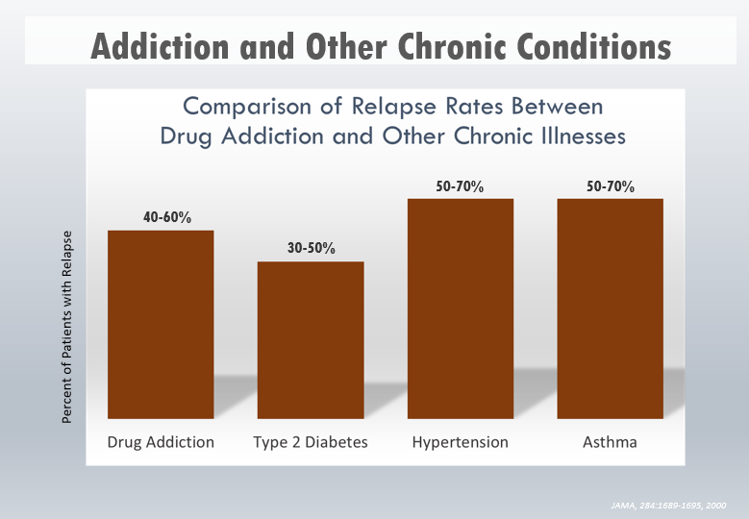
Source: JAMA 284: 1689-1695, 2000
Created by ACOG District II in 2018
Notes:
Speaker notes:
Relapse rates for drug-addicted patients are compared with those suffering from diabetes, HTN, and asthma. Relapse is common and similar across these illnesses (as is adherence to medication). Thus, drug addiction should be treated like any other chronic illness, with relapse serving as a trigger for renewed intervention – JAMA 284: 1689-1695, 2000.

Slide 7
Substance Use Disorders (SUDs)
Substance use disorders occur when the recurrent use of alcohol and/or drugs causes clinically and functionally significant impairment, such as health problems, disability, and failure to meet major responsibilities at work, school or home.
Alcohol Use Disorder (AUD)
Opioid Use Disorder (OUD)
Stimulant Use Disorder
Hallucinogen Use Disorder (HUD)
Tobacco Use Disorder
Cannabis Use Disorder
Source: SAMHSA; https://www.samhsa.gov/disorders/substance-use
Created by ACOG District II in 2018

Slide 8

Opioid Use Disorder (OUD)
Opioid use disorder is a chronic, treatable brain disease that can be managed successfully by combining medications with comprehensive care and recovery
support, which enables those with OUD
to regain control of their health and
their lives.
In 2014, an estimated 1.9 million people had an OUD related to prescription pain relievers and an estimated 586,000 had an OUD related to heroin use.
Sources: SAMHSA; https://www.samhsa.gov/disorders/substance-use
ACOG. Opioid Use and Opioid Use Disorder in Pregnancy. Opinion No. 711. ACOG Committee Opinion on Obstetric Practice & the American Society of Addiction Medicine. Replace Opinion No. 524, May 2012. Published August 2017.
Created by ACOG District II in 2018
Notes:
Speaker Notes:
Symptoms of opioid use disorders include strong desire for opioids, inability to control or reduce use, continued use despite interference with major obligations or social functioning, use of larger amounts over time, development of tolerance, spending a great deal of time to obtain and use opioids, and withdrawal symptoms that occur after stopping or reducing use, such as negative mood, nausea or vomiting, muscle aches, diarrhea, fever, and insomnia.
Emphasize that substance use disorders (SUDs) are chronic medical conditions, treatment is available, family and peer support is necessary and recovery is possible.
Emphasize that opioid pharmacotherapy (i.e. methadone, buprenorphine) and behavioral therapy are effective treatments for OUD
For pregnant women with an opioid use disorder, opioid agonist pharmacotherapy is the recommended therapy and is preferable to medically supervised
withdrawal because withdrawal is associated with high relapse rates, which lead to worse outcomes. – ACOG CO #711

Slide 9
DSM-V Diagnostic Criteria: OUD & SUD
A minimum of 2-3 criteria is required for a mild substance use disorder diagnosis, while 4-5 is moderate, and 6 or more is severe.
  Taking the opioid in larger amounts and for longer than intended
  Wanting to cut down or quit but not being able to do it
  Spending a lot of time obtaining the opioid
  Craving or a strong desire to use opioids
  Repeatedly unable to carry out major obligations at work, school, or home due to opioid use
  Continued use despite persistent or recurring social or interpersonal problems caused or made worse by opioid use
  Stopping or reducing important social, occupational, or recreational activities due to opioid use
  Recurrent use of opioids in physically hazardous situations
  Consistent use of opioids despite acknowledgment of persistent or recurrent physical or psychological difficulties from using opioids
*Withdrawal manifesting as either characteristic syndrome or the substance is used to avoid withdrawal (Does not apply when used appropriately under medical supervision)
*This criterion is not considered to be met for those individuals taking opioids solely under appropriate medical supervision. Source: APA 2013
Created by ACOG District II in 2018
Notes:
Speaker Notes:
The Diagnostic and Statistical Manual of Mental Disorders (DSM) is published by the American Psychiatric Association (APA) and offers a common language and standard criteria for the classification of mental disorders.

Slide 10
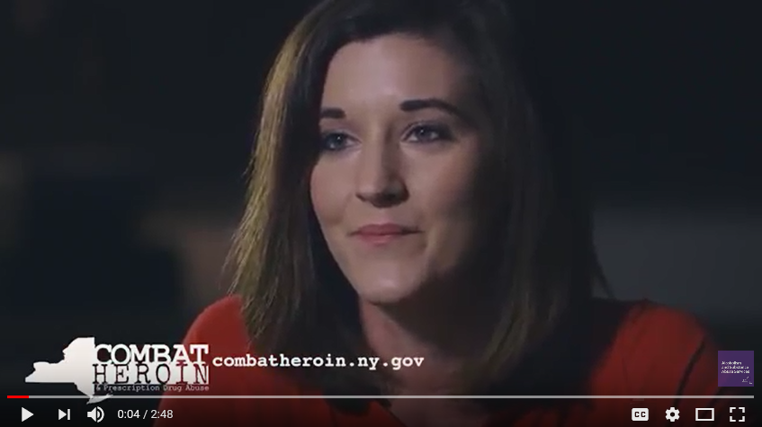
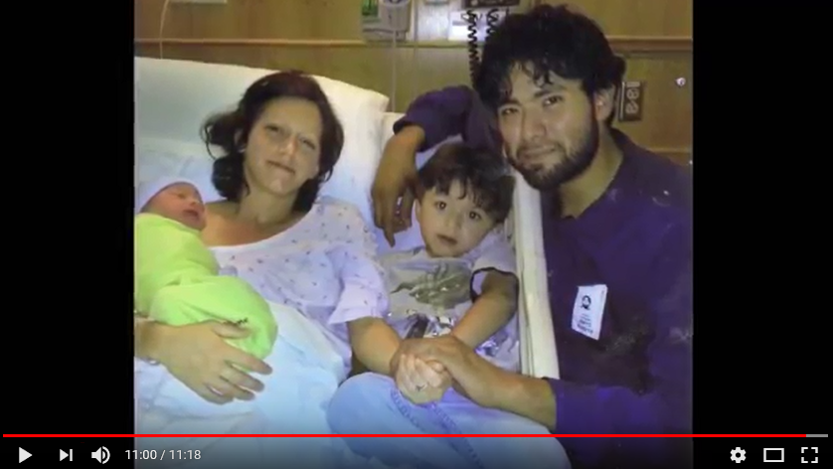


It Can Happen to Anyone
https://youtu.be/Pet6ugDj8CY
https://youtu.be/DbeVhMye9NQ
https://youtu.be/6NBNKvYSWPo
https://youtu.be/KtZLIoQglys
Created by ACOG District II in 2018
Notes:
Speaker Notes:
Videos, click one to show

Slide 11
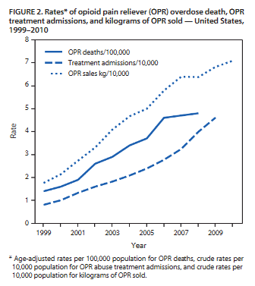
Prescribing Practices
In 2012, providers wrote 259 million
prescriptions for opioids
    More than enough for every American adult to have a bottle of pills
    20% of those with a pain-related diagnosis, acute or chronic, receive an opioid prescription
    Opioid prescriptions:
        Have a place in pain management when used appropriately
        Can lead to OUD
Source: https://www.cdc.gov/vitalsigns/opioid-prescribing/
https://www.researchgate.net/publication/278354874_Vital_Signs_
Overdoses_of_Prescription_Opioid_Pain_Relievers-United_States_1999-2008_Reprinted_from_MMWR_vol_60_pg_1487-1492_2011
Created by ACOG District II in 2018
Notes:
Speaker Notes:
The figure above shows rates of opioid pain reliever (OPR) overdose death, OPR treatment admissions, and kilograms of OPR sold in the US during 1999-2010. During 199-2008, overdose death rates, sales, and substance abuse treatment admissions related to OPR all increased substantially
NOTE: Chronic pain defined as pain that:
Typically lasts >3 months or past the time of normal tissue healing
14 % of adults have chronic pain

Slide 12
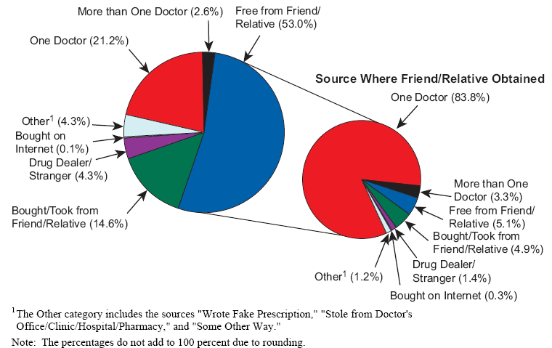
Where Pain Relievers Were Obtained for Most Recent Nonmedical Use among Past Year Users Aged 12 or Older: 2012-2013
Source: SAMHSA 2013; https://www.samhsa.gov/data/sites/default/files/NSDUH-DetTabs2014/NSDUH-DetTabs2014.htm#tab6-47a
Created by ACOG District II in 2018

Slide 13
Impact of Overdose Deaths in NYS
The drug-related death rate for women is 8.7 per every 100,000 people and 22 per 100,000 people for men. In both, the number of drug deaths have grown considerably – a 48% increase from 2010-2015 for women and an 83% increase for men.
Drug Deaths by Sex in New York State 2010-2015
 |  | 2010 | 2011 | 2012 | 2013 | 2014 | 2015
Female |  | 601 | 701 | 735 | 821 | 826 | 891
Male |  | 1,159 | 1,448 | 1,527 | 1,662 | 1,684 | 2,118
Centers for Disease Control and Prevention, National Center for Health Statistics, “Underlying Cause of Death 1999-2015,” on CDC WONDER Online Database, released December 2016. Data are from the Multiple Cause of Death Data File, 1999-2015, as compiled from data provided by the fifty-seven vital statistics jurisdictions through the Vital Statistics Cooperative Program, http://wonder.cdc.gov/mcd-icd10.html.
Source: http://www.rockinst.org/pdf/health_care/2017-04-20-By_numbers_brief_no8.pdf
Created by ACOG District II in 2018
Notes:
Speaker Notes:
Even with aggressive state action, 3,009 New Yorkers died from drug overdoses or from chronic drug abuse in 2015, a 71 percent increase from 2010. Between 2010 and 2015, 14,173 people died from drugs in New York State. In the preceding six years (2004-2009), there were 9,754 total deaths.

Slide 14
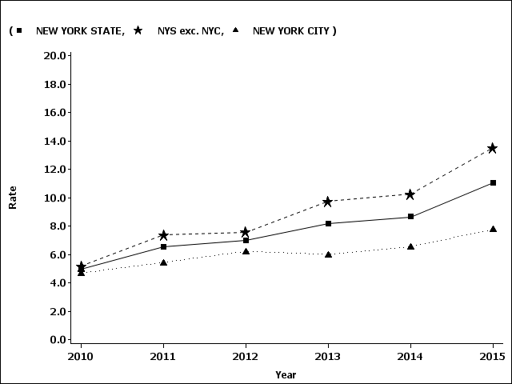
New York State Opioid-Related Deaths
New York State overdose deaths involving any opioid, crude rate per 100,000 population
Source: https://www.health.ny.gov/statistics/opioid/
Notes:
Speaker Notes:
Rates are continuing to rise and there are differences in the data in urban vs. rural areas.
(Drug overdose is under-reported as a cause of death. Vital statistics data collects aggregate drug-death data and those sources are also available at the same link)

Slide 15
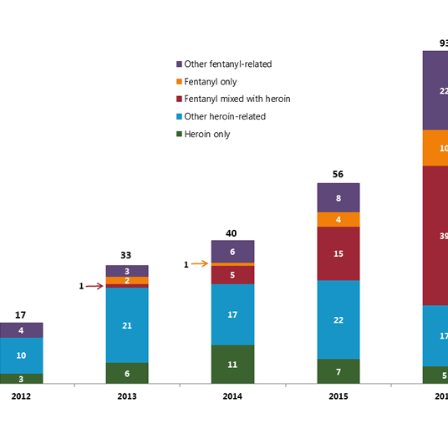
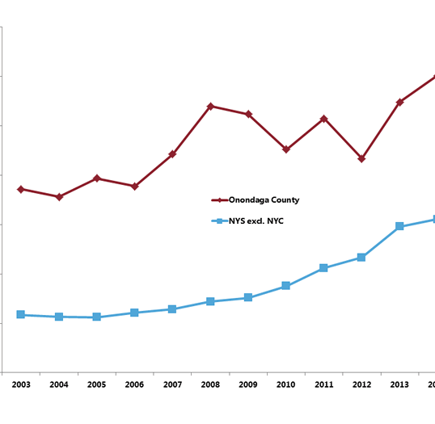
Scope of the Problem in Onondaga County
As an RPC- serve 14 counties and 18 hospitals-County HD data:
OC has the 3rd highest rate in NYS for New born drug related DX 300.6/10,000
Created by ACOG District II in 2018

Slide 16
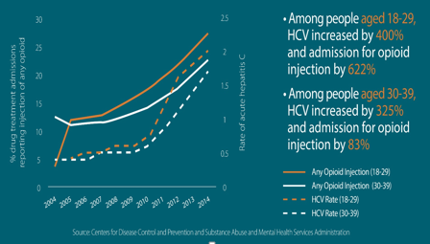
Hepatitis C & Opioid Injection rose Dramatically in Younger Americans from 2004-2014

Slide 17
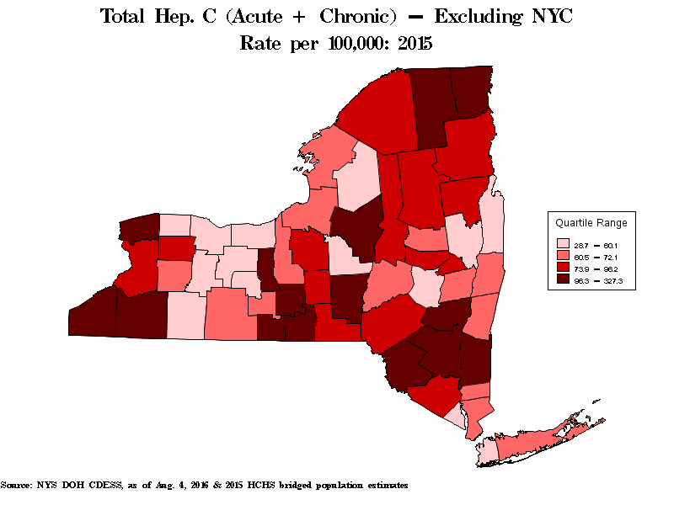
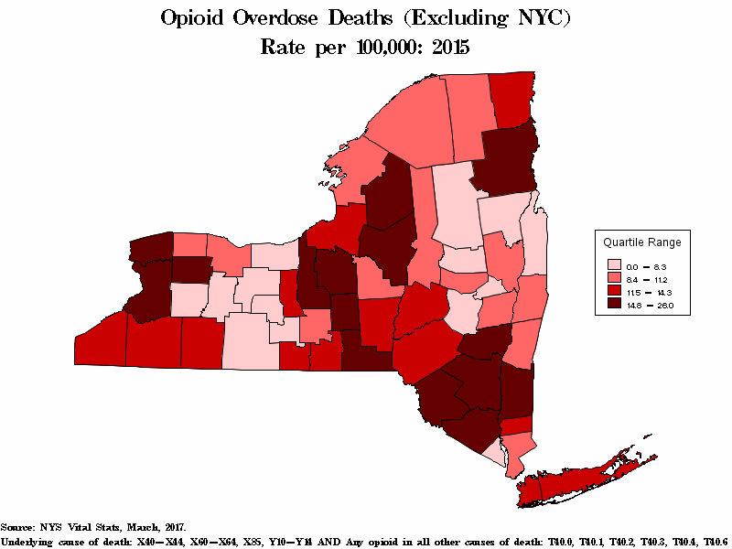
Dual epidemics

Slide 18
Screening vs. Testing
Screening based only on factors such as poor adherence to prenatal care or prior adverse pregnancy outcome, can lead to missed cases and may add to stereotyping and stigma. Therefore, it is essential that screening be universal with a validated verbal tool.
A positive biochemical drug test result is not in itself diagnostic of OUD or its severity.
Urine drug testing only assesses for current or recent substance use; therefore, a negative test does not rule out sporadic substance use. Also, urine toxicology testing may not detect many substances, including some synthetic opioids, some benzodiazepines, and designer drugs.
Source: ACOG. Opioid Use and Opioid Use Disorder in Pregnancy. Opinion No. 711. ACOG Committee Opinion on Obstetric Practice & the American Society of Addiction Medicine. Replace Opinion No. 524, May 2012. Published August 2017.
Created by ACOG District II in 2018
Notes:
Speaker Notes:
Before pregnancy and in early pregnancy, all women should be routinely asked about their use of alcohol and drugs, including prescription opioids and other medications used for nonmedical reasons.
To begin the conversation, the patient should be informed that these questions are asked of all pregnant women to ensure they receive the care they require. Maintaining a caring and nonjudgmental approach, as well as screening when the patient is alone, are important and will yield the most inclusive disclosure.
A review of data in the state’s Prescription Drug Monitoring Program (PDMP) to identify all reported medications that have been prescribed to the woman needs to be included as part of the initial visit and rechecked over the course of the care.

Slide 19
Urine Toxicology
Urine drug testing has been used to detect or confirm suspected opioid use, but should be preformed only with the patient’s consent and in compliance with state laws. Pregnant women should be informed of the potential ramifications of a positive test result, including any mandatory reporting requirements.
Limitations of urine toxicology:
Typically does not test for alcohol or tobacco use
Potential for false positive and false negative results
Increases risk for possible child welfare involvement
Test results do not assess parenting capabilities
Often applied selectively
Lab cut-off points for sensitivity
Sources: ACOG. Opioid Use and Opioid Use Disorder in Pregnancy. Opinion No. 711.
Tenore, P. L. (2010). Advanced Urine Toxicology Testing. Journal of Addictive Diseases, 29(4), 436-448.
Roberts, S. C., Zahnd, E., Sufrin, C., & Armstrong, M. A. (2014). Does adopting a prenatal substance use protocol reduce racial disparities in CPS reporting related to maternal drug use? A California case study. Journal of Perinatology, 35(2).
Notes:
Speaker Notes:
Limitations also exist with use of screening tools such as, substantial underreporting for all classes of illicit drugs (Garg et al 2015).

Slide 20
ACOG Screening Guidance
Assess all pregnant women for SUDs.
Screening for substance use should be part of comprehensive obstetric care and should be done at the first prenatal visit in partnership with the pregnant woman.
Early universal screening, brief intervention (such as engaging the patient in a short conversation, providing feedback and advice), and referral for treatment (SBIRT) of pregnant women with OUD improve maternal and infant outcomes and should be incorporated into the maternity care setting. (see appendix, slides 65-70 for screening tools)
Who can perform SBIRT?
Physicians, nurse practitioners, licensed midwives, physician assistants, nurses, health or substance use counselors, prevention specialists, and other health or behavioral health staff.
Source: ACOG. Opioid Use and Opioid Use Disorder in Pregnancy. Opinion No. 711. ACOG Committee Opinion on Obstetric Practice & the American Society of Addiction Medicine. Replace Opinion No. 524, May 2012. Published August 2017.
New York State OASAS, https://www.oasas.ny.gov/admed/sbirt/index.cfm
Created by ACOG District II in 2018
Notes:
Speaker Notes:
NOTE: SBIRT is billable to commercial health plans as well as Medicare and Medicaid. Depending on the payer, provider of service and additional variables (e.g., length of service, setting), there are different codes used to report SBIRT services for reimbursement as well as different rates of reimbursement.
Check with particular private payers for up to date and policy-specific information as well as documentation requirements.
See Appendix for coding guidance

Slide 21
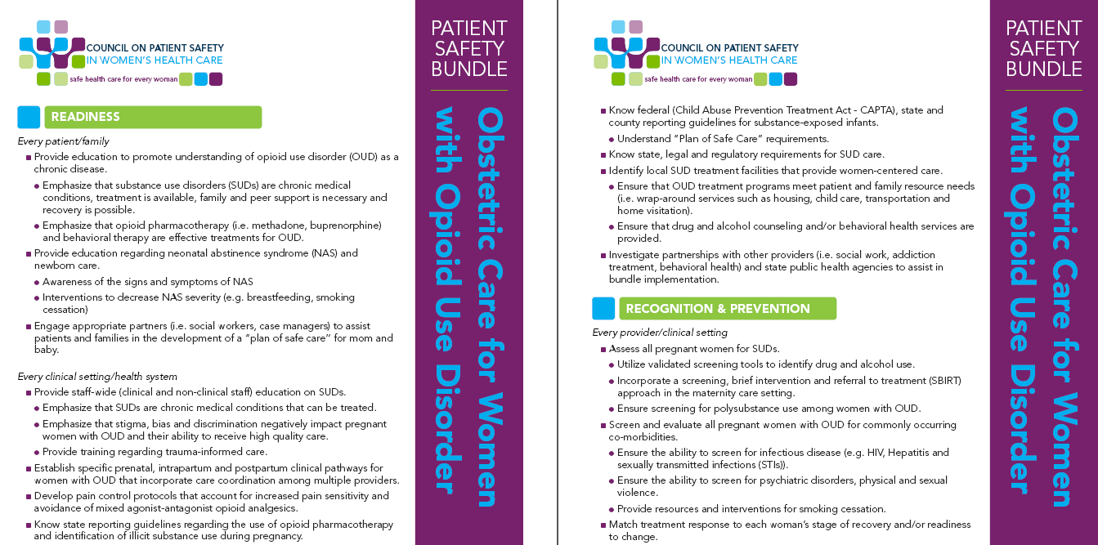
ACOG Patient Safety Bundle
Obstetric Care for Women with Opioid Use Disorder
Created by ACOG District II in 2018
Notes:
Speaker Notes:
The bundle, “Obstetric Care for Women with Opioid Use Disorder, “ is a summary of existing, evidence-based guidelines regarding the clinical care of pregnant and postpartum women with OUD. ACOG District II is expanding upon this national resource by providing implementation tools and several resources to help providers and systems implement best practices for OUD in pregnancy.

Slide 22

READINESS
(Every Patient / Family)
Created by ACOG District II in 2018

Slide 23

Readiness
Stigma/bias/discrimination
Chronic disease
Treatment
Education
Family/patient engagement
Care coordination
Multidisciplinary care coordination
Antenatal, intrapartum, postpartum planning
Pain control
Know guidelines and statutes
Know best resources
Created by ACOG District II in 2018
Notes:
Speaker Notes:
This education is for ob-gyns, women’s health care providers & family practice providers who deliver patients

Slide 24
Enhance Patient & Family Engagement
Provide education to promote understanding of OUD as a chronic disease.
Engage the patient, her partner, family, or other support (if she desires) early in the process and care plan.
Encourage the patient to describe the dynamics of her support network and identify who she would like to participate in her care.
Create a bundle (toolkit) to assist with patient and family engagement and to help manage the patient’s expectations such as:
  Am I hurting my baby?
  Is Medication-assisted treatment (MAT) safe for my baby?
  Will my baby be taken away from me if I am using? Are there issues with specific drugs?
  Breastfeeding recommendations – refer to ACOG guidelines
  What is Neonatal Abstinence Syndrome (NAS) and what are the long-term effects of NAS? (see appendix, slide 73 for NAS resources)
  What is the role of child protective services (CPS) and what requires a notification or a report to CPS? (see appendix, slide 83- CAPTA flowchart)
Created by ACOG District II in 2018
Notes:
Speaker Notes:
Treatment will look different at every hospital, and will depend on the severity of the baby’s withdrawal.
It is important to understand and know the county and hospital philosophy for reporting/notifying CPS

Slide 25
Enhance Patient & Family Engagement
Utilize motivational interviewing techniques, include trauma-informed care, and communicate positive stories of people with OUD to engage the patient in her care (see appendix, slide 75 for SAMHSA resource)
Provide written information for the patient and her family that addresses her key concerns (assess patient health literacy to improve comprehension)
Schedule a prenatal consultation with a neonatologist, NNP, MFM, or social worker to provide the patient facts about what happens at the particular institution or with the NICU to educate the patient and her family on the care of the baby following delivery, including discussion of:
  Neonatal Assessment
  Breastfeeding recommendations
  The NAS scoring system tool – empower patient by reviewing components of assessment systems, discuss the limitations of the tool and strategies for engaging mother in the process
Created by ACOG District II in 2018
Notes:
Speaker Notes:
Sometimes patients need to be read to, and the patient should consider writing down notes or her goals to demonstrate that she has absorbed and truly grasp the concepts and information provided.

Slide 26
Reduce Stigma
Change perceptions of OUD through the use of a common language and emphasize that SUDs are chronic medical conditions that can be treated.
Stigma, bias, and discrimination negatively impact pregnant women with OUD and their ability to receive high quality care.
Strive to use language that helps reduce stigma, accurately reflects science, promotes evidence-based treatment, and demonstrates respect for patients. For example, replace “drug abuser” with “person with a substance use disorder” or “in recovery” rather than being “clean.”
Develop tools to educate multidisciplinary teams of providers on the use of non-judgmental and harm-reduction focused language and learn how to acknowledge and change implicit biases of providers.
Engage all staff in training, including clinical, administrative, and all other
office personnel.
Source: Drug Policy Alliance
Created by ACOG District II in 2018
Notes:
Speaker Notes:
Expand upon bullet #1: screen for social determinants of health for example, pregnancy may be an opportunity for women, their partners and other people living in their household to change their patterns of substance use. Providers who care for women with opioid use disorder in pregnancy need to understand the complexity of the woman’s social, mental and physical problems in order to provide appropriate advice and support throughout pregnancy and in the postpartum period. (World Health Organization, 2014)
People who use drugs are often judged, using nonjudgmental language strengthens the quality of care offered
Language can harm and further alienate people who use drugs; results of alienation:
Patients may not seek out services
may not return for appointments
may not engage in difficult conversations
may not get essential & lifesaving care

Slide 27
Words Matter
X Don’t Use
Use
Dehumanizing, demeaning, demoralizing, language, such as:
People-first language that confers respect, such as:
Addict
When speaking generally, say: person who uses drugs. When talking about a specific issue, say: person who has a problematic relationship with drugs.
When referring to the newborn, they are not born addicted rather they have prenatal substance exposure
Get clean, Clean drug test
Stay away from this term, which implies that a person was previously “dirty.” Instead say: a person who formerly used drugs. When possible, ask the person directly how they refer to themselves and their journey. If referring to a test, say: test was negative, test was not positive for substance
Crazy vs. “normal”
Avoid using terms that refer to mental illness – unless that’s truly what's being discussed. Instead: celebrate difference and diversity of experiences and approaches.
Source: Drug Policy Alliancehttp://www.drugpolicy.org/sites/default/files/documents/Drug-Use-Glossary-for-Elected-Officials.pdf
Created by ACOG District II in 2018
Notes:
Speaker Notes:
This chart provides guidance on language to avoid when talking about drug use and people who use drugs, with the intention moving away from stigmatize and toward people-first language that confers dignity and respect. It is important to focus on the whole person, not a behavior.

Slide 28
Words Matter
X Don’t Use
Use
Dehumanizing, demeaning, demoralizing, language, such as:
People-first language that confers respect, such as:
Do not use dehumanizing terms for people who use various substances – that contributes to the othering, stigmatizing, and discrimination of people who have needs. Instead say: person who uses injection drugs/crack cocaine/synthetic cannabinoids, if in fact it’s necessary to specify.
Junkie, Crackhead, Zombie, Tweaker
“Those” people
Don’t use “othering” language that draws false distinctions among people. Instead: use inclusive language and describe the group or individual using people –first language.
Crack baby
This label is not scientifically supported and leads to damaging stereotyping. Poverty - not drugs - was found to pose a much higher danger to children’s outcomes. Instead say: prenatal exposure to a controlled substance.
Source: Drug Policy Alliancehttp://www.drugpolicy.org/sites/default/files/documents/Drug-Use-Glossary-for-Elected-Officials.pdf
Created by ACOG District II in 2018

Slide 29
Neonatal Abstinence Syndrome (NAS)
Provide education regarding neonatal abstinence syndrome (NAS) and newborn care.
Infants born to women who used opioids during pregnancy should be monitored by a pediatric care provider for neonatal abstinence syndrome (NAS), a drug withdrawal syndrome that opioid-exposed neonates may experience shortly after birth.
  Engage patients early on in care and offer a consultation with MFM or pediatrics in their third trimester
  Ensure awareness of the signs and symptoms of NAS
Include interventions to decrease NAS severity (eg, maternal-infant bonding and breastfeeding, and smoking cessation)
Created by ACOG District II in 2018
Notes:
Speaker Notes:
It is important to consider that NAS can occur after exposure to other substances as well.
Ensure childbirth education programs cover some discussion to various medication use during pregnancy and encourage mom to ask more questions after class (goal to trigger mothers to talk about potential opioid use)
Also referred to as NOW Neonatal opiate withdrawal

Slide 30
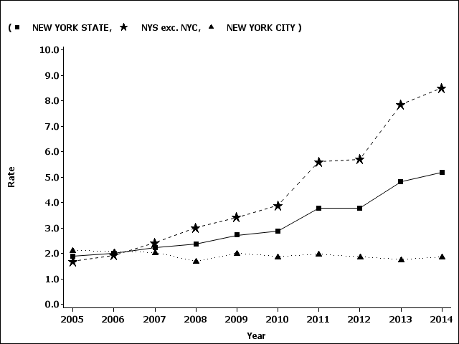
NYS Neonatal Abstinence Syndrome Rate
New York State neonatal abstinence syndrome (NAS) crude rate per 1,000 newborn discharges (any diagnosis)
Source: https://www.health.ny.gov/statistics/opioid/
Created by ACOG District II in 2018
Notes:
Note:
This data, by itself, should not be described or presented as ONLY representing increases in illicit opioid use. As NYS healthcare systems increase engagement of pregnant women with OUD in opioid agonist treatments (eg, methadone and buprenorphine), these rates will continue to climb as NAS is an expected but manageable condition related to prenatal exposure to licit and illicit opioids.

Slide 31
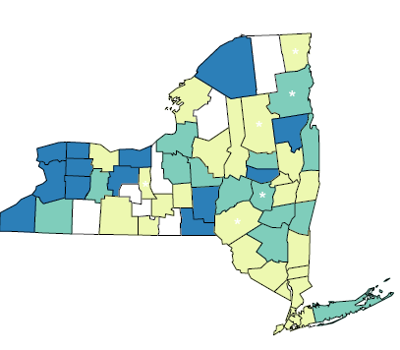

New York State NAS by county
New York State neonatal abstinence syndrome crude rate per 1,000 newborn
discharges (any diagnosis)
Crude hospital discharge rate
Counties are shaded based on quartile distribution
(* Fewer than 10 events in the numerator, therefore the rate is unstable)
Definition: Newborn with withdrawal syndrome or affected by narcotics via placenta or breast milk.
Source: 2012-2014 SPARCS Data as of September 2016
~ The SPARCS data do not include visits/discharges by people who sought care from hospitals
outside of NYS, which may lower numbers and rates for some counties, care from hospitals
especially those which border other states.
Notes:
Note:
County data for NAS reflects the hospital of birth and not necessarily where the family/caregivers live.

Slide 32
NAS: Signs to Watch For
Increased muscle tone “tightness”
Poor eating or vomiting. Often, babies look like they want to eat, but they are not able to suck and swallow at the same time
High pitched or long periods of crying or fussiness
Trouble sleeping. Without enough sleep, they are not able to eat properly.
Tremors or shaking
Diarrhea. This may cause the baby to lose weight.
Fever or sweating
Frequent yawning or sneezing
Difficulty breathing because of a stuffy nose, fast breathing, or forgetting to breathe
Breakdown of skin on face or knees because of rubbing on the linen
Possible seizures
*Use a modified NAS scoring system (eg, Finnegan’s)
Source: Catholic Health Women Care NAS Pamphlet
Created by ACOG District II in 2018
Notes:
Speaker Notes:
Providers need to know the process at their hospital for delivery and need to inform women that the baby will be observed for a period of time to assure a healthy beginning. (include post-hospital discharge signs/symptoms)
Assessment or differential diagnosis of infants is essential to rule out other medical conditions

Slide 33
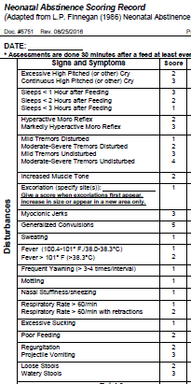
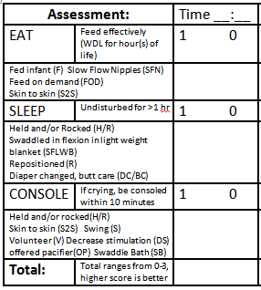
Assessment Tools
Current tool:
Finnegan
New tool:
Eat Sleep Console (ESC)

Slide 34
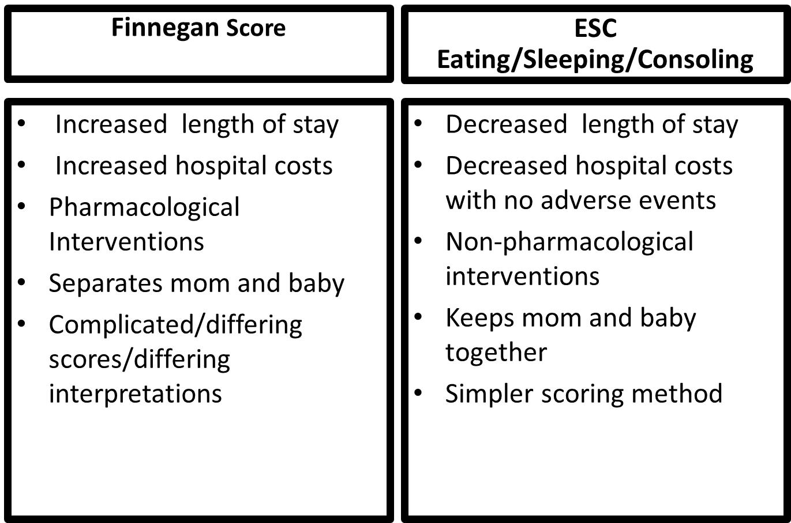
Why Change???

Slide 35
New Tool: Eat Sleep Console
Ask 3 questions:
  Does the baby EAT appropriately for the age?
  Does the baby SLEEP undisturbed >1 hour?
  If crying, is the baby CONSOLED within 10 minutes?
  ***Utilize all interventions prior to scoring***

Slide 36
Finnegan Scores ESC Scores
HIGH scores are BAD
  Finnegan scores increase when the infant’s symptoms are worsening
LOW scores are GOOD
HIGH scores are GOOD
  ESC scores decrease when the infant’s symptoms are worsening
LOW scores are BAD

Slide 37


Eat
Feed effectively based on age
  1= yes
  0= no
Interventions
  Infant Fed
  Slow Flow Nipples
  No scheduled feedings,
  Feed on Demand (whether
  Human milk or Formula fed)
  Skin to skin

Slide 38


Sleep
Undisturbed for >1 hour
  1=yes
  0=no
Interventions
  Held
  Swaddled in flexion with
  light weight blanket
  (hands in or out)
  Repositioned
  Diaper changed, butt care

Slide 39

Console
If crying, be consoled within 10 minutes
  1=yes
  0=no
Interventions
    Best done in parent room
    Held or rocked (If no support system use
    volunteer list)
    Skin to skin
    Slow swing
    Environment – decreased stimuli,
    noise, and light
    Pacifier offered
    Swaddle Bath

Slide 40
Plan of Safe Care
Understand “Plan of Safe Care” requirements.
Child Abuse Prevention and Treatment Act (CAPTA) (see appendix, slide 83 for resources)
Talk with mom to ensure she has thought about safe care for herself and her baby after delivery
  - Ensure access and referral to support in the community for breastfeeding, postpartum care (including depression screening and family planning), and social services following release from health care providers
Address the health and substance use disorder treatment needs of the baby and family
Ensure mom has a plan for continuity of care post-delivery – a safe house to care for her baby, MAT, crib, car seat, etc.
Created by ACOG District II in 2018
Notes:
Speaker Notes:
Add the conversation of a “plan of safe care” to the conversation during specific trimester teaching and incorporate a Perinatal Network referral to assist with community resources and connections.

Slide 41

READINESS
(Every Outpatient
Clinical Setting/Health System)
Created by ACOG District II in 2018

Slide 42
Practice Approach
Practices should clearly define the approach to screening and testing pregnant patients for opioid use based on what best aligns with their resources, expertise, and capacity.
An important first step all practices should initiate is mapping of local resources such as identifying available treatment centers for pregnant women and locating buprenorphine prescribing providers.
  Educate ALL staff on the practice approach and why you are screening, explain the reasons (eg, identify patients early on for care, next steps, NICU stay, etc.)
  Explain to staff why withdrawing a mom while pregnant is not optimal
Created by ACOG District II in 2018
Notes:
Speaker Notes:
Refer to the ACOG Committee Opinion on Opioid Use Disorder in Pregnancy as well as the words that matter slides.

Slide 43
Practice Approach Algorithm
What is our philosophy of caring for and treating pregnant patients with OUD?
Following a positive screen or disclosure of probable OUD
Patient readiness to engage in treatment (if not ready initially, provide relevant, non-judgmental educational materials and/or schedule another appointment in a short interval to develop trust)
Full range of patient care offered at practice (prenatal care and MAT)
Refer patient out for all needed services
(patient discharged)
Prenatal care only referred out co-managed for MAT
Signs of acute withdrawal?
Referral to experienced MAT provider (office-based buprenorphine or opioid treatment program (OTP))
Patient consents to coordinate treatment plans
Go to ER, consider in-patient stabilization or referral to experienced addiction provider
Patient linked to mental health, chemical dependency and social
(eg, housing , transportation, WIC etc.) services.
Notes:
Speaker Notes:
Clearly define the practices approach to screening and testing pregnant women with opioid use disorder. Does your office screen, if so what tool is used? What do you do once you have a positive?
Issues to consider:
Local legal requirements to report and the availability of appropriate treatment options.
Withdrawal symptoms (COWS - see appendix, slide 84) may include:
Maternal: Dilated pupils, anxiety, hypertension, tachycardia, muscle spasms, tremors, sweating chills, flushing, GI distress, vomiting, diarrhea
Fetal: Fetal distress, fetal tachycardia, late decelerations (EFM)

Slide 44
Opportunities for Education
Understanding of COWS Scores
Management of Withdrawal
Atarax (Hydroxyzine) H1 histamine antagonist 50-100mg Q 6 prn
Clonidine alpha 2 agonist decrease sympathetic outflow 0.1-0.3mg Q 1 hr until sx resolve-max 1.2mg/day
Benzodiazepines decrease catecholamines and agitation Diazepam 5 mg QID prn

Slide 45
Practice Education: Patient Encounters
  Ensure office staff are knowledgeable about patient education, MAT, available opioid treatment programs and the potential impact on the fetus (see appendix, slide 72 for resources)
    This may include coordinating a meet and greet with a pediatrician and ensuring an appointment is scheduled prior to delivery, connecting the patient to community-based services (eg, mental health services).
Discuss the importance of trauma-informed care and an environment of open communication (see appendix, slide 78 for trauma-informed care resource)
Created by ACOG District II in 2018
Notes:
Speaker Notes:
Provide patients with a reassuring environment that promotes trust. The fact that the patient is seeking care and treatment, trusting their ob-gyn provider with their fears, personal situation and hopes, is why care is needed beyond our own biases.
Educate about opioids, OUD as a chronic disease, NAS, stigma, non withdrawal during pregnancy, trauma informed care
What can / should be done in the office setting:
Provide information about perinatal risks
Assess/address social risks
Close interval follow-up including motivational interviewing

Slide 46
Trauma-Informed Care
Provide training regarding trauma-informed care to your staff.
*It is important that the staff who use motivational interviewing, recognize trauma-informed care as an element in the tapestry of a woman’s life.
Understand the neurobiology of trauma
Recognize the signs and symptoms of trauma in patients and families
Screen for physical and sexual violence (eg, use ACES screening 10 question as a guide (see appendix, slide 78 for example)
Coordinate care with behavioral health/psychiatric care teams
Prevent re-traumatization
Seek someone in the community to educate your staff on trauma- informed care, read articles and books, and recognize cues to help where staff need to go with questions.
  - Attend trainings provided by crisis centers/universities
Created by ACOG District II in 2018
Notes:
Speaker Notes:
"Research has shown that traumatic experiences are associated with both behavioral health and chronic physical health conditions, especially those traumatic events that occur during childhood. Substance use (such as smoking, excessive alcohol use, and taking drugs), mental health conditions (such as depression, anxiety, or PTSD), and other risky behaviors (such as self-injury and risky sexual encounters) have been linked with traumatic experiences. Because these behavioral health concerns can present challenges in relationships, careers, and other aspects of life, it is important to understand the nature and impact of trauma, and to explore healing." https://www.samhsa.gov/trauma-violence

Slide 47
Becoming a MAT Provider
Buprenorphine Waiver Training:
To prescribe or dispense buprenorphine, physicians must qualify and apply for a waiver under the Drug Addiction Treatment Act of 2000 (DATA 2000).
Physicians: The DATA 2000 specifies training is necessary for physicians to obtain a waiver to engage in office-based treatment of opioid use disorders using drugs approved by the FDA on Schedules III, IV, and V.
Nurse Practitioners and Physician Assistants: In July 2016, President Obama signed the Comprehensive Addiction and Recovery Act (CARA) into law. CARA authorizes qualified NPs and PAs to become waivered to prescribe buprenorphine in office-based settings for patients with Opioid Use Disorder (OUD) for a five-year period expiring in October 2021. ASAM, AANP, and AAPA are authorized by statute to provide this training.
* For alternatives to becoming a licensed treatment provider, go to www.buprenorphine.samhsa.gov. Click on "Data Physician Locator" under the "General" category. This will bring you to a listing of qualified physicians, which you can search by city, county or zip code.
Created by ACOG District II in 2018
Notes:
Speaker Notes:
Refer to the ACOG District II OUD webpage for information on available/upcoming waiver training programs

Slide 48
Methadone vs. Buprenorphine in Pregnancy
Methadone | Buprenorphine
May have better treatment retention No risk of precipitating withdrawal (with initiation of therapy) Treatment initiation may be easier | May have less severe NAS Fewer drug interactions Ability to be treated on an outpatient basis and does not require daily visits Reduced risk of overdose during induction
Created by ACOG District II in 2018
Notes:
Speaker Notes:
Methadone has significant pharmacokinetic interactions with many other medications, such as anti-retroviral agents, and can prolong the QTc interval in a dose-related fashion, which should be considered before new medications are introduced.
Refer to the SAMHSA pocket guide link for a comparison of methadone vs. buprenorphine and further details: https://store.samhsa.gov/shin/content/SMA16-4892PG/SMA16-4892PG.pdf

Slide 49
Assessment, care and referral of women in pregnancy
Medication –Assisted Treatment of Opioid Use (SAMHSA 2016)
Methadone Buprenorphine
Opioid agonist
Daily
Detoxification and maintenance
Liquid concentrate, tablet, oral solution, diskette, powder
Certified Treatment programs
Comprehensive program should include MAT , psychological support, counseling
Can cause prolonged Q-T interval or arrhythmia
Opioid partial agonist
Daily
Relieves withdrawal symptoms
Oral Tablet or film under tongue
DEA Waivered provider, fill at pharmacy
Comprehensive counseling and support available but not mandated.
May increase liver impairment, use with caution with preexisting liver disease

Slide 50
Pain Management Strategies: Practice-Based
Develop pain control protocols that account for increased pain sensitivity and avoidance of mixed agonist-antagonist opioid analgesics.
Educate providers on strategies to avoid or minimize the use of opioids for pain management, highlighting alternative pain therapies such as nonpharmacological, and non-opioid pharmacologic treatments.
  Confirm dose of methadone or buprenorphine with women’s health care provider and with ISTOP/PMP.
Ensure awareness of dosage needs throughout the phases of pregnancy including addressing pain medication with patients and appropriate hospital staff at delivery.
  - If the patient is in prolonged labor, she may need to use her maintenance therapy medications during labor.
Created by ACOG District II in 2018
Notes:
Speaker Notes:
A shared decision making approach is essential

Slide 51
Establish Care Coordination
Establish specific prenatal, intrapartum and postpartum clinical pathways for women with OUD that incorporate care coordination among multiple providers (see appendix, slides 80-82).
Help women’s health care providers obtain resources to become buprenorphine trained.
Ensure pediatricians in the community are equipped with patient education about NAS and provide education about OUD.
Educate emergency medicine physicians about the unique care plans for OUD in pregnant women and create protocols/processes for caring for this population when presenting to the ED (eg, care management/coordination through the development of algorithms/visual aids).
Every hospital should standardize their discharge education and dosing for opioids (7 day supply limit).
Identify provider champions who can promote education and encourage other providers and systems to become engaged.
Created by ACOG District II in 2018

Slide 52
Establish Care Coordination
Ensure that OUD treatment programs meet patient and family resource needs (eg, wrap-around services such as housing, child care, transportation and home visitation).
Identify a facilitator to train new staff, determine gaps in services, and bring teams together through hospital-based quality improvement programs.
Seek out community health worker networks in your region
Created by ACOG District II in 2018
Notes:
Speaker Notes:
Broome County providers have access to the Baby Basics program for mothers with OUD using community health workers to ensure peer support.
The program provides underserved families prenatal materials that are comprehensive and easy to read, but also serve as a catalyst for learning and family literacy. The program also empowers, engages and educates underserved parents so that they become effective users of the healthcare system and can advocate for themselves and their families and build community initiatives so families receive integrated, coordinated prenatal and parenting messages
https://ncsacw.samhsa.gov/files/Collaborative_Approach_508.pdf

Slide 53
RECOGNITION
(Every Provider/Clinical Setting)
Created by ACOG District II in 2018

Slide 54
Recognition
Assess ALL
SBIRT
Polysubstance use
Co-morbidities
Psychiatric disorders
Intimate Partner Violence (IPV)
Smoking
Readiness to change
Notes:
Speaker Notes:
This next section will address the various key words noted on the slide related to screening in which all pregnant women should be screened at entry to maternity care, with mechanisms in place to ensure that those who screen positive receive follow up assessments, intervention, and linkages to treatment services.

Slide 55
Start with SBIRT!
Screening: the healthcare professional assesses a patient for risky substance use behaviors using standardized screening tools. Screening can occur in any healthcare setting
Brief Intervention: the healthcare professional engages a patient showing risky substance use behaviors in a short conversation, providing feedback and advice
Referral to Treatment: the healthcare professional provides a referral to brief therapy or additional treatment to patients who screen in need of additional services
Goodman,D. , Fisher, T. 2018 COUNCIL ON PATIENT SAFETY IN WOMEN’S HEALTH CARE Recognizing Opioid Use Disorder During Pregnancy: Effective Screening for OUD and its Co-Morbidities

Slide 56
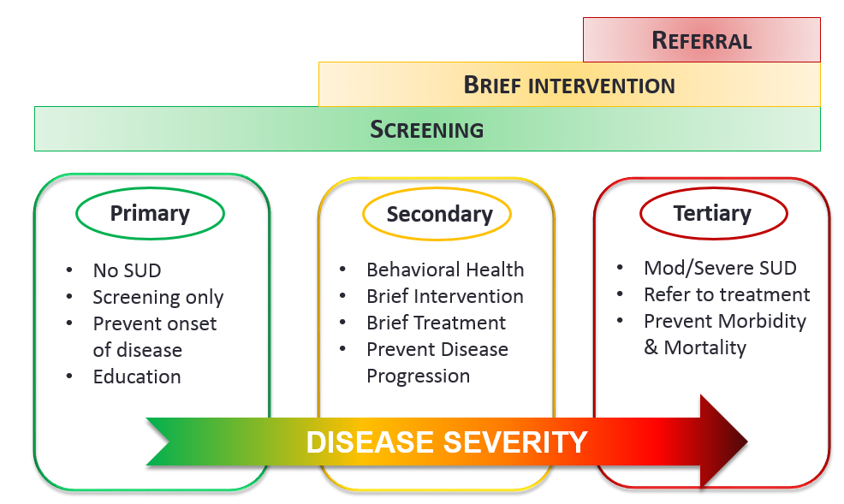
SBIRT! A Population Health Approach to SUD
Goodman, D.. , Fisher, T. 2018 COUNCIL ON PATIENT SAFETY IN WOMEN’S HEALTH CARE
Recognizing Opioid Use Disorder During Pregnancy: Effective Screening for OUD and its Co-Morbidities

Slide 57
Not only Substance Use
High rates of comorbidities associated with perinatal substance
  Mental health
  Infectious disease: HCV, HBV, HIV, STIs
  Tobacco
Assessment should include screening for all of the above and
  Social determinants: housing, food, transportation, social supports
  Intimate partner violence
Consider a comprehensive screening approach
Goodman, D.. , Fisher, T. 2018 COUNCIL ON PATIENT SAFETY IN WOMEN’S HEALTH CARE
Recognizing Opioid Use Disorder During Pregnancy: Effective Screening for OUD and its Co-Morbidities

Slide 58
Implementation
Thing to consider in preparation for SBIRT implementation
  Privacy during screening
  Workflow for screening and timely follow up if positive
  Roles and responsibilities in process
  Referral options if indicated
  Billing for Brief Intervention services
Capturing data in an ongoing way is essential to inform program development
Goodman, D.. , Fisher, T. 2018 COUNCIL ON PATIENT SAFETY IN WOMEN’S HEALTH CARE
Recognizing Opioid Use Disorder During Pregnancy: Effective Screening for OUD and its Co-Morbidities

Slide 59
Essential Components of SBIRT Implementation
Identify screening tool(s) relevant to your context
Plan workflows: who, where, who else is involved
Identify resources in practice or community
    Mental health counselor
    Social worker
    Obstetrical care provider
    MAT prescriber
    Psychiatric consultant for appropriate level of care and diagnosis/management of comorbidities
Be able to communicate openly and knowledgeably about child protective services reporting requirements
    Ensure policies are consistent about reporting across OB and Pediatrics
Notes:
SBIRT is endorsed by the American College of Obstetricians and gynecologists. Our treatment of perinatal substance use disorders should reflect the recognition of SUD as a chronic disease process.

Slide 60
Screening Step 1:
AUDIT –C: 3 questions about past year alcohol use
  How often did you have a drink containing alcohol in the past year?
  How many drinks did you have on a typical day when you were drinking in the past year?
  How often did you have 4 or more drinks on one occasion in the past year?
NIDA: 1 question about past year drug use
  How many times in the past year have you used an illegal drug or used a prescription medication for nonmedical reasons?
Do you use tobacco?
Do you use marijuana?
Follow up if positive: AUDIT-10 and DAST-10 questions explore severity of alcohol and drug use
Goodman, D.. , Fisher, T. 2018 COUNCIL ON PATIENT SAFETY IN WOMEN’S HEALTH CARE
Recognizing Opioid Use Disorder During Pregnancy: Effective Screening for OUD and its Co-Morbidities
Notes:
The paper screening process involves two steps: a pre-screen and a follow up. The pre-screen consists of 4 questions: 3 about past use of alcohol, and1 about past year use of drugs. Follow up includes filling out an additional form (or forms): one for risky alcohol use, the other for drug use.

Slide 61
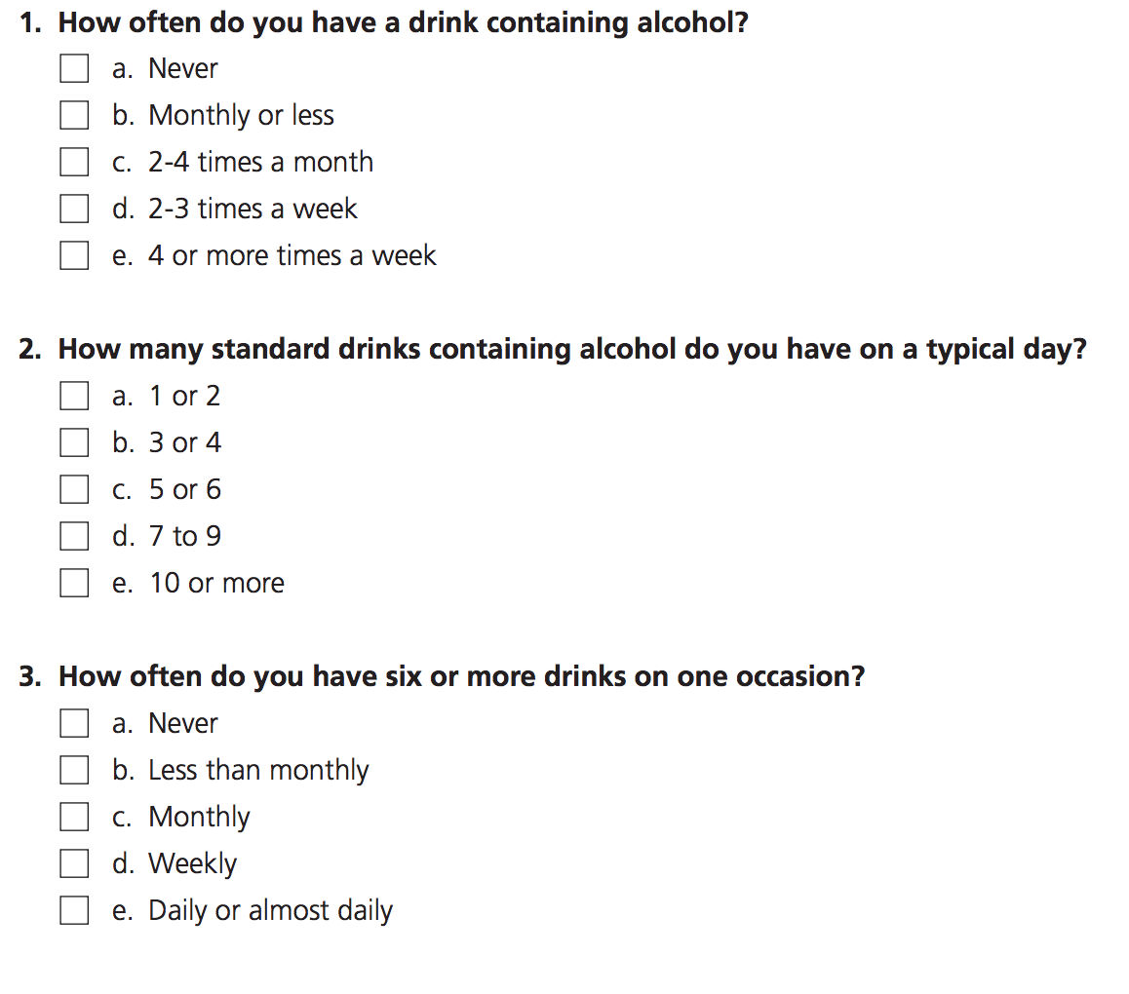
Audit C

Slide 62
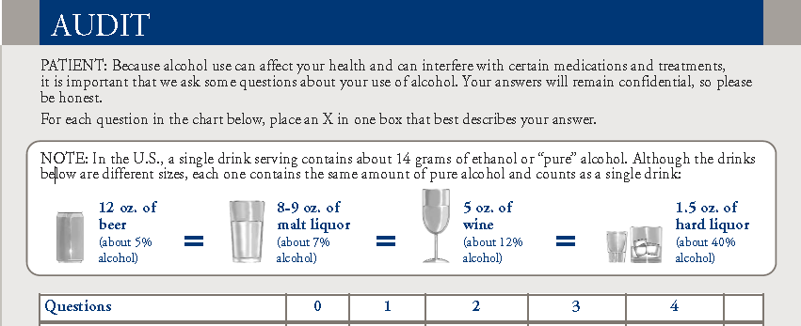

Screening Step 2: Severity of Alcohol Use AUDIT 10
AUDIT C is reflected in the first 3 questions of AUDIT 10
A score of 3 or more on AUIDT C indicates risky alcohol use for a woman
A score of 8 or more on AUDIT indicates hazardous or harmful alcohol use
Any continued alcohol use is potentially harmful in pregnancy
Notes:
The paper screening process involves two steps: a pre-screen and a follow up. The pre-screen consists of 4 questions: 3 about past use of alcohol, and1 about past year use of drugs. Follow up includes filling out an additional form (or forms): one for risky alcohol use, the other for drug use.

Slide 63
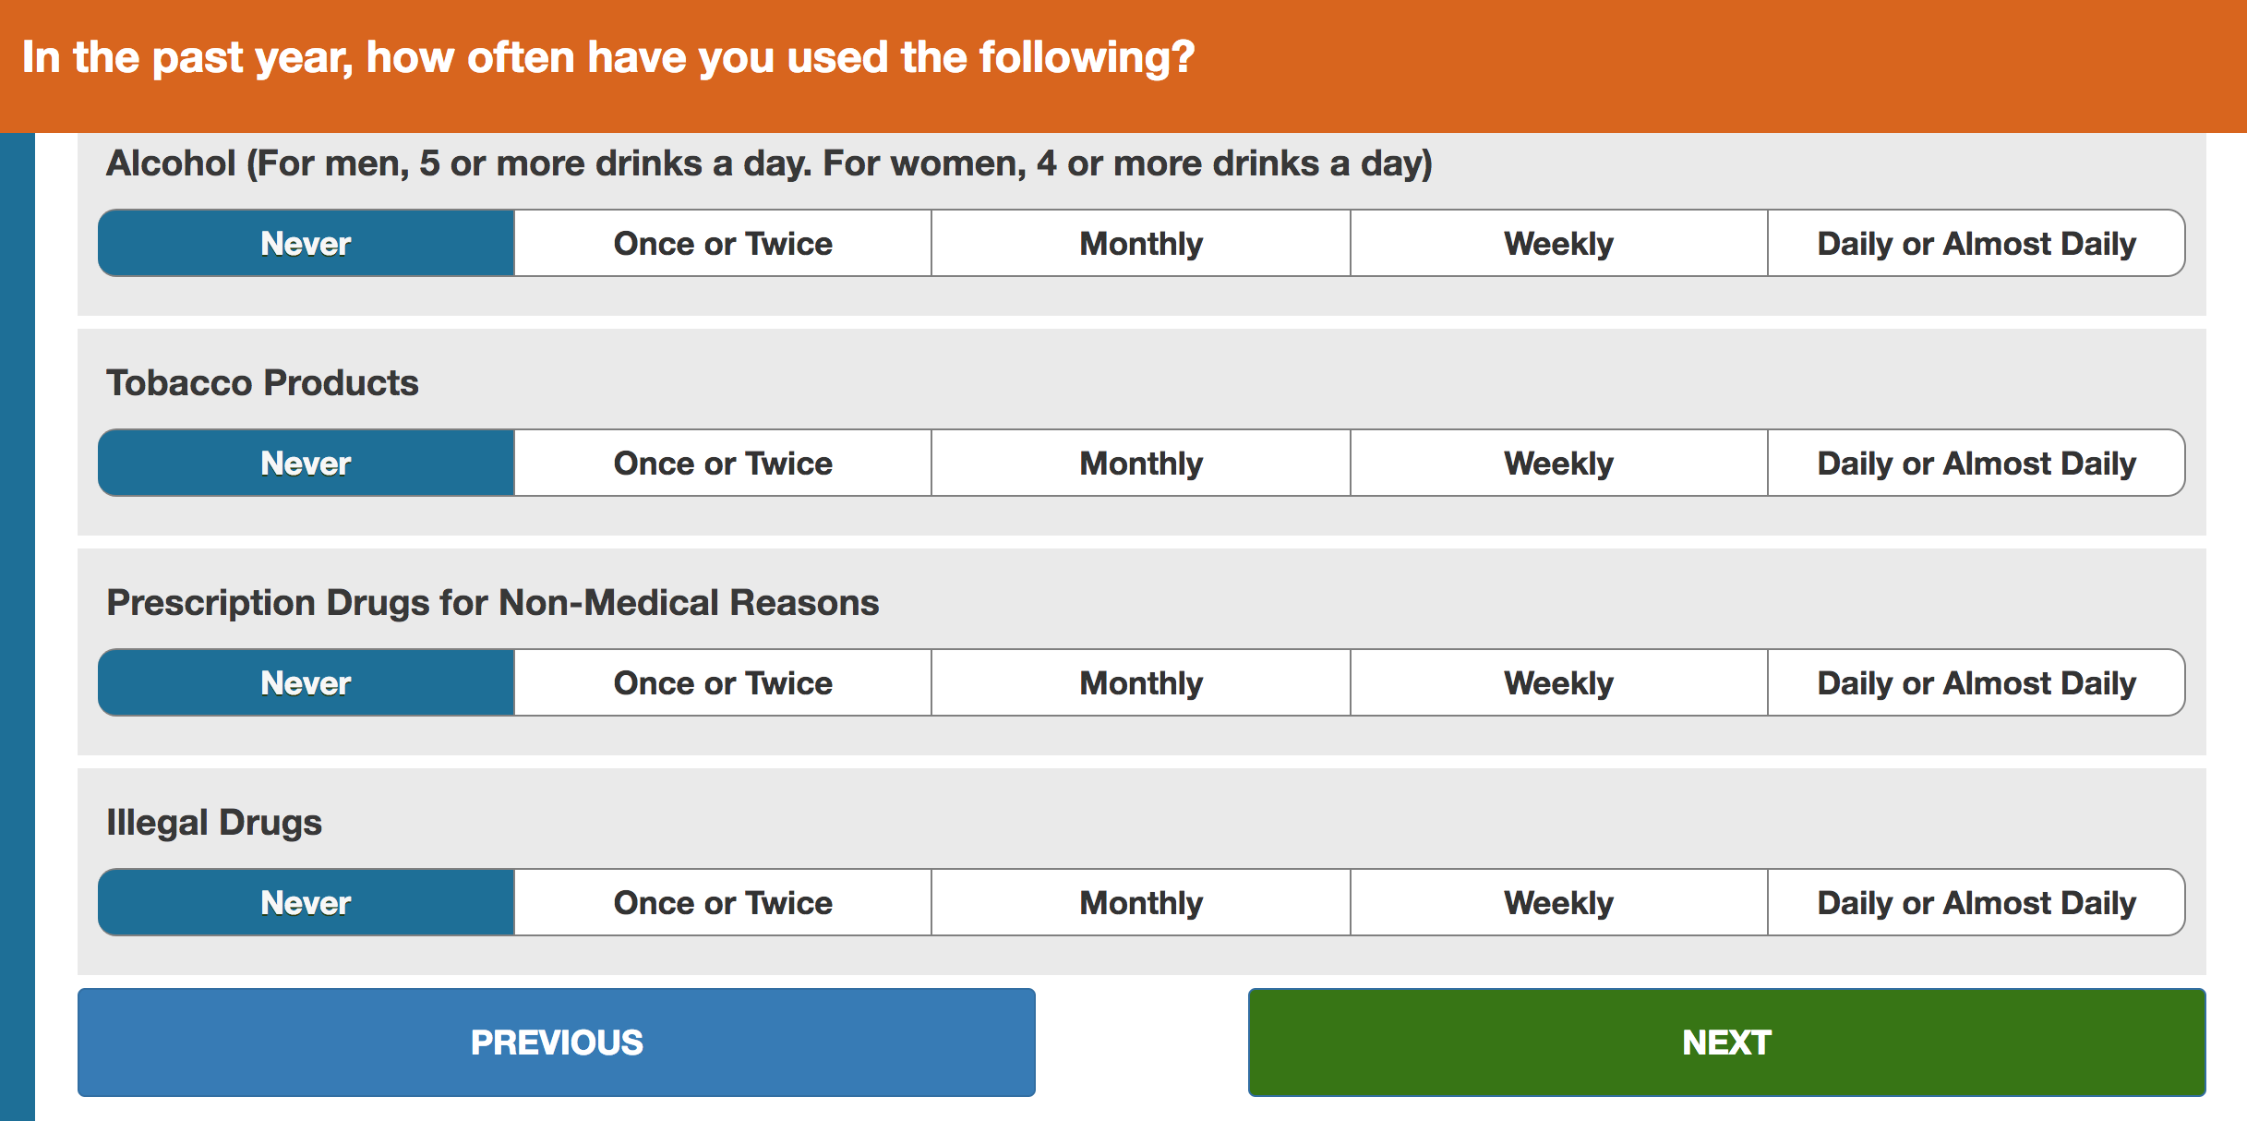
NIDA Drug Screening Tool

Slide 64
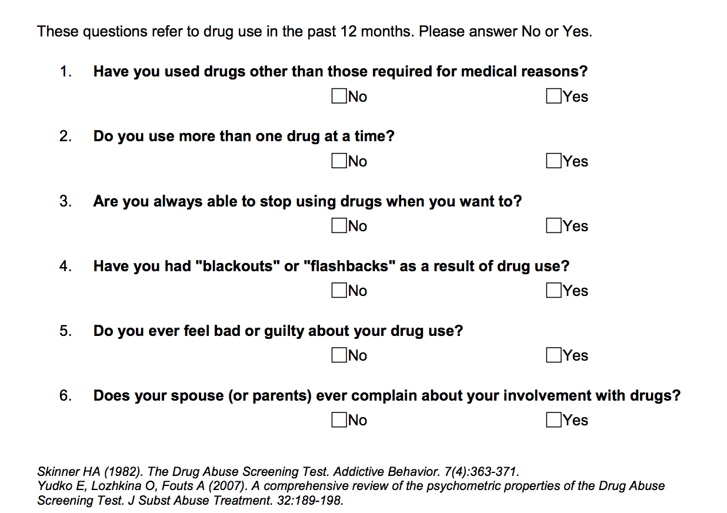
Drug Abuse Screening Test (DAST – 10)

Slide 65
CRAFFT Screening Tool for Adolescents
C | Have you ever ridden in a CAR driven by someone (including yourself) who was "high" or had been using alcohol or drugs?
R | Do you ever use alcohol or drugs to RELAX, feel better about yourself, or fit in?
A | Do you ever use alcohol/drugs while you are by yourself, ALONE?
F | Do you ever FORGET things you did while using alcohol or drugs?
F | Do your family or FRIENDS ever tell you that you should cut down on your drinking or drug use?
T | Have you gotten into TROUBLE while you were using alcohol or drugs?

Slide 66
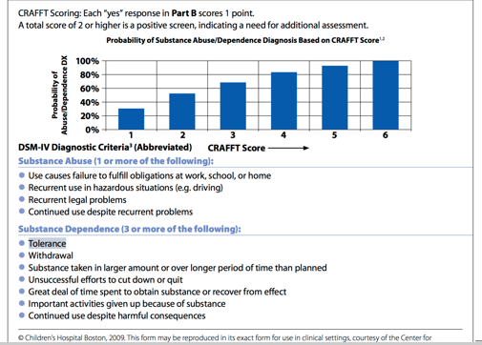
The CRAFFT Screening Interview
Scoring Instructions: For Clinic Staff Use Only

Slide 67
Brief Intervention
Patients who screen positive for OUD in pregnancy should receive a brief intervention. This intervention should use principles of motivational interviewing to affect behavioral change (see appendix, slide 75)
Effective brief intervention includes 3 steps:
  Offer feedback
  Listen and understand the patient’s motivation (eg, “I hear that you use x to deal with stress of life at home”)
  Explore other options to address patient’s motivation for substance use (eg, “Are there other ways to deal with stress in a more healthy way?”)
Note: providing written handouts to ALL women can reach those who are afraid to disclose use, but who may be at risk and need treatment
Source: The role of screening, brief intervention, and referral to treatment in the perinatal period. American Journal of Obstetrics & Gynecology,
Special Report. November 2016
Created by ACOG District II in 2018
Notes:
Speaker notes:
Principles of motivational interviewing include using an empathetic counseling style, asking open-ended questions, developing rapport and trust, expressing empathy, and rolling with resistance. Motivational interviewing must be nonjudgmental and works best if the patient adopts the motivation and develops a plan to change her behavior.
The brief intervention can be followed with an oral or written “contract” in which the patient states what she plans on doing to reach readiness, abstinence, or interim goals toward eliminating substance use and the provider arranges for follow up visits.
For those patients who are unable to make any behavioral change or use increases during pregnancy, referral for specialized addiction treatment should be made.

Slide 68
Referral to Treatment
Match treatment response to each woman’s stage of recovery and/or readiness to change.
Work with behavioral health/case managers in-office (if available) to assist with the intervention component of SBIRT
Make referrals as needed that facilitate access to treatment and related services for women who need these services
  Make connections with treatment providers to build relationships
  Communicate with MAT providers at least once a month
Ensure support for women’s health care providers starting buprenorphine waiver training or newly trained (see appendix, slide 87 for resources)
Created by ACOG District II in 2018

Slide 69


SUNY Upstate Medical University
Centering Pregnancy Special Care
Provide comprehensive patient-centered care, improving outcomes for mothers and newborn .
Promote breastfeeding, infant safety and other choices that improve newborn outcomes
Enhance patient satisfaction, providing a powerful and enriched perinatal and birthing experience in the presence of a high-risk pregnancy.

Slide 70

Multidisciplinary Team
Maternal Fetal Medicine/Obstetrician
Midwife CNM/CM
Addiction medicine and services
Neonatologist/Pediatrician
Dental
Gastroenterology
Infectious Disease

Slide 71
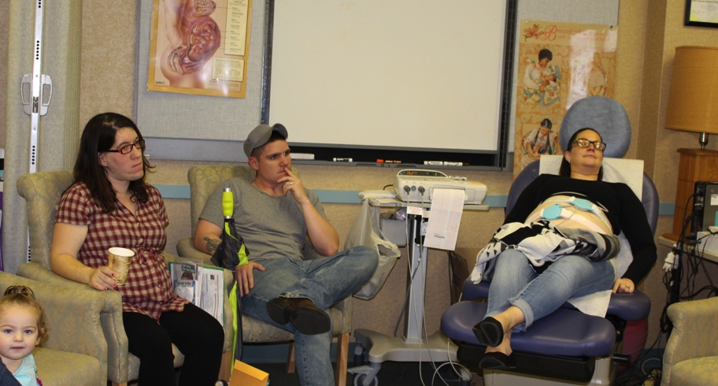

Multidisciplinary Team
Psychiatric care, mental heath and trauma based care, stress reduction
Social services and community health outreach
Nutrition
Pediatric nurse educators – infant massage
NICU meeting with neonatologist
OCHD Healthy Families Doula program
Central New York Care Collaborative

Slide 72
READINESS
(Every Inpatient
Clinical Setting/Health System)
Understanding Your Hospital Approach/Philosophy
Created by ACOG District II in 2018

Slide 73
Regional Perinatal Center (RPC) & Hospital Education
Engage community resources - ensure that all agencies are involved in the community – create resource guides, etc.
All hospital teams should be trained in trauma-informed care, substance use disorders, opioid use disorder, safe care plan, etc. (see appendix for examples).
Facilitate discussions with childbirth educator, obstetric provider (ob-gyn or licensed midwife), pediatric provider or neonatologist, anesthesiologist, and social worker to establish a plan and clarity of approach to care.
Understand the hospital policy/approach for evaluating newborns for substance exposure at the time of delivery.
The ob-gyn provider should know the basic discharge
criteria for the at risk newborn.
Created by ACOG District II in 2018

Slide 74
Pain Management: General
Develop pain control protocols that account for increased pain sensitivity and avoidance of mixed agonist-antagonist opioid analgesics.
Each hospital is encouraged to develop guidelines for management of patients with OUD.
Patients with OUD may experience more pain (increased sensitivity) and require higher doses of opioids (tolerance).
As appropriate, maximize non-pharmacologic therapies (eg, PT) and non-opioid pharmacologic treatments (eg, NSAIDS). Avoid mixed agonist-antagonists.
Share ‘withdrawal” order set for pregnancy patients (include anesthesia, pharmacy, OBs, and neonatologists/pediatricians) (see slide 79 for sample order set)
Created by ACOG District II in 2018
Notes:
Speaker Notes:
Effective alternatives pain medications should be easily accessible consult with hospital pharmacy if needed

Slide 75
Pain Management
Medical Care
Evaluation and management avoiding bias from patient’s history of OUD and/or pregnancy.
Medication-assisted treatment (MAT)
Prenatal care
Women with OUD are as (or more) susceptible to medical conditions
Pregnancy may alter the presentation of common medical conditions
Pregnancy is not a contraindication to appropriate evaluation or opioid pain management
Assess engagement in treatment
Assess for prenatal care
Tx: Yes. Verify MAT dose/frequency. Avoid changes unless medically necessary and in consult with MAT provider.
PNC: Yes. Update provider
PNC: No. Refer for prenatal care
Tx: No. Assess willingness to engage in treatment and refer
Created by ACOG District II in 2018
Notes:
Speaker Notes:
Verify dose/frequency and do not change unless medically necessary (if in treatment)
Pain management/medical care appropriate to the complaint without bias for the patient’s hx of OUD/pregnancy
Assess for prenatal care. Refer to/or update OB provider.
Assess for engagement in treatment and refer to/or update treatment provider
Develop pain control protocols that account for increased pain sensitivity and avoidance of mixed agonist-antagonist opioid analgesics.
Educate providers on strategies to avoid or minimize the use of opioids for pain management, highlighting alternative pain therapies such as nonpharmacological (eg, exercise, physical therapy, behavioral approaches), and non-opioid pharmacologic treatments.
Ensure awareness of dosage needs throughout the phases of pregnancy including addressing pain medication with patients and appropriate hospital staff at delivery.
- If the patient is in long labor, she may need to use her maintenance therapy medications during labor.
Ensure appropriate use of opioids for postpartum and short-term pain use.
Share ‘Withdrawal” order set for pregnancy patients (include anesthesia, pharmacy, OBs, and neonatologists/pediatricians) (see slide x for sample order set)

Slide 76
Pain Management: Intrapartum
Intrapartum analgesia needs are the same as for any other woman
  It should not be assumed that MAT is sufficient for intrapartum analgesia
Methadone or buprenorphine should be continued throughout labor
  Buprenorphine should not be temporarily stopped in anticipation of delivery
  MAT should not be used/adjusted for intrapartum analgesia
IV access may be more difficult
Neuraxial anesthesia is safe
  The incidence of hypotension may be increased in the presence of some co-morbid health conditions (eg, liver disease)
Avoid mixed agonist-antagonists
Created by ACOG District II in 2018

Slide 77
Pain Management: Postpartum
Reassure the patient that their pain will be addressed.
Medications for MAT should not be assumed to cover postpartum pain or adjusted/interrupted for pain management.
Vaginal delivery: Non-opioid analgesics are often adequate
Cesarean delivery: Patients often experience more pain and require higher than average opioid doses
It is impossible to predict a patient’s pain level or opioid need
Maximize nonpharmacological (eg, heat) and non-opioid pain management (eg, TAB block, Toradol); double concentration patient-controlled analgesia (PCA)
  Consider scheduled, rather than PRN, medications
Avoid agonist/antagonists and full antagonists.
Breastfeeding should be encouraged for women who are on a stable dose of methadone or buprenorphine, interested, and have no other contraindications
Created by ACOG District II in 2018
Notes:
Speaker notes:
Goal- subjective pain relief without excessive side effects
Under treatment is common
Patients should be monitored closely for CNS or respiratory depression

Slide 78
Withdrawal/Overdose
Withdrawal
Assess severity of symptoms using a Clinical Opiate Withdrawal Scale (COWS) (see appendix, slide 84)
Symptomatic management
Consult Addiction Medicine
Naloxone for respiratory depression/maternal overdose
antihistamines, alpha agonists, benzodiazepines, and opioid replacement
Can continue prescribed methadone or buprenorphine but cannot initiate treatment without waiver approval
Created by ACOG District II in 2018
Notes:
Speaker Notes:
Primarily for patients unable to withdraw completely from low doses of opioids or when there is a delay in getting care at a substance abuse treatment center
Not intended to be a comprehensive resource or address emergency management
Alpha-2 agonists binds to K⁺ channel receptors shared by opioids and decreases sympathetic outflow. Benzodiazepines bind to GABA-A receptor which reduces catecholamine release and in turn, decreases agitation, insomnia, muscle aches, craving.
Opioids are best for natural interruption in opioid use and should be used cautiously in antagonist induced withdrawal. Opioids only be prescribed for management of opioid addiction by licensed providers but are a reasonable option when there is a valid medical indication (e.g. sickle cell pain).
More information regarding protocols and medications to symptomatic management will be provided in a future provider education bundle.

Slide 79
Treatment Services
Identify local SUD treatment facilities that provide women-centered care.
Ensure that drug and alcohol counseling and/or behavioral health services are provided.
Create better engagement and communication among providers within the continuum of care and across service areas, including the justice system, as needed
Educate all providers of the importance of universal screening and have resources available for those screening positive (see appendix, slides 85-86 for NYS OASAS Treatment Services; OASAS live dashboard https://findaddictiontreatment.ny.gov or call HOPEline 877.846.7369)
Contact local counties for a list of Substance Use Disorder Treatment Referral/Provider Directory (provide name of the contact by County)
Use of the Medicaid Cab program to schedule (five day advance notice) visits even if it brings patients two hours away from RPC and ensure Medicaid cab companies are involved in the solution
Created by ACOG District II in 2018
Notes:
Speaker Notes:
Investigate partnerships with other providers (eg, social work, addiction treatment, behavioral health) and state public health agencies to assist in bundle implementation.

Slide 80
Conclusion
Screening for substance use should be part of comprehensive obstetric care and should be done at the first prenatal visit in partnership with the pregnant woman.
It is vital to use language that helps reduce stigma, accurately reflects science, promotes evidence-based treatment, and demonstrates respect for patients.
Specific prenatal, intrapartum and postpartum clinical pathways for women with OUD that incorporate care coordination among multiple providers should be established.
Various resources exist, including those listed in the attached appendix
Created by ACOG District II in 2018

Slide 81
ACOG District II Opioid Use Disorder in Pregnancy
Task Force & Key Partners
Leah Kaufman, MD FACOG Co-Chair
David Garry, DO, FACOG Co-Chair
Cynthia Abraham, MD, FACOG
Michelle Bode, MD, MPH
Erin Bortel, MSW
Sharon Chesna, MPA
Michele Calvo, MPH
Kathleen Dermady, DNP, LM, CNM, NP
Darcy Dreyer
Christie Finch
Aimee Gomlak, FACHE
Dede Hill
Lyla Hunt
Julia Hunter, MD, MPH, FASAM
Solita Jones, MS
Marilyn Kacica, MD, MPH
Melissa Kubenik, MD, FACOG
Nicholas Kulbida, MD, FACOG
Helena LaDue, LMSW, CASAC
Kristen Lawless, MS
Lauren Miller, MD, MPH
Maria Morris-Groves, MSEd
Debby O’Brien
James Scott, MD, FACOG
Neil Seligman, MD, MS, FACOG
Maggie Taylor, PhD
Darlene Walker, RN, FNP
Bridget Walsh
Ellie Ward
  Alliance for Innovation on Maternal Health (AIM)
  HANYS’ Statewide Opioid Addiction Prevention and Management Collaborative
  NYSDOH AIDs Institute, Office of Drug User Health
  NYSDOH’s New York State Perinatal Quality Collaborative (NYSPQC)
  NYS Office of Alcoholism and Substance Abuse Services (OASAS)
Created by ACOG District II in 2018

Slide 82


Contact ACOG District II
For questions on this project:
Kelly Gilchrist
Manager, Medical Education
kgilchrist@ny.acog.org
Kristin Zielinski, MA, MPP
Senior Director of Operations
kzielinski@ny.acog.org
American College of Obstetricians and Gynecologists (ACOG), District II
100 Great Oaks Boulevard, Suite 109
Albany, NY 12203
(518) 436-3461
www.acogny.com
Stay up to date:
Like us on Facebook!
Follow us! Twitter: @ACOGD2

Slide 83
Resources: Screening Tools
4 Ps*
Parents: Did any of your parents have a problem with alcohol or other drug use?
Partner: Does your partner have a problem with alcohol or drug use?
Past: in the past, have you had difficulties in your life because of alcohol or other drugs, including prescription medications?
Present: In the past month, have you drank any alcohol or used other drugs?
Scoring: Any “yes” should trigger further questions
CRAFFT – Substance Abuse Screen for Adolescents & Young Adults
C Have you ever ridden in a CAR driven by someone (including self) who was high or had been using alcohol or drugs?
R Do you ever use alcohol or drugs to RELAX, feel better about yourself, or fit in?
A Do you ever use alcohol or drugs while you are by yourself or ALONE?
F Do you ever FORGET things you did while using alcohol or drugs?
F Do your FAMILY or friends ever tell you that you should cut down on your drinking our drug use?
T Have you ever gotten in TROUBLE while you were using alcohol or drugs?
Scoring: Two or more positive items indicates the need for further assessment
Source: https://www.acog.org/Clinical-Guidance-and-Publications/Committee-Opinions/Committee-on-Obstetric-Practice/Opioid-Use-and-Opioid-Use-Disorder-in-Pregnancy
Created by ACOG District II in 2018

Slide 84
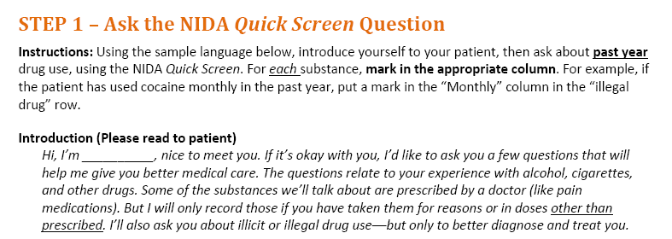
Resources: Screening Tools
Source: https://www.drugabuse.gov/sites/default/files/files/QuickScreen_Updated_2013%281%29.pdf
Created by ACOG District II in 2018
Notes:
Speaker Notes:
Universal screening is associated with better overall health outcomes. Tell your patients you’d like to ask them a few questions that you ask all your patients.

Slide 85
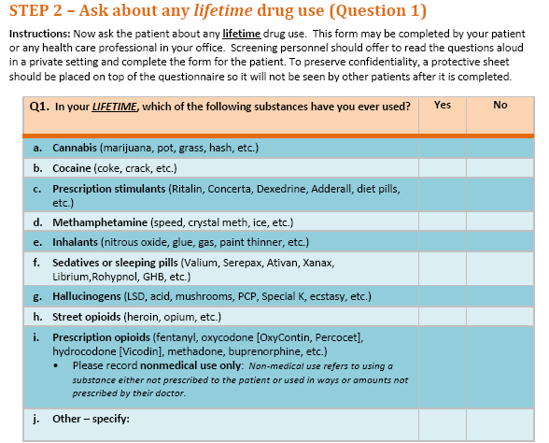
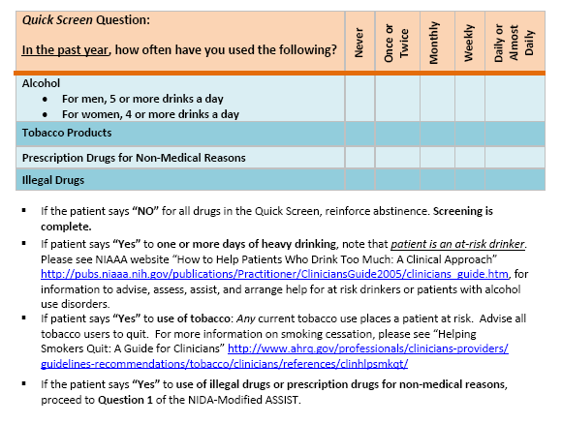
Resources: Screening Tools
Source: https://www.drugabuse.gov/sites/default/files/files/QuickScreen_Updated_2013%281%29.pdf
Created by ACOG District II in 2018

Slide 86
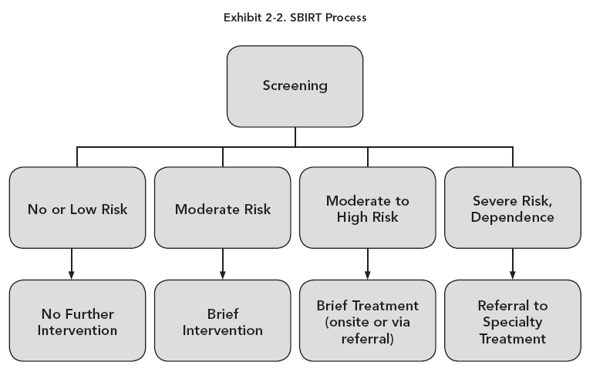
Resources: Screening Tools
Source: https://www.integration.samhsa.gov/sbirt/TAP33.pdf
Created by ACOG District II in 2018
Notes:
Speaker Notes:
About 25% of patients screened will require a brief intervention, while 4% will need a referral to specialty treatment. The remaining 70% includes abstainers and low risk users who will simply require positive reinforcement for continuing to abstain, or reduce use to lower-risk levels.
1: Screening- Universal Screening using a brief, validated questionnaire to determine use and severity of alcohol, illicit drugs and prescription drug abuse and inform the level of appropriate intervention. No blood or urine test is administered.
2: Brief Intervention – Brief motivational and awareness-raising intervention given to those whose substance use is putting their health and well-being at risk (5-30 minutes). The intervention is performed on-site following the screening.
3: Referral to Treatment: Referral to specialty care for patients with high-risk substance use (and/or patients with diagnosed substance use disorders).

Slide 87
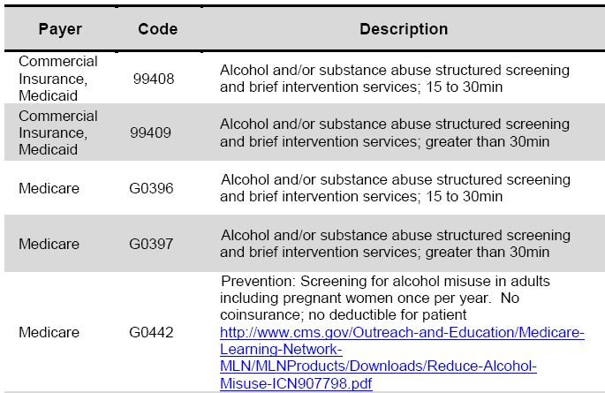
Resources: Reimbursement for SBIRT
Source: https://www.integration.samhsa.gov/sbirt/Reimbursement_for_SBIRT.pdf
Created by ACOG District II in 2018
Notes:
Speaker Notes:
Reimbursement for SBIRT:
The American Medical Association (AMA) has approved several billing codes that will allow you toe be reimbursed for providing screening and brief intervention services.
Medical procedures are coded using Common Procedure and Terminology (CPT) and Healthcare Common Procedure Coding System (HCPCS) codes.
Screening and brief intervention may be provided in an office, emergency department or inpatient visits for both new and established patients. Virtually all payers use AMA’s Evaluation and Management (E&M) CPT Codes to pay physician’s services.
Many payers reimburse for independent licensed health practitioners such as advance practice nurses, psychologists, and masters-level social workers. A few will pay for service provided by health professionals under the supervision of a physician. Several CPT codes can be used.
The chart above shows the most commonly used codes.

Slide 88
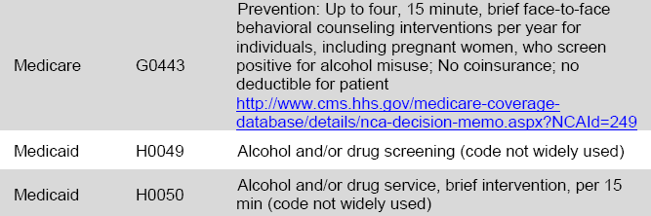
Resources: Reimbursement for SBIRT
Source: https://www.integration.samhsa.gov/sbirt/Reimbursement_for_SBIRT.pdf
Created by ACOG District II in 2018

Slide 89
Resources: Patient Education
Risks of continued SUD in Pregnancy: https://www.marchofdimes.org/pregnancy/street-drugs-and-pregnancy.aspx
Benefits of Medication-assisted treatment (MAT) in pregnancy with methadone and buprenorphine:
https://store.samhsa.gov/shin/content//SMA14-4124/SMA14-4124.pdf
Safety of the newborn, developing a plan of safe care for mother and newborn:
https://ncsacw.samhsa.gov/files/CAPTA_SEI_Statutory_Summary.pdf
https://www.guttmacher.org/state-policy/explore/substance-use-during-pregnancy
Neonatal Abstinence Syndrome: What You Need to Know: http://www.nnepqin.org/wp-content/uploads/2017/08/ToolkitOUD_5_2_NAS_Parent_Education_Guide.pdf
Breast feeding - ABM Clinical Protocol #21: Guidelines for Breastfeeding and the Drug-Dependent Woman
https://www.ncbi.nlm.nih.gov/pmc/articles/PMC2989871/pdf/bfm.2009.9987.pdf
Created by ACOG District II in 2018

Slide 90
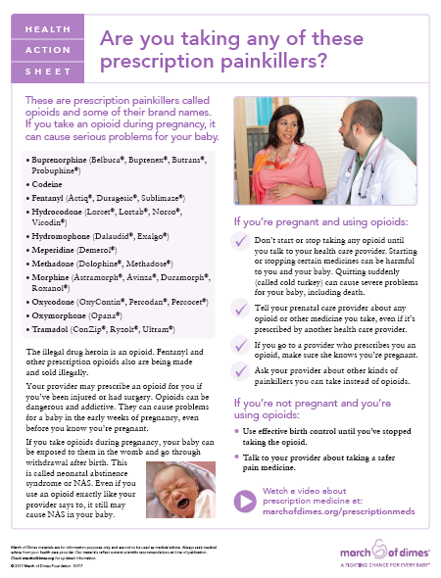
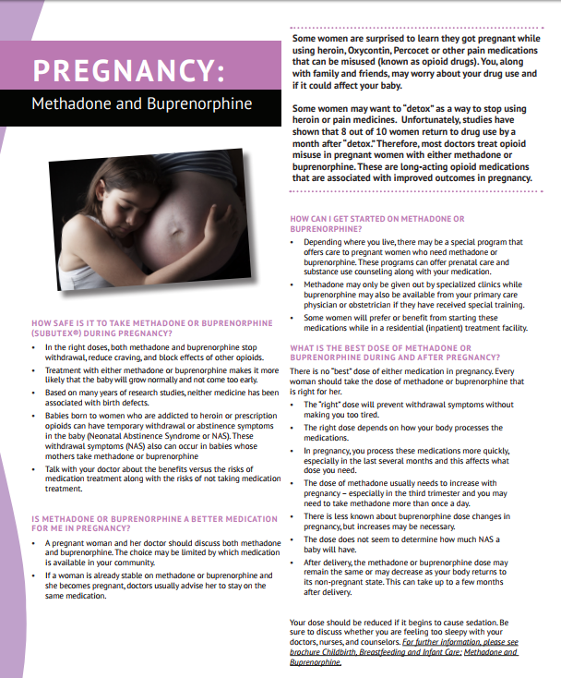
Resources: Patient Education
Sources: https://www.marchofdimes.org/pregnancy/prescription-opioids-during-pregnancy.aspx
https://pcss-o.org/wp-content/uploads/2015/10/WAGBrochure-Opioid-Pregnancy_Final.pdf
Created by ACOG District II in 2018

Slide 91
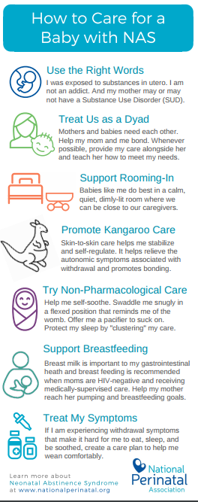

Resources: Patient Education
Sources: Catholic Health Women Care
National Perinatal Association
Created by ACOG District II in 2018

Slide 92
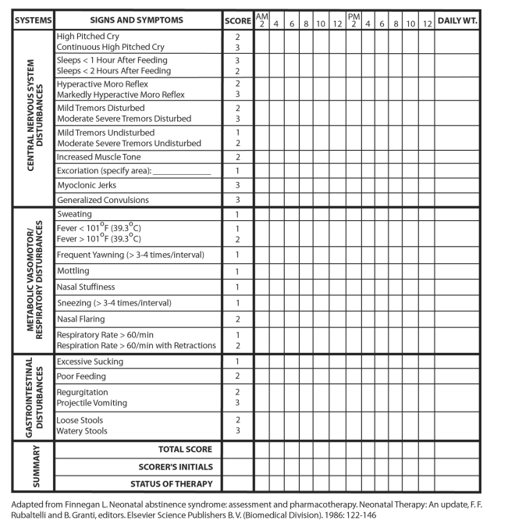
Resources: Provider Tools – NAS Scoring
EXAMPLE
Created by ACOG District II in 2018
Notes:
Speaker Notes:
The screening tool is used IN THE NICU and when scores improve, the baby can go home.

Slide 93
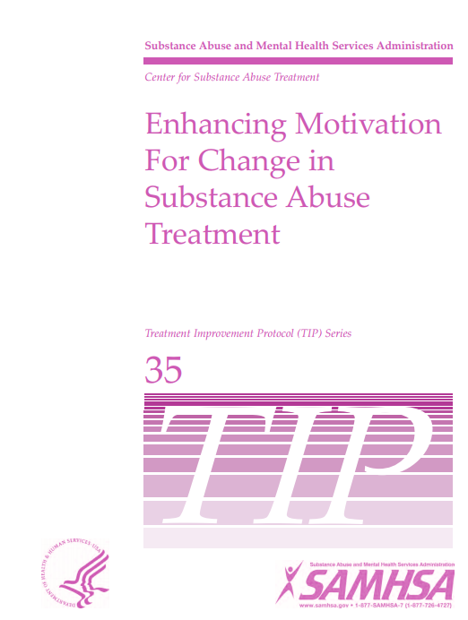
Resources: Provider Tools – Motivational Interviewing
Motivational Interviewing: Motivational interviewing is a therapeutic style intended to help clinicians work with clients to address their ambivalence. While conducting a motivational interview, the clinician is directive yet client centered, with a clear goal of eliciting self-motivational statements and behavioral change from the client, and seeking to create client discrepancy to enhance motivation for positive change.
Source: https://store.samhsa.gov/shin/content//SMA13-4212/SMA13-4212.pdf
Created by ACOG District II in 2018

Slide 94
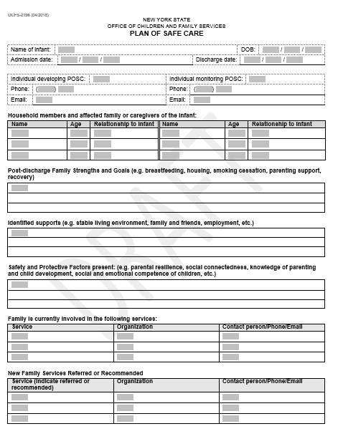
Resources Providers: Plan of Safe Care
EXAMPLE
Final Coming Soon
Created by ACOG District II in 2018

Slide 95
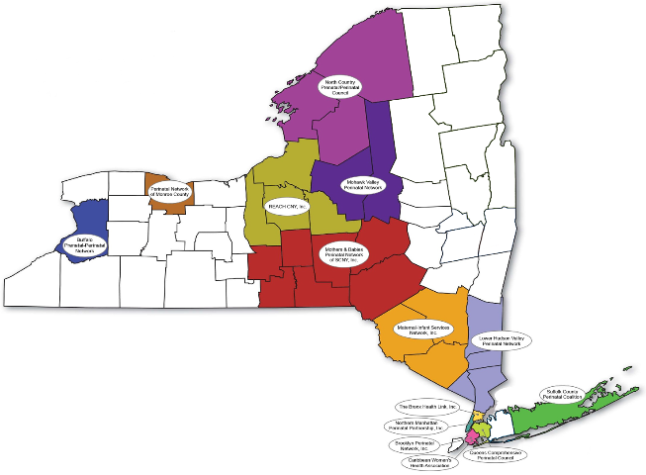
Resources: Provider Tools – Perinatal Networks
Perinatal networks can serve as a valuable community resource:
Knowledge of local programs that a woman can utilize for various medical and social needs.
May have home visiting programs or can provide a warm connection.
Serve as a maternal child health resource referral network.
Referral to community connections and with the employ of Community Health Workers (CHW)
  CHW’s can help identify other community resources that might come up such as WIC, SNAP, childcare, parenting etc.
Follow up after a direct referral for more information about support services.
Created by ACOG District II in 2018
Notes:
Speaker Notes:
There are currently 14 perinatal networks located throughout New York State. All of the networks coordinate services that are needed by infants, women of childbearing age, and families to assure that appropriate services are available and accessible.
Consulting with your Regional Perinatal Center (RPC) may be helpful to identify Perinatal Networks in your region.

Slide 96
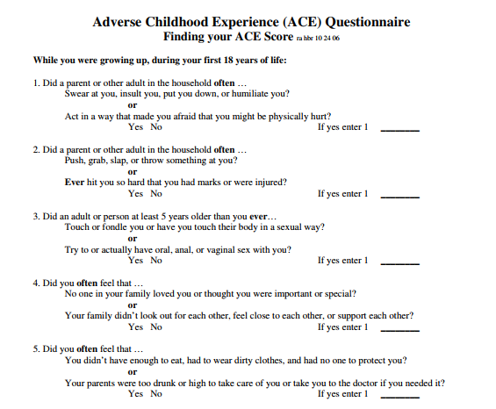
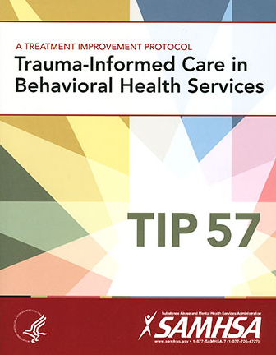
Resources: Provider Tools – Trauma Informed Care
Source: https://www.ncjfcj.org/sites/default/files/Finding%20Your%20ACE%20Score.pdf
https://store.samhsa.gov/product/TIP-57-Trauma-Informed-Care-in-Behavioral-Health-Services/SMA14-4816
Created by ACOG District II in 2018
Notes:
Speaker Notes: A FEW QUESTIONS:
While you were growing up, during your first 18 years of life:
1. Did a parent or other adult in the household often …
Swear at you, insult you, put you down, or humiliate you?
or
Act in a way that made you afraid that you might be physically hurt?
Yes No If yes enter 1 ________
2. Did a parent or other adult in the household often …
Push, grab, slap, or throw something at you?
or
Ever hit you so hard that you had marks or were injured?
Yes No

Slide 97
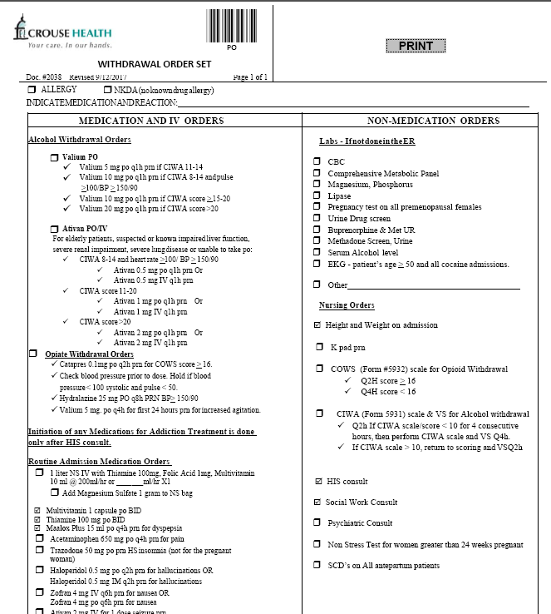
Resources: Provider Tools – Withdrawal Order Set
EXAMPLE
Source: Crouse Health Withdrawal Order Set
Created by ACOG District II in 2018

Slide 98

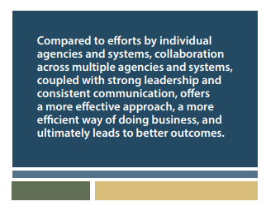
Resources: Provider Tools – Collaborative Approach
Source: https://store.samhsa.gov/product/A-Collaborative-Approach-to-the-Treatment-of-Pregnant-Women-with-Opioid-Use-Disorders/SMA16-4978
Created by ACOG District II in 2018

Slide 99
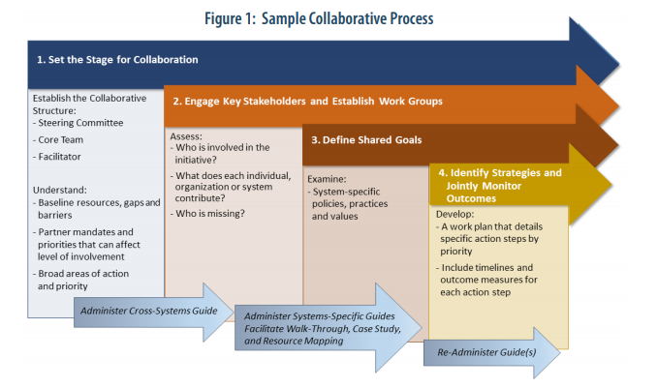
Resources: Provider Tools
Source: https://store.samhsa.gov/product/A-Collaborative-Approach-to-the-Treatment-of-Pregnant-Women-with-Opioid-Use-Disorders/SMA16-4978
Created by ACOG District II in 2018

Slide 100
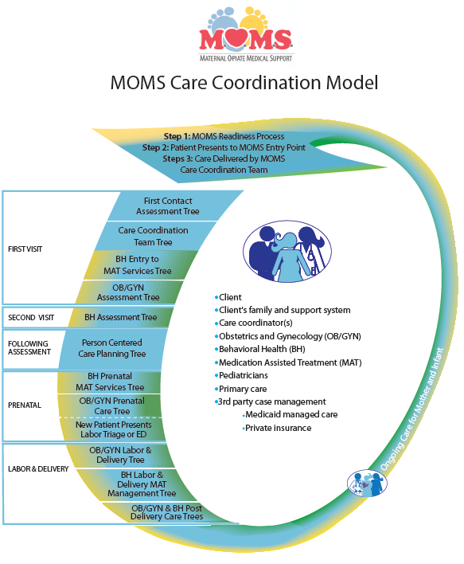
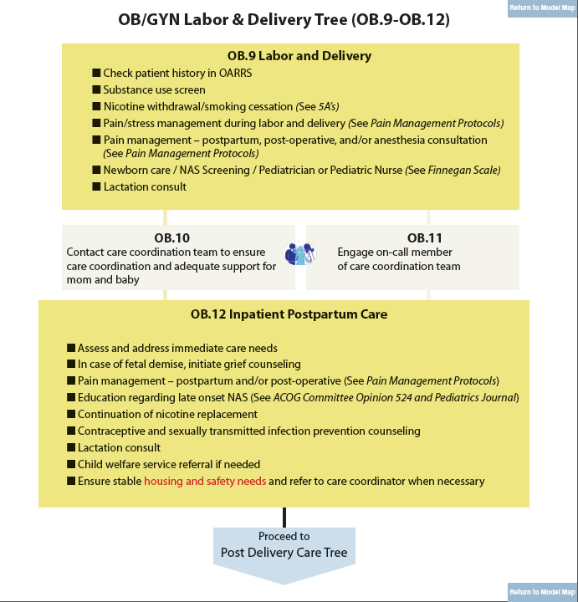
Resources: Provider
Source: http://momsohio.org/healthcare-providers/decision-trees/decisiontree-attributes/MOMS-Decision-Tree_F3_12-8-15.pdf
Created by ACOG District II in 2018

Slide 101
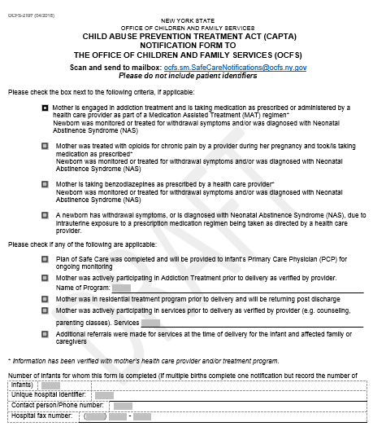
Resources: Provider Tools – CAPTA Notification
EXAMPLE
Final Coming Soon
Created by ACOG District II in 2018

Slide 102
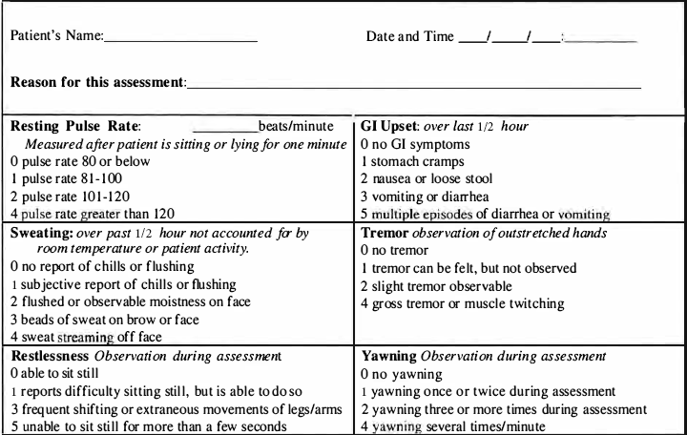
Clinical Opiate Withdrawal Scale (COWS)
EXAMPLE
Source: https://www.drugabuse.gov/sites/default/files/files/ClinicalOpiateWithdrawalScale.pdf

Slide 103
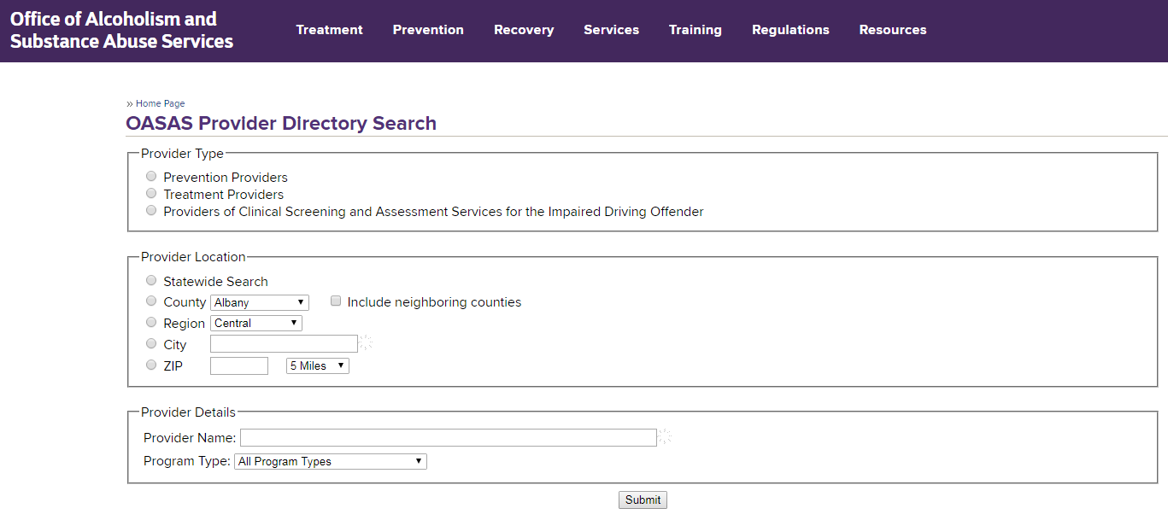
Resources: Provider Directory
Sources: https://apps.oasas.ny.gov/reports_doc/TreatmentDirectory.pdf
https://oasas.ny.gov/providerDirectory/index.cfm
Created by ACOG District II in 2018

Slide 104
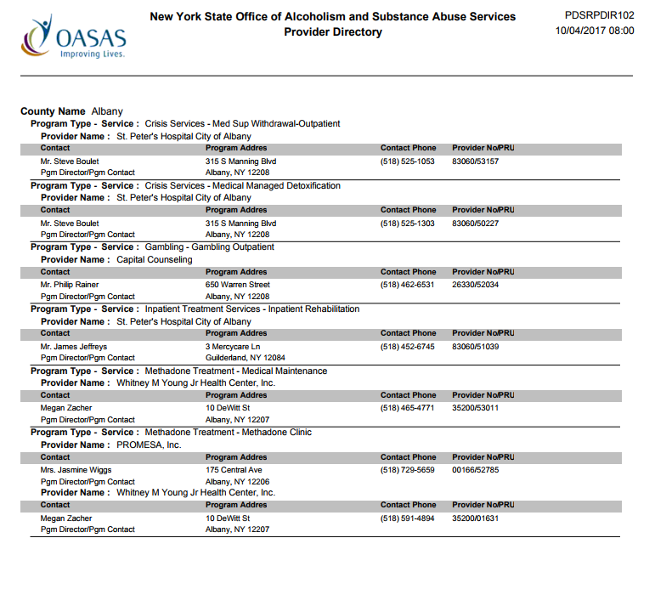
Resources: Provider Directory
Sources: https://apps.oasas.ny.gov/reports_doc/TreatmentDirectory.pdf
https://oasas.ny.gov/providerDirectory/index.cfm
Created by ACOG District II in 2018

Slide 105
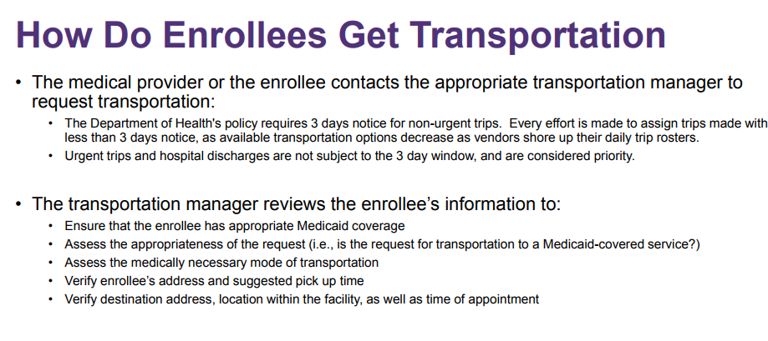
Resources: Medicaid Transportation Services
New York State Medicaid Cab Services
Currently the Department contracts with two Transportation Managers
• Medical Answering Services, LLC • All Counties North of NYC - https://www.medanswering.com (800) 850-5340 (24 hours a day, 7 days a week)
• LogistiCare Solutions, LLC
New York City - http://www.nycmedicaidride.net (877) 564-5911 (24 hours a day, 7 days a week)
Long Island - https://www.longislandmedicaidride.net (844) 678-1101 (24 hours a day, 7 days a week)
Created by ACOG District II in 2018
Notes:
https://www.health.ny.gov/health_care/medicaid/redesign/dsrip/docs/2015-12-17_medtrans_overview.pdf
Questions, Comments, Concerns Department of Health Medicaid Transportation Unit medtrans@health.ny.gov (518) 473-2160

Slide 106
Additional Resources
ACOG Maternal Opioid Bundle
http://safehealthcareforeverywoman.org/patient-safety-bundles/obstetric-care-for-women-with-opioid-use-disorder/
ACOG Maternal Opioid Bundle Resource Listing
http://safehealthcareforeverywoman.org/wp-content/uploads/2017/08/Obstetric-Care-for-Women-with-Opioid-Use-Disorder-Bundle_Resource-Listing.pdf
Buprenorphine Waiver Training Resources
https://elearning.asam.org/products/the-asam-buprenorphine-course-acog march-3-2017
https://pcssnow.org/clinical-coaching/
https://pcssnow.org/resources/
Guidance for Treating Pregnant and Parenting Women with OUD and Their Infants
https://store.samhsa.gov/shin/content/SMA18-5054/SMA18-5054.pdf
HANYS Opioid Addiction Prevention & Management Collaborative
https://www.hanys.org/quality/collaboratives_and_learning_networks/opioids/
Medications for OUD
https://store.samhsa.gov/shin/content/SMA18-5063FULLDOC/SMA18-5063FULLDOC.pdf
SBIRT
http://bigsbirteducation.webs.com/addictionwebinars.htm
https://www.integration.samhsa.gov/clinical-practice/sbirt#why
http://www.sbirtoregon.org/
The Alcohol Use Disorders Identification Test (AUDIT)
https://www.integration.samhsa.gov/clinical-practice/sbirt/AUDIT_Manual,_2.pdf
Created by ACOG District II in 2018

