Slide 1
Stanching for Flow:
Lowering Maternal Mortality from Obstetrical Hemorrhage
J. Christopher Glantz, MD, MPH
Professor of OB/GYN and Public Health Sciences
Division of Maternal-Fetal Medicine
University of Rochester Medical Center

Slide 2
The Good News
 | https://www.cdc.gov/mmwr/preview/mmwrhtml/mm4838a2.htm

Slide 3
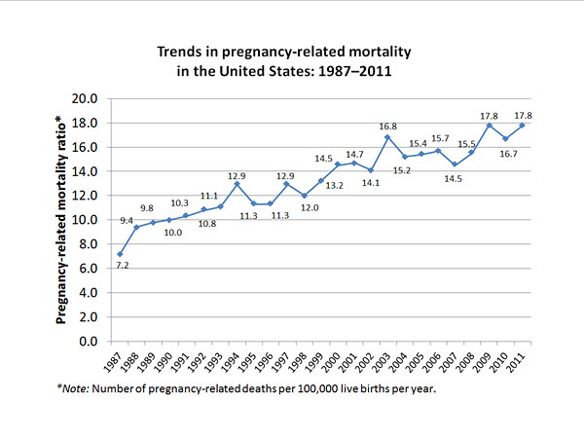
The Not-So-Good News
02
02
CDC 2014

Slide 4
NYS Maternal Mortality Rates by Region: 1987- 2002
6.6 in Upstate New York
20.3 in NYC
12.9 in NYS
*Per 100,000 livebirths
Notes:
(NYS, Upstate and NYC RATE WILL AUTOMATICALLY APPEAR)
(REFER TO SLIDE)
There is a wide divergence on maternal mortality rates around the state. The next slide will show the specific regional numbers of maternal deaths.
Source NYS Department of Health
(CLICK FOR NEXT SLIDE)

Slide 5
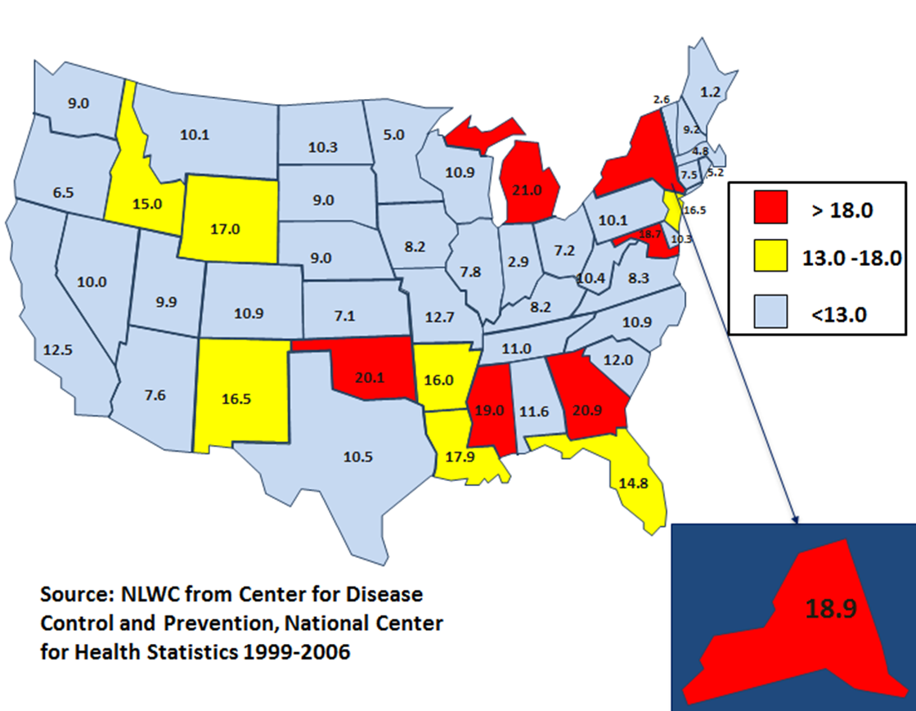
US Maternal Mortality New York State Ranked 47th out of 50 States
(per 100,000 liveborn infants)
Notes:
Now that I have provided you with an overview of the materials you’ve received as part of the SMI, I want to talk with you about their impetus. Why the SMI and why now?
This map demonstrates individual state maternal mortality rates. New York State Ranked 47th out of 50 States. New York’s death rate of 18.9 per 100,000 places it among the highest in the country and is about double that of most other states.
Only a small minority of states approach New York’s maternal mortality rate.

Slide 6
2002 NYS Review (NYSDOH, ACOG, MSSNY)
Strengthen regionalization of maternity care
Reduce the number of high-risk pregnancies
Maximize ascertainment of maternal deaths
Continue in-depth reviews of maternal deaths
Educate community hospital staff on the maternal death review process
Educate ER staff on obstetrical emergencies

Slide 7
Safe Motherhood Initiative: Initial Goals and Objectives
Identify causes of maternal death using standard protocols
Create quality assurance recommendations for implementation at RPC and affiliate hospitals
Promote prevention of maternal mortality by increasing awareness and education

Slide 8
SMI Findings
Voluntary reporting and review of maternal deaths between 2007 and 2009 (until funding ended)
A minority of deaths actually were reported and reviewed
But of those reviewed, a significant number of deaths were judged potentially preventable

Slide 9
SMI Recommendations
Establish a statewide, standardized, mandatory reporting and review system of pregnancy-related deaths
All OB units must have a post-anesth care unit (PACU) protocol
Promote the practice of multidisciplinary care in patients with co-existing morbidities.
Educate all OB staff in early recognition of critical conditions – septic shock, hemorrhage, thromboembolism, and severe pregnancy-related hypertension – and how to rapidly respond and treat these conditions

Slide 10
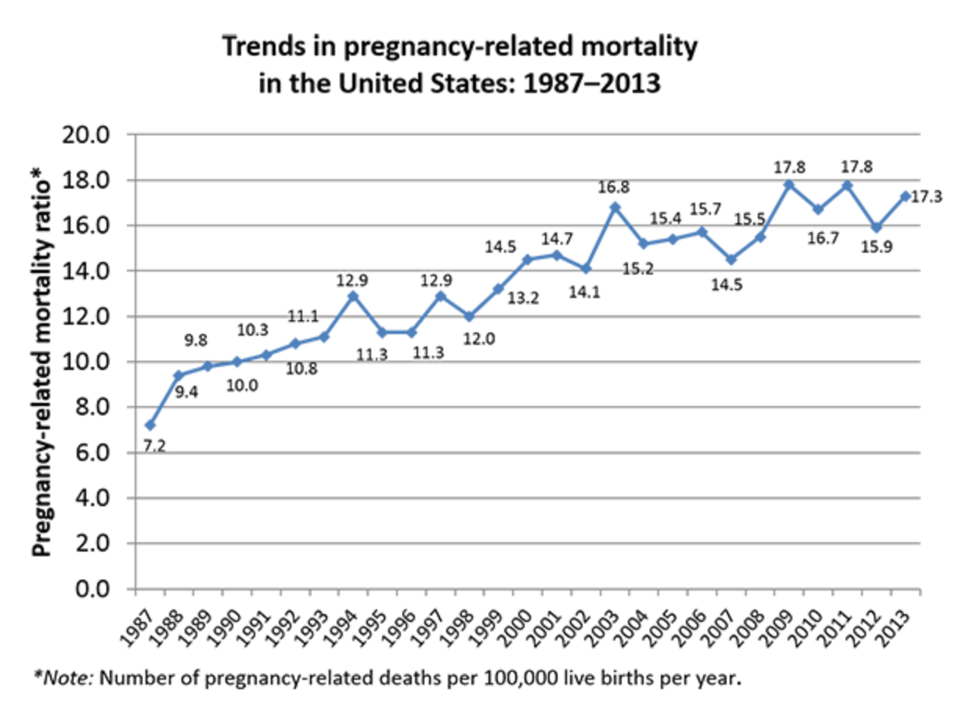
2017: www.cdc.gov/reproductivehealth/maternalinfanthealth/pmss.html

Slide 11
Possible Reasons
Changes in reporting
Pregnancy checkboxes on death certs
Greater awareness
Increasing maternal morbidities
Obesity, DM, HTN, ART, age, etc.
More inductions and cesareans
Socioeconomic, insurance, and patient factors
USA = #47 in maternal mortality of all countries
Trends in Maternal Mortality: 1990 to 2015.
http://apps.who.int/iris/bitstream/handle/10665/194254/9789241565141_eng.pdf;jsessionid=F735614920D87419B998E67D48C4179A?sequence=1

Slide 12
Hospital Protocol Review
2011: “Merck for Mothers” commits financial support for further work on maternal mortality
2011-13: ACOG District II requested and reviewed 90 hospital emergency protocols
Wide variation in content and evidence-base

Slide 13
Pregnancy-Related Death United States 2011-13
https://www.cdc.gov/reproductivehealth/maternalinfanthealth/pmss.html

Slide 14
Potential Preventability
Hemorrhage: 50% - 93%
Hypertension: 28% - 60%
Thromboembolism: 17% - 50%
Sepsis: 43% - 73%
Berg et al. Obstet Gynecol 2005;106:1228
De La Rosa et al. Obstet Gynecol 2017;227:3S
Main EK et al. Obstet Gynecol 2015;125:938
Bauer ME et al. Obstet Gynecol 2015;126:747
Briller J. Obstet Gynecol 2017;129:819

Slide 15
SMI v2: 2013-present
A pro-active approach to prevention on morbidity and mortality
Underwritten by Merck for Mothers
Putting the “M” back in MFM (and MCH)
Began with focus on hemorrhage, hypertension, and venous thromboembolism
Workgroups developed bundles
D’Alton ME. AM J Obstet Gynecol 2013
Lu MC et al. Mat Child Health J 2015

Slide 16
The Concept of Bundles
The Institute for Healthcare Improvement (IHI) defines a bundle as a structured way of improving the processes of care and patient outcomes through a small, straightforward set of evidence-based practices—generally three to five—that, when performed collectively and reliably, have been demonstrated to improve patient outcomes
Notes:
The Institute for Healthcare Improvement (IHI) developed the concept of bundles to help health care providers more reliably deliver the best possible care for patients.
The IHI bundles for induction and augmentation and communication have been used successfully by many hospitals for obstetric care.

Slide 17
Participation
118 out of 127 New York State obstetric hospitals participating in the SMI
49 Level 1
26 Level 2
35 Level 3
18 RPCs
Ob-Gyn
Nursing
Anesthesia
Pediatrics
Critical Care
Cardiology
Family Practice
Midwifery
Hospital Administration
All major hospital associations
Notes:
Over the past 18+ months, clinical experts have gathered quarterly (8 meetings to date) and are representative of varying levels of hospital care across the state.
115 out of 127 NYS hospitals have confirmed agreements
The clinical group recommended that protocols to manage the 3 leading causes of maternal mortality (Hem, HTN, VTE) should be available at all centers providing OB care.
Standardizing and improving care for women experiencing conditions that are most likely to lead to maternal death has the potential to impact the statewide death rate.
This initiative involves work with multiple stake holders at each institution, including a wide range of clinicians and administrative leadership, as well as all major hospital associations.

Slide 18
Dissemination
“Bundle Boxes”
Binders
Cards and Posters
Videos
Websites
Meetings
Conference Calls
Startup and PR Incentives

Slide 19
Obstetric Hemorrhage “The 4 R’s”
RECOGNITION
READINESS
RESPONSE
REPORTING
Notes:
The “Key Elements” outlined here provide an overview of the components of the obstetric hemorrhage bundle. For information on how to further implement and incorporate this bundle within the obstetric unit, please refer to the introductory section of this toolkit for an overview of important clinical considerations.
These key elements remain the same despite some minor changes to the bundle.

Slide 20
Obstetric Hemorrhage: Key Elements “The 4 R’s”
RECOGNITION & PREVENTION (every patient)
Risk assessment
Prenatal, admission/intrapartum, postpartum
Transfer to appropriate level of care
Type & Screen versus Type & Cross
Universal active management of 3rd stage of labor
Notes:
The “Key Elements” outlined here provide an overview of the components of the obstetric hemorrhage bundle. For information on how to further implement and incorporate this bundle within the obstetric unit, please refer to the introductory section of this toolkit for an overview of important clinical considerations.
These key elements remain the same despite some minor changes to the bundle.

Slide 21
Risk Assessment: L&D Admission
EXAMPLE
Medium Risk
[ ] Prior cesarean, uterine surgery,
or multiple laparotomies
[ ] Multiple gestation
[ ] >4 prior births
[ ] Prior obstetric hemorrhage
[ ] Large myomas
[ ] EFW >4000 g
[ ] Obesity (BMI >40)
[ ] Hematocrit <30% & other risk
Type & SCREEN, review protocol
High Risk
[ ] Placenta previa/low lying
[ ] Suspected accreta/percreta
[ ] Platelet count <70,000
[ ] Active bleeding
[ ] Known coagulopathy
[ ] (2 or more medium risk factors)
Type & CROSS, review protocol
* Establish a culture of huddles for high-risk patients & post-event debriefing *
Notes:
No changes to this slide
TALKING POINTS (if needed):
Early opportunities for the recognition & prevention of obstetric hemorrhage exist for every patient. Risk assessment, anticipation, and planning occur during:
- Prenatal care
- Antepartum
- L&D admission
- Intrapartum developing risk
Examples of clinical situations that are known to increase a patient’s risk for hemorrhage include an abnormally adherent placenta, morbid obesity, clinically significant coagulopathies, and other situations such as a patient’s social/religious/personal choices in relation to receiving blood products.
Upon admission to Labor and Delivery, a patient’s obstetric hemorrhage risk status should be identified. Some examples of medium and high risk situations are outlined in these risk assessment tables.

Slide 22
How Much Blood Loss Is Too Much?
Estimated vs. Quantitative blood loss
Definitions vs. physiologic significance
Stages of hemorrhage/hypovolemia
Underestimation of EBL
Failure to respond until late
Collecting vs. weighing
Immediate vs. delayed blood loss

Slide 23
Obstetric Hemorrhage: Key Elements
READINESS (every unit)
Blood bank (massive transfusion protocol: MTP)
Cart & medication kit
Oxytocin, miso, 15-methyl PGF_{2α}, methylergonovine
Hemorrhage education & drills for staff
Notes:
The “Key Elements” outlined here provide an overview of the components of the obstetric hemorrhage bundle. For information on how to further implement and incorporate this bundle within the obstetric unit, please refer to the introductory section of this toolkit for an overview of important clinical considerations.
These key elements remain the same despite some minor changes to the bundle.

Slide 24
Blood Bank: Massive Transfusion Protocol
OB care institutions must have:
A Massive Transfusion Protocol (MTP)
Ability to quickly obtain 6 units PRBCs and 4 units FFP
Ability to obtain O-neg blood immediately
Established systems between L&D and BB to activate MTP
Emergency Release Protocol and mechanisms to obtain platelets and additional products in a timely fashion
Blood transfusion or cross-matching should not be used as a negative quality marker
Notes:
CHANGES MADE (indicated in red):
Removed “P” in “PRBCs” throughout the bundle to be consistent with national blood bank association language.
Added sentence from a new draft statement that will be sent in a letter to hospital CEOs/CMOs and also included in an additional guidance document.
Anecdotally, some SMI hospitals have noted the difficulty in retrieving blood in the event of an obstetric emergency due to a lack of overall awareness of the need for blood products on the L&D unit.
TALKING POINTS (if needed):
Multidisciplinary coordination and preparation, particularly with the anesthesiology team and blood bank, is critical in order to provide safe obstetrical care. When the anesthesiology team is not present at the initial moments of the hemorrhage (i.e., many non-cesarean hemorrhage cases), they should be called IMMEDIATELY.
The first step in ensuring the usefulness of an MTP is to have established with the blood bank what situation would trigger the release of large amounts of products. The blood bank will clearly need assurance that a “senior” person is on board and has determined the need for the products. While the essence of the communication should be uniform across hospitals, the details around personnel, phone, forms, etc. may vary.
To activate the MTP, individuals must be immediately made aware of the number to call and clear language should be used, such as “activate massive transfusion protocol.” Conversely, a mechanism/signal for cancelling the request for large amounts of products should be embedded in any hospital protocol.
Stat labs should include:
• Type & crossmatch if not already done
• Hemoglobin and platelet count, PT(INR)/PTT, fibrinogen
• Arterial blood gas as needed
• Point of care testing for ABG/Hg/electrolytes may be useful
In the case of large blood loss and anticipation of ongoing blood loss, transfusion should be initiated without waiting for blood work. Also, time should not be wasted trying to send blood and/or start A-line if this is difficult; starting a second IV is more important. The most important blood work in this situation is to send a blood sample to the blood bank so that the patient can be typed and screened/crossmatched if it has not already been done.
If an immediate transfusion is not indicated, continue conventional resuscitation with IV fluids and ongoing evaluation.

Slide 25
Recommended Instruments Hemorrhage Cart
EXAMPLE
Vaginal
Cesarean/Laparotomy
[ ] Vaginal retractors; long weighted speculum
[ ] Long instruments (needle holder, scissors, Kelly clamps, sponge forceps)
[ ] Intrauterine balloon
[ ] Banjo curette
[ ] Bright task light
[ ] Procedural instructions (balloon)
[ ] Hysterectomy tray
[ ] #1 chromic or plain catgut suture & reloadable straight needle for B-Lynch sutures
[ ] Intrauterine balloon
[ ] Procedural instructions (balloon, B-Lynch, arterial ligations)
Notes:
No changes to this slide.
TALKING POINTS (if needed):
Both the cart and the medication kit should include copies of the institution’s hemorrhage protocol, checklist, flowsheet, and debriefing tool.
As two of the medications (Hemabate and Methergine) need refrigeration, it is critical that staff know where these are stored.
Another source for additional medications should be immediately available 24 hours a day/7 days a week in the event that additional doses are needed, or the primary supply is not replaced when used.
25

Slide 26
Obstetric Hemorrhage: Key Elements
RESPONSE (every hemorrhage)
Checklist
Support for patients/families/staff for all significant hemorrhages
Notes:
The “Key Elements” outlined here provide an overview of the components of the obstetric hemorrhage bundle. For information on how to further implement and incorporate this bundle within the obstetric unit, please refer to the introductory section of this toolkit for an overview of important clinical considerations.
These key elements remain the same despite some minor changes to the bundle.

Slide 27
Hemorrhage Checklist
EXAMPLE
RECOGNITION
Call for assistance (obstetric hemorrhage team)
Designate
Team leader
Checklist reader/recorder
Primary RN
Announce
Cumulative blood loss
Vital signs
Determine stage
Notes:
TALKING POINTS:
While this is technically a “new” checklist, no substantial clinical changes have been made to it other than the change in oxytocin dosing.
In addition to the old format being tested during simulations at Montefiore Medical Center, hospitals have indicated that the previous iteration was difficult to read and not useful in the middle of an emergency.
The hemorrhage workgroup has streamlined all stages of the checklist by eliminating unnecessary wording and ensuring readability.
27

Slide 28
Obstetric Hemorrhage: Key Elements
REPORTING / SYSTEMS LEARNING (every unit)
Huddles & debriefs
What was done well and what could be improved
Were checklists and processes used effectively?
Did the team function cohesively? Were roles understood?
Was communication clear?
Multidisciplinary review of serious hemorrhages
Monitor outcomes & processes metrics
Notes:
The “Key Elements” outlined here provide an overview of the components of the obstetric hemorrhage bundle. For information on how to further implement and incorporate this bundle within the obstetric unit, please refer to the introductory section of this toolkit for an overview of important clinical considerations.
These key elements remain the same despite some minor changes to the bundle.

Slide 29
Team Training
Teams are key in handling emergencies
Defined roles
Know what to do in advance
Interactions and trust
Confidence in ability
Preparation and review

Slide 30
Team Training and Simulation
Experience comes at a cost
Best to learn before an emergency!
Multidisciplinary
OB, Peds, Anesthesia, Nursing
Focus on roles and interactions
Facilitators and video
Debrief and discuss afterwards

Slide 31
Tracking and Reporting (every unit)
Monitor outcomes and processes metrics
Track (severe) hemorrhages and outcomes
Transfusions, ICU admits, death
Review data to identify improvements and areas for further improvement
Notes:
No changes made to this slide
TALKING POINTS (if needed):
Huddle: a brief gathering of team to make sure everyone is “on the same page”
May be done in many ways:
––Throughout the shift at set time intervals
––Ad hoc as acuity changes
––Important to have at least 1 major huddle during each shift (so at least 2-3 times daily depending on schedule)
Pick a time with the multidisciplinary team that works well for all
––Keep track of whether it occurred and who attended initially
Debriefing can be done after each case, but is critical after a major event for multiple reasons:
––Team able to gather and review the event together
––May help to uncover systems issues
––Important for all team members to be heard
Identify events that should trigger a debrief at your institution
––Use a template
––Pick a time and place with the multidisciplinary team that works well for all
––Keep track of whether it occurred and who attended initially
––Record systems issues uncovered

Slide 32
Progress
Bundles adopted/adapted to varying degrees by hospitals
Data on hemorrhage and maternal deaths tracked
122,738 deliveries from Sept 2014 – April 2015
0.1% - 0.2% ICU admit or hyst
0.3% received ≥4 units blood
Only 1 reported maternal death from hemorrhage (2-3 “expected”)

Slide 33
Data Interpretation Issues
Hemorrhage incidence
Accuracy of assessment
Transfusions and ICU admits
Thresholds versus morbidity
Deaths
Accuracy of reporting
Small numbers

Slide 34
NYSDOH Tracking
71 Participating hospitals
Documentation of maternal hemorrhage risk assessment increased by 171%, from 27% at baseline (April 2014) to 72% in September 2015
Current tracking
Hemorrhage incidence and morbidities
Risk assessment
Drills
Debriefs

Slide 35
Summary
NYS has improved to #30 nationally (2016)*
Although the maternal mortality ratio increased from 18.9 in 2010 to 20.9 in 2016
Change takes time: difficult to track effectiveness of hemorrhage initiatives
Keeping hemorrhage “on the radar”
Continued progress requires continued funding to expand scope beyond hemorrhage
ACOG and NYSDOH collaboration is essential
*https://www.americashealthrankings.org/explore/health-of-women-and-children/measure/maternal_mortality/state/NY?edition-year=2016

