Slide 1
PERINATAL REGIONALIZATION
Looking Back and Moving Forward in New York State

Slide 2
Perinatal Regionalization is an comprehensive, coordinated geographically structured system of care organized around a series of Regional Perinatal Centers (RPCs), each supporting and providing clinical expertise, education and quality improvement to a group of affiliate birthing centers and hospitals.

Slide 3
Perinatal Regionalization
Toward Improving the Outcomes of Pregnancy I (1976) - first promoted the concept of regionalization to improve outcomes.
Toward Improving the Outcomes of Pregnancy II (1993) – emphasized the importance of care prenatally through infancy.

Slide 4
Perinatal Regionalization

Slide 5
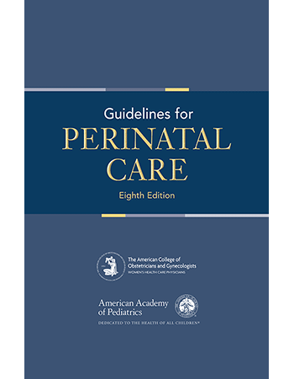
Perinatal Regionalization
Professional organizations also strongly support regionalized care
American Congress of Obstetricians and Gynecologists (ACOG)
American Academy of Pediatrics (AAP)

Slide 6
Levels of Perinatal Regionalized Care
Regional Perinatal Center (RPC)
Provides the highest level of care
Level III
Provides care to high risk women and neonates with subspecialty services
Level II
Provides care to moderately complicated women and neonates
Level I
Basic care for low risk women and newborns
No neonatal intensive care unit services.

Slide 7
Why Perinatal Regionalization?
To ensure that women and their babies will have ready access to the services they need through:
Ensuring access to an expert health care team
Maximizing resources of the various facilities across the state – centralizes technology
Allows for ongoing quality improvement to better ensure quality services across all levels of perinatal care.

Slide 8
Ultimate Goals of Perinatal Regionalization
Decrease maternal morbidity and mortality
Decrease infant morbidity and mortality

Slide 9
Regionalization in New York State
1985: Office of Health Systems Management (OHSM) initiates “appropriateness review” examining delivery of high technology services, including high risk neonatal services
1985- 1990: research underscores efficacy of regionalization and improvement of outcomes for high risk mothers and neonates

Slide 10
Regionalization in New York State
1996 – 1997: Perinatal ad hoc work group convened responding to concerns about managed care and consulting/transfer agreements
1998: DOH workgroup develops designation criteria, regulations, and Statewide Perinatal Data System (SPDS)

Slide 11
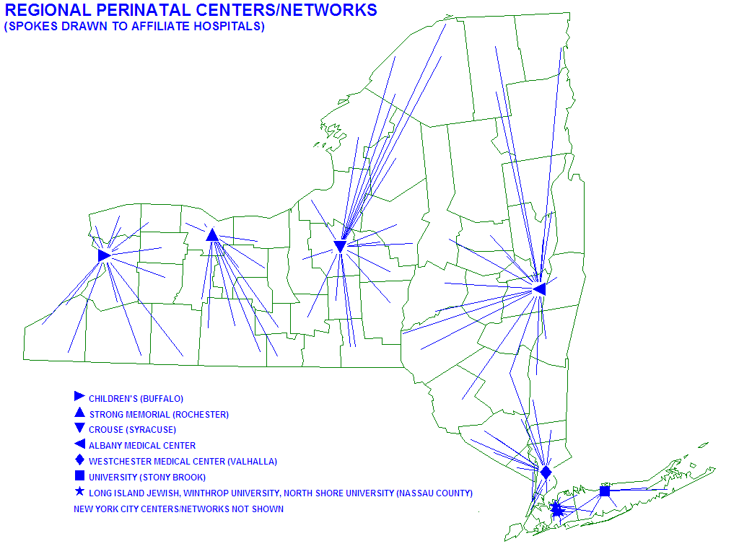
Perinatal Regionalized System in NYS

Slide 12
New York State Regional Perinatal Centers
1 | John R. Oishei Children’s Hospital
2 | Strong Memorial Hospital
3 | Crouse Hospital
4 | Albany Medical Center
5 | Westchester Medical Center
6 | Montefiore Med Center- Jack D Weiler Hospital of A Einstein College Div
7 | Maimonides Medical Center
8 | Mount Sinai Hospital
9 | NYU Langone Hospital Center
10 | New York Presbyterian- New York Weill Cornell Center
11 | New York Presbyterian- Columbia Presbyterian Center
12 | NYCHHC Bellevue Hospital Center
13 | University Hospital of Brooklyn
14 | Long Island Jewish Medical Center
15 | North Shore University Hospital
16 | University Hospital (Stony Brook)
17 | NYU Winthrop Hospital

Slide 13
Outcomes for Newborns in New York State
New York’s infant mortality rate decreased from 5.8 deaths per 1,000 live births in 2005 to 4.6 deaths per 1,000 live births in 2015.
Neonatal mortality rates decreased from 4.2 deaths per 1,000 live births in 2004 to 3.1 deaths per 1,000 live births in 2015.
Post-neonatal mortality rates remained steady at 1.6 per 1,000 births for several years and then decreased to 1.4 per 1,000 live births in 2013.
Since 2009, 90% of very low birthweight infants born in New York State have been delivered in hospitals than have a Level III or higher designation.

Slide 16
RISK ADJUSTED VLBW NEONATAL MORTALITY RATES BY DESIGNATED PERINATAL LEVEL 6-YEAR PRE (INITIAL) AND POST & 3-YEAR FOLLOW UP
 | PRE (INITIAL) 1996-2001 | POST 2004-2009 | FOLLOW UP 2010-2012
RPC | 12.5%* | 10.2%* | 9.7%
LEVEL III | 13.4%** | 11.6% | 11.1%
LEVEL II | 12.6% | 13.4%** | 12.9%
LEVEL I | 17.3%** | 14.6% | 13.0%
Undesignated | 13.9% | N/A | N/A
Statewide | 13.0% | 11.0% | 10.5%
*Significantly lower than statewide rate
**Significantly higher than statewide rate

Slide 17
Outcomes for Pregnant/Postpartum Women in New York State
In 2015 approximately 337,000 pregnancies were documented with 235,000 births with nearly 50% unplanned or mistimed.
In 2016, New York ranked 30th in maternal deaths out of 50 States.
Leading causes of maternal death include embolism, hemorrhage, infection, cardiac disorders and hypertension.
In New York, Black women are 3.4 times more likely to die than White women.
Severe maternal morbidity (SMM) occurs approximately 100 times more frequently than maternal mortality.
The rate of SMM increased from 172.7 per 10,000 delivery hospitalizations in 2008 to 238.5 per 10,000 delivery hospitalizations in 2014.

Slide 18
Trends in Maternal Mortality as Reported in Vital Records* Maternal deaths within 42 days of end of pregnancy
*Causes of death from death records A34, O00-O95,O98-O99.

Slide 19
Trends in Maternal Mortality as Reported in Vital Records* Maternal deaths within 42 days of end of pregnancy
*Causes of death from death records A34, O00-O95,O98-O99.

Slide 20
Women’s Health in New York State
Data from NY’s Behavioral Risk Factor Surveillance System demonstrate that report a variety of health conditions:
Overweight and obesity (46%)
Physical inactivity (24%
Depression (19%)
Binge drinking (18%)
Tobacco use (17%)
High blood pressure (9%)
Diabetes (3%)
Physical, mental or emotional disability (14%).

Slide 21
Question
Is the current system of perinatal hospital care in New York State where it needs to be to care for New York’s women and newborns?

Slide 22
Perinatal Redesignation
Changes in:
Maternal and neonatal standards of care
Hospital capacity, realignments and affiliations
Changing demographics and birth rates
Landscape of health care

Slide 23
Perinatal Designations Then (2003) and Now (2018)
Designated Level | 2003 | 2018
Regional Perinatal Centers | 17 (including 2 joint pairs) | 17 (individual centers)
Level III | 34 | 34
Level II | 28 | 26 (includes one designated in 2017)
Level I | 72 | 46
Total Maternity Hospitals | 151 | 123

Slide 24
NYS Birthing Centers
Center Name | Location
Buffalo Women's Services | Buffalo
Brooklyn Birthing Center | Brooklyn
The Birthing Center of New York | Brooklyn

Slide 25
Perinatal Regionalization - Objective
To improve the quality of care for all pregnant and postpartum women and newborns in New York State in birthing centers and birth hospitals in accordance with current standards for perinatal care.

Slide 26
Process for Developing Standards Recommendations
Identified current standards of perinatal care
Guidelines for Perinatal Care – 8th Edition; ACOG Obstetric Care Consensus – Levels of Maternal Care; Commission for Accreditation of Birth Centers
ACOG – Society of Maternal Fetal Medicine Obstetric Care Consensus Panel – Levels of Maternal Care; and literature review.
NYSDOH convened 49 member Expert Panel including:
Representatives from RPCs, Level I, II and III perinatal hospitals
Partners such as NYS Association of Licensed Midwives, March of Dimes, hospital associations, health plans, and other partners.
National organizations including Association of Women’s Health, Obstetric and Neonatal Nurses (AWHONN) and ACOG representative for Maternal Care Consensus.

Slide 27
Process for Developing Standard Recommendations
Expert Panel
Co-chairs
Christa Christakis, MPP, Executive Director, ACOG-NY
Dr. Greg Young, FACEP, Assistant Commissioner, Western Region, NYSDOH
Facilitator
Dr. Clare Bradley, Chief Medical Officer, IPRO

Slide 28
Levels of Perinatal Regionalized Care
Regional Perinatal Center (RPC)
Level III
Level II
Level I
Birthing Center

Slide 29
General Components of Standards
Staffing
Agreements, Policies and Procedures
Facility Capabilities
Role of RPC
Quality Improvement
Case Volumes and acuity

Slide 30
Process for Developing Standard Recommendations
Expert Panel
Three in-person meetings of the full panel
September 2017, March and May 2018
Panel Subcommittees include:
Role of the Regional Perinatal Center and Affiliation Agreements
Transfers
Neonatal Services
Behavioral Health
Subspecialists
Finance
Panel is providing recommendations for NYSDOH consideration.

Slide 31
Standard Recommendations Topics
Recommendations cover requirements for:
Staffing of birthing centers and level of perinatal care
Chiefs of services – maternal fetal medicine and neonatology
Anesthesiology
Advanced practitioners – midwives, nurse practitioners, physician assistants, nursing.
Subspecialists – cardiology, hematology, infectious disease, genetics, nephrology, endocrinology, gastroenterology, nutrition, radiology, pulmonology, immunology, pharmacology and adult and neonatal – pediatric surgical and subspecialists.
Social work and mental health services.
Therapists – physical and occupational therapy, speech pathology.

Slide 32
Standard Recommendations Topics
Recommendations cover requirements for:
Staff requirements for basic life support, advanced cardiac life support, neonatal resuscitation program and lactation training.
Facility capabilities
Anesthesia, respiratory, radiology and laboratory services.
Pharmacy services.
Intensive Care Unit – Critical Care services.
Neonatal Intensive Care Unit services.
Role of RPC and affiliation agreements
Transfer agreements
Behavioral health
Finance

Slide 33
Standard Recommendations - Under Discussion
Acuity and volume standards – Current regulations require:
A minimum of high-risk newborn and maternal days for Levels II, II and RPCs.
A minimum of 8,000 births in a RPC and affiliate region.
A minimum case mix index for high risk newborn and maternal patients.
A minimum number of NICU beds for Levels II, III and RPCs.
Staff are examining maternal and neonatal morbidity and mortality data and reaching out to other states to determine what, if any, standards should be incorporated

Slide 34
Standard Recommendations – Under Discussion
Finance Subcommittee working with the Office of Health Insurance Program (OHIP) and Department of Financial Services (DFS) to discuss topics such as:
Transfers to out-of-network hospitals
Transfers of mother when newborn is transferred for higher level of care and vice versa
Back transfers to lower level hospitals when higher level of care is no longer needed.
Other topics/areas impacting payment.

Slide 35
Next Steps
Complete subcommittee meetings to resolve outstanding issues
Review expert and subcommittee recommendations and present final updated standard recommendations to the full expert panel
Initiate the development of standard metrics to assess maternal and neonatal outcomes.
Develop and issue preliminary on-line survey to assess impact of new standards on current perinatal hospital system - Summer/Fall 2018
Notice of Proposed Rulemaking (NPRM) under development- Summer 2018.
Webinar Presentations and Training on Proposed Standards to Providers – Fall/Winter 2018/ Early 2019

Slide 36
Next Steps
Issue final designation survey to birthing centers and obstetrical hospitals - Spring Summer 2019
On-site visits - Summer – Fall 2019
All perinatal hospitals requesting RPC status
All perinatal hospitals requesting Level III status
A selection of perinatal hospitals requesting birthing center, Level I and II status
Final regulations posted for public comment - Spring 2020
Finalize standard metrics to assess maternal and neonatal outcomes.

Slide 37
Perinatal Regionalization Metrics
Perinatal metrics will provide a mechanism to assess quality of the system including, but not limited to:
Compare and contrast outcomes by various levels or affiliative regions
Identify high level performers and quality practice
Identify potential issues with performance
Identify areas for quality improvement.

Slide 38
New York’s Commitment
"New York is committed to ensuring that women receive high quality health care at every stage of their lives, and with these new, comprehensive efforts, we are once again taking action to break down barriers to health care access and provide skillful and compassionate care to all New Yorkers." (Governor Andrew Cuomo)

