Slide 1
New York State’s Health Care Transformation: Perinatal Care & the Path to Medicaid Payment Reform through Value-Based Payments
Douglas G. Fish, MD Medical Director, Division of Program Development and Management
Office of Health Insurance Programs
Office of Health Insurance Programs, NYSDOH
June 7, 2018

Slide 2
Agenda
Terminology
DSRIP Program to Value-Based Payment
Target Budget Adjustments & Distribution of Shared Savings - Examples
Measuring Performance for VBP Arrangements
VBP Quality Measurement in 2018

Slide 3
Terminology
Behavioral Health – Encompasses Mental Health or Substance Use conditions
Efficiency – defined as ACTUAL cost /EXPECTED cost, and determines if there are savings or losses
Fee-for-Service – 2 Usages: 1) Claims are submitted by the provider and paid by the plan, vs 2) Medicaid members who are not yet in Managed Care
Medicaid MCO – Managed Care Organization (MCO) in Medicaid Program
PCP – may be Primary Care Provider or Primary Care Practitioner, depending on the setting or usage, so be careful.
Provider – can be a practice, a hospital, nursing home, community-based organization or a practitioner, as examples.
VBP Contractor – An entity, either a provider or groups of providers, engaged with a Medicaid Managed Care Organization in a VBP contract.
VBP Roadmap – CMS-approved document of standards, guidelines and recommendations pertaining to VBP in New York State’s Medicaid Program

Slide 4
Medicaid Redesign Team (MRT) Waiver Amendment
Part of the Medicaid Redesign Team (MRT) plan was to obtain a 1115 Waiver, which would reinvest MRT-generated, federal savings back into New York’s health care delivery system.
In April 2014, Governor Andrew M. Cuomo announced that New York State and CMS finalized an agreement on the MRT Waiver Amendment.
Allowed the state to reinvest $8 billion of the $17.1 billion in federal savings generated by MRT reforms for 6.3 million members.
The MRT Waiver Amendment goals are to:
Transform the State’s Health Care System
Bend the Medicaid Cost Curve
Assure Access to Quality Care for all Medicaid members
1115 Waiver renewed for 5 years, as of December 2016

Slide 5
The New World: Paying for Outcomes not Inputs
Volume of Care
(FFS)
Value of Care
(VBP)
FFS - Fee for Service
Value Based Payment (VBP)
An approach to Medicaid reimbursement that rewards value over volume
An approach to incentivize providers through shared savings and financial risk
A method to directly tie payment to providers with quality of care and health outcomes
A component of DSRIP that is key to the sustainability of the program
Source: New York State Department of Health Medicaid Redesign Team. A Path Towards Value Based Payment, New York State Roadmap for Medicaid Payment Reform. New York State Department of Health (NYS DOH) DSRIP Website. Originally Published June 2015.Updated and approved by CMS March 2017. https://www.health.ny.gov/health_care/medicaid/redesign/dsrip/2017/2017-03-30_cms_vbp_roadmap_approval_letter.htm
https://www.health.ny.gov/health_care/medicaid/redesign/dsrip/2017/docs/2016-06_vbp_roadmap_final.pdf

Slide 6
VBP Transformation: Overall Goals and Timeline
Goal: To improve population and individual health outcomes by creating a sustainable system through integrated care coordination and rewarding high value care delivery.
NYS Payment Reform
Clinical Advisory Groups
Bootcamps
VBP Pilots
2016 | 2017 | 2018 | 2019 | 2020
DSRIP Goals
April 2017
April 2018
April 2019
April 2020
PPS requested to submit growth plan outlining path to 80-90% VBP
> 10% of total MCO expenditure in Level 1 VBP or above
> 50% of total MCO expenditure in Level 1 VBP or above.
> 15% of total payments contracted in Level 2 or higher
80-90% of total MCO expenditure in Level 1 VBP or above
> 35% of total payments contracted in Level 2 or higher
Acronyms: NYS = New York State; PPS = Performing Provider System; MCO = Managed Care Organization

Slide 7
Today’s discussion will focus on the Managed Care Organization (MCO) to VBP Contractor (Provider) relationship.
Rate Setting
$
Legend:
$
$
VBP stakeholder Funds flow
$
$
MCO
State
$
Contracting Arrangements
$
*A VBP Contractor is the entity that contracts the VBP arrangement with the MCO. This can be:
Accountable Care Organization (ACO)
Independent Practice Association (IPA)
Individual provider (either assuming all responsibility and
upside/downside risk or subcontracting with other providers)
Individual providers brought together by an MCO to create a VBP arrangement through individual contracts with these
providers.
$
VBP
Contractor*
Note: A PPS is not a legal entity and therefore cannot be a VBP Contractor. However, a Performing Provider System (PPS) can form one of the entities above to be considered a VBP Contractor.

Slide 8
Target Budget Adjustments & Distribution of Shared Savings

Slide 9
Target Budget Setting Components are Flexible
The State does not mandate a specific methodology to be used to calculate a target budget for an arrangement. However, contracts should specify that a target budget will be used.
The VBP Roadmap outlines a recommended, but not required, method to establish a target budget.
Baseline Setting
Trend Determination
Risk Adjustment
Performance Adjustment
Guideline: Historic claims data
3 year look back. Recent years are weighted more.
Guideline: Growth Trend
1 year look back weighted evenly by two factors:
VBP contractor specific growth trend (50%)
regional growth rate (50%)
Guideline: Performance Adjustments
(Efficiency / Quality)
Adjustment to target budget with combined range of -6% to 6% for quality and efficiency.
Guideline: Risk Adjustment Factor
TCGP = 3M CRG methodology
Subpopulations = risk adjustment methodology used for Plan rate setting
Bundles of Care (IPC, Maternity) = Altarum’s episode severity adjustment

Slide 10
VBP Levels in New York State
No financial risk to providers in Upside Only arrangements (Level1)
In addition to choosing which integrated services to focus on, the MCOs and contractors can choose different levels of Value Based Payments:
Level 0 VBP | Level 1 VBP | Level 2 VBP | Level 3 VBP
FFS with bonus and/or withhold based on quality scores | FFS with upside-only shared savings available when outcome scores are sufficient | FFS with risk sharing (upside available when outcome scores are sufficient) | Prospective capitation PMPM or Bundle (with outcome-based component)
FFS Payments | FFS Payments | FFS Payments | Prospective total budget payments
No Risk Sharing | ↑ Upside Only | Upside & ↓ Downside Risk | ↑ Upside & ↓ Downside Risk

Slide 11
Payer | Forestland Care
Payer Premium | $ 6,000 ($ 500 PMPM)
Provider | New York Medical Group (contracts a VBP arrangement)
2014 Claims | Primary Care: $ 2,000 ER (Opioid overdose): $ 2,600 Total: $ 4,600
Provider Cost | $ 4,000
VBP Budget | $ 5,500
Level 1 Agreement
50% Shared Savings (Upside Only)
If Quality Metrics met
MCO Profit & Loss
[A] | Revenue (Premium) | $ 6,000
[B] | Cost (Claims) | $ 4,600
[A-B] | Profit | $ 950 + $ 450 = $ 1,400
[S] | Shared Savings (50%) | $ (450)
[A – B + S] | Total Profit / (Loss) | $ 950
Provider Profit & Loss
[B] | Revenue (Claims) | $ 4,600
[C] | Provider Cost | $ 4,000
[B-C] | Profit | $ 600
[S] | Shared Savings (50%) | $ 450
[B – C + S] | Total Profit / (Loss) | $ 1,050
Shared Savings Calculation
[TB] | Target Budget | $ 5,500
[B] | Claims | $ 4,600
[TB - B] | Shared Savings | $ 900
$6,000
$4,600
Premium
MC FFS
State
Payer/MCO
Provider

Slide 12
Level 1 Agreement
Payer | Forestland Care
Payer Premium | $ 6,000 ($ 500 PMPM)
Provider | New York Medical Group (contracts a VBP arrangement)
2014 Claims | Primary Care: $ 2,500 ER (Opioid overdose): $ 3,500 Total: $ 6,000
Provider Cost | $ 5,000
VBP Budget | $ 5,500
50% Shared Savings (Upside Only)
If Quality Metrics met
SCENARIO 2
MCO Profit & Loss
[A] | Revenue (Premium) | $ 6,000
[B] | Cost (Claims) | $ 6,000
[A-B] | Profit | $ 0
[S] | Shared Savings (100%) | $ (500)
[A – B] | Total Profit / (Loss) | $ 0
Provider Profit & Loss
[B] | Revenue (Claims) | $ 6,000
[C] | Provider Cost | $ 5,000
[B-C] | Profit | $ 1,000
[S] | Shared Savings (0%) | $ 0
[B – C + S] | Total Profit / (Loss) | $ 1,000
Shared Savings Calculation
[TB] | Target Budget | $ 5,500
[B] | Claims | $ 6,000
[TB - B] | Shared Savings | $ (500)
QUESTION: In this scenario, how many dollars are at risk for the provider?
ANSWER:
$0. Level 1 is upside only.
$6,000
$4,600
Premium
MC FFS
State
Payer/MCO
Provider

Slide 13
Payer | Forestland Care
Payer Premium | $ 6,000 ($ 500 PMPM)
Provider | New York Medical Group (contracts a VBP arrangement)
2014 Claims | Primary Care: $ 2,000 ER (Bench Press Accident): $ 2,600 Total: $ 4,600
Provider Cost | $ 4,000
TCGP Budget | $ 5,500
Level 2 Agreement
90% Shared Savings (Upside)
50% Shared Losses (Downside)
If Quality Metrics Met
MCO Profit & Loss
[A] | Revenue (Premium) | $ 6,000
[B] | Cost (Claims) | $ 4,600
[A - B] | Profit | $590 + $810 = $1,400
[S] | Shared Savings (10%) | $ (810)
[A – B + S] | Profit / (Loss) | $ 590
Provider Profit & Loss
[B] | Revenue (Claims) | $ 4,600
[C] | Provider Cost | $ 4,000
[B - C] | Profit | $ 600
[S] | Shared Savings (90%) | $ 810
[B – C + S] | Profit / (Loss) | $ 1,410
Shared Savings Calculation
[TB] | Target Budget | $ 5,500
[B] | Claims | $ 4,600
[TB - C] | Shared Savings | $ 900
QUESTION: If, in this scenario, the total cost of claims was $6,000, how many dollars would be at risk for the provider?
ANSWER:
$250. The provider is taking risk for 50% of losses above the target budget.
$6,000
$4,600
Premium
MC FFS
State
Payer
Provider

Slide 14
Payer | Forestland Care
Payer Premium | $ 6,000 ($ 500 PMPM)
Provider | New York Medical Group (contracts a VBP arrangement)
2014 Claims | Primary Care: $ 2,000 ER (Bench Press Accident): $ 2,600 Total: $ 4,600
Provider Cost | $ 4,000
TCGP Budget | $ 5,500
Level 3 Agreement
Full Capitation
MCO Profit & Loss
[A] | Revenue (Premium) | $ 6,000
[B] | Cost (Target Budget) | $ 4,600 $ 5,500
[A – B] | Profit / (Loss) | $ 500
Provider Profit & Loss
[B] | Revenue (Target Budget) | $ 4,600 $ 5,500
[C] | Provider Cost | $ 4,000
[B – C] | Profit / (Loss) | $ 1,500
QUESTION: If, in this scenario, the total cost of claims was $6,000, how many dollars would be at risk for the provider?
ANSWER: $500. The provider is taking risk for all spending above the target budget.
$6,000
$ 5,500
Premium
Capitation
State
Payer
Provider

Slide 15
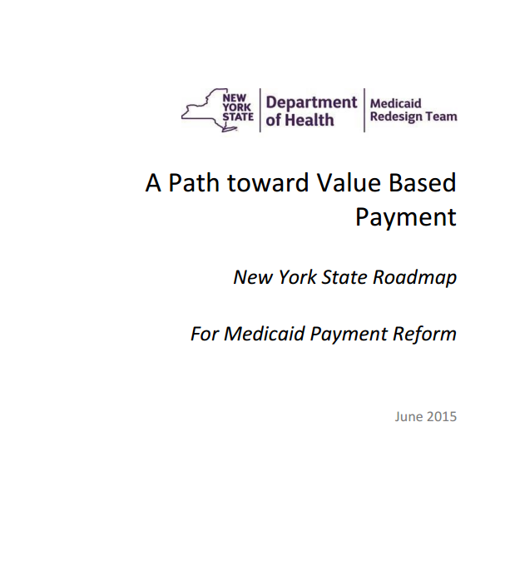
Standard: Implementation of SDH Intervention
“To stimulate VBP contractors to venture into this crucial domain, VBP contractors in Level 2 or Level 3 agreements will be required, as a statewide standard, to implement at least one social determinant of health intervention. Provider/provider networks in VBP Level 3 arrangements are expected to solely take on the responsibilities and risk.” (VBP Roadmap, p. 41)
Description:
VBP contractors in Level 2 or 3 arrangement must implement at least one social determinant of health intervention. Language fulfilling this standard must be included in the MCO contract submission to count as an “on-menu” VBP arrangement.

Slide 16
Guideline: SDH Intervention Selection
“The contractors will have the flexibility to decide on the type of intervention (from size to level of investment) that they implement…The guidelines recommend that selection be based on information including (but not limited to): SDH screening of individual members, member health goals, impact of SDH on their health outcomes, as well as an assessment of community needs and resources.” (VBP Roadmap, p. 42)
Description:
VBP contractors may decide on their own SDH intervention. Interventions should be measurable and able to be tracked and reported to the State. SDH Interventions must align with the five key areas of SDH outlined in the SDH Intervention Menu Tool, which includes:
1) Education, 2) Social, Family and Community Context, 3) Health and Healthcare 4) Neighborhood & Environment and 5) Economic Stability
The SDH Intervention Menu Tool was developed through the NYS VBP SDH Subcommittee and is available here:
https://www.health.ny.gov/health_care/medicaid/redesign/dsrip/vbp_library/

Slide 17
June 2018
17
Standard: Inclusion of at Least One, Tier 1 Community-Based Organization (CBO)
“Though addressing SDH needs at a member and community level will have a significant impact on the success of VBP in New York State, it is also critical that community based organizations be supported and included in the transformation. It is therefore a requirement that starting January 2018, all Level 2 and 3 VBP arrangements include a minimum of one Tier 1 CBO (VBP Roadmap, p. 42)
Description:
VBP contractors in a Level 2 or 3 arrangement MUST include at least one, Tier 1 CBO.
A Tier 1 CBO is a non-profit, non-Medicaid billing, community-based social and human service organizations (e.g. housing, social services, religious organizations, food banks)
Source: New York State Department of Health Medicaid Redesign Team, A Path Towards Value Based Payment, New York State Roadmap for Medicaid Payment Reform, NYS DOH VBP website. June 2016 updated version, approved by CMS March 2017.

Slide 18
18
Measuring Performance for VBP Arrangements

Slide 19
CMS Meaningful Measures Framework
19
Focus everyone’s effort on the same quality areas:
Address high-impact measure areas
Patient-centered and meaningful to patients
Outcome-based where possible
Relevant and meaningful to providers
Minimize level of burden for providers
Remove measures where performance is already very high
Significant opportunity for improvement
Address measure needs for population-based payment through alternative payment models
Align across programs and/or other payers

Slide 20
NYS Focus on Meaningful Measures Objectives
Focus Areas:
State Efforts:
Align across programs and/or other payers
Outcome-based where possible
Relevant and meaningful to providers
Minimize level of burden for providers
Remove measures where performance is already very high
Address measure needs for population-based payment through alternative payment models
Medicaid Involvement in Advanced Primary Care (APC) Initiative
Reevaluate Quality Measure Sets (Clinical Advisory Groups, Measure Support Task Force, VBP Workgroup)
VBP Pilot Measure Testing (Controlling High Blood Pressure)

Slide 21
Upside and Down Side Risk Sharing Arrangements
While VBP encourages efficiency, quality is paramount!
No savings will be earned without meeting minimum quality thresholds.
Quality Targets % Met goal | Level 1 VBP Upside Only | Level 2 VBP Up - and downside when actual costs < budgeted costs | Level 2 VBP Up - and downside when actual costs > budgeted costs
> 50% of Quality Targets Met | 50% of savings returned to VBP contractors | Up to 90% of savings returned to VBP contractors | VBP contractors are responsible for up to 50% losses
<50 % of Quality Targets Met | Between 10 – 50% of savings returned to VBP contractors (sliding scale in proportion with % of Quality Targets met) | Between 10 – 90% of savings returned to VBP contractors (sliding scale in proportion with % of Quality Targets met) | VBP contractors responsible for 50-90 % of losses (sliding scale in proportion with % of Quality Targets met)
Quality Worsens | No savings returned to VBP contractors | No savings returned to VBP contractors | VBP contractors responsible for up to 90% of losses
Source: New York State Department of Health Medicaid Redesign Team, A Path Towards Value Based Payment, New York State Roadmap for Medicaid Payment Reform, NYS DOH VBP website, June 2016 updated version approved by CMS March 2017.

Slide 22
Obstetric Practices
Obstetric practitioners are core to the principles of value based payment programs.
1) Obstetric practitioners drive attribution for the Maternity VBP arrangement.
Stimulus funding can increase significantly as more OB providers are brought into the network
2) Primary Care Practitioners drive attribution for the Total Care for the General Population arrangement
3) Can also achieve greater efficiency and quality by following guideline-recommended standards for obstetric provider or primary care practitioner in VBP
Keep it simple!
Shared benefits for both MCO and provider network supported by the practitioner

Slide 23
Maternal & Infant Mortality and VBP
June 2018
NY State ranks 30th in Maternal Mortality and 10th in Infant Mortality
Important to address health disparities in a culturally and linguistically appropriate way.
Value Based Payments are, at their core, quality improvement drivers.
VBP will support other efforts to decrease maternal and infant mortality.
Quality measures should address both the mother and the infant.

Slide 24
Children’s Health Clinical Advisory Group Recommendations
The Children’s Health Clinical Advisory Group (CAG) was tasked with selecting child-focused quality measures for inclusion in VBP arrangements beginning in 2018.
A group of maternity measures was recommended based on their relevance to child health quality.
These are applicable to TCGP as well as the Maternity arrangement, given Maternity is part of TCGP.
The TCGP/IPC CAG is asked to review these measures (see table below) and consider which (if any) measures should be added to the TCGP/IPC measure set.
It is suggested that that “timeliness and frequency of prenatal and postpartum care visits” may be most appropriate to include. Do you agree?
Recommended Measure | Description | Category | Classification | Measure Steward | NQF Endorsed?
Infants exclusively fed with breast milk in hospital | The number of newborns exclusively fed with breast milk during the newborn´s entire hospitalization. | Cat 1 | P4R | The Joint Commission | Y
Live births less than 2500 grams | The adjusted rate for live infants weighing less than 2500 grams among all deliveries by women continuously enrolled in a plan for 10 or more months. | Cat 1 | P4R | Agency for Healthcare Research and Quality | Y
Timeliness and frequency of prenatal and postpartum care visits | Prenatal Care: The percentage of deliveries that received a prenatal care visit as a patient of the organization in the first trimester or within 42 days of enrollment in the organization. Postpartum Care: The percentage of deliveries that had a postpartum visit on or between 21 and 56 days after delivery. | Cat 1 | P4P | National Center for Quality Assurance | N
Women provided most or moderately effective methods of contraceptive care within 3 to 60 days of delivery | Among women aged 15-21 who had a live birth, the percentage that is provided a most effective (sterilization, contraceptive implants, intrauterine devices or systems (IUD/IUS)) or moderately (injectables, oral pills, patch, ring, or diaphragm) effective method of contraception within 3 and 60 days of delivery. | Cat 1 | P4R | Office of Population Affairs | Y
Behavioral risk assessment for pregnant women | Percentage of women who gave birth during a 12-month period who were seen at least once for prenatal care and who were screened for depression, alcohol use, tobacco use, drug use, and intimate partner violence. | Cat 2 | N/A | No Current Steward | N

Slide 25
25
VBP Quality Measurement in 2018
Measure Classification and Categorization

Slide 26
Categorizing and Prioritizing Quality Measures
Category 1 – Approved quality measures felt to be clinically relevant, reliable, valid, & feasible.
Category 2 – Measures that are clinically relevant, valid and probably reliable, but where feasibility could be problematic.
Category 3 – Measures that are insufficiently relevant, reliable, valid, and/or feasible.

Slide 27
Category 1 Measures
Category 1 quality measures as identified by the Stakeholders and accepted by the State are to be reported by VBP Contractors.
The State classified each Category 1 measure as P4P or P4R:
Pay for Performance (P4P)
Pay for Reporting (P4R)
Measures designated as P4P are intended to be used in the determination of shared savings amounts for which VBP Contractors are eligible.
Performance on the measures can be included in both the determination of the target budget and in the calculation of shared savings for VBP Contractors.
Measures designated as P4R are intended to be used by MCOs to incentivize VBP Contractors for reporting data to monitor quality of care delivered to members under the VBP contract.
MCOs and VBP Contractors will be incentivized based on timeliness, accuracy & completeness of data reporting.
Measures can move from P4R to P4P through the annual Clinical Advisory Group and State review process or as determined by the MCO and VBP Contractor.
Source: New York State Department of Health Medicaid Redesign Team, A Path Towards Value Based Payment, New York State Roadmap for Medicaid Payment Reform, NYS DOH VBP website, June 2016 updated version, approved by CMS March 2017.

Slide 28
VBP Quality Measure Set Annual Review
Annual Review
Clinical Advisory Groups will convene to evaluate the following:
Feedback from VBP Contractors, MCOs, and stakeholders
Any significant changes in evidence base of underlying measures and/or measurement gaps
Categorization of measures and make recommended changes
State Review Panel
Review data, technical specification changes or other factors that influence measure inclusion/exclusion*
Review measures under development to test reliability and validity
Review measure categorizations from CAG and make recommendations where appropriate (Cat. 1 vs. Cat. 2; P4P vs. P4R)
NYSDOH Communicates to MCO and VBP Contractors
Final VBP Workgroup Approval
Data Collection and Reporting
Annual Review Cycle
NYSDOH Technical Review
Review Measure Results
CAG Annual Meeting
Assess Changes to Measures, Retirement, or Replacement

Slide 29
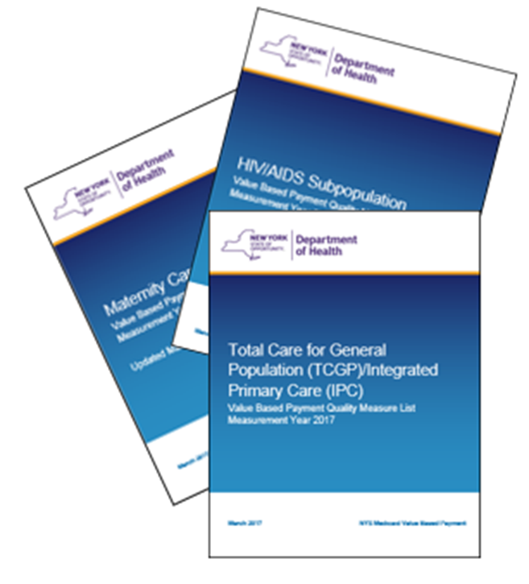
Annual Update Cycle
Final VBP Arrangement Measure Sets and Reporting Guidance
The VBP Quality Measure Sets for each arrangement will be finalized and posted to the NYS DOH VBP website by the end of October of the year preceding the measurement year and have been published for Measurement Year 2018. (Link)
The VBP Measure Specification and Reporting Manual will be released alongside the Quality Assurance Reporting Requirements (QARR) Manual in October of the measurement year and has been published for Measurement Year 2017. (Link)

Slide 30
Three Key Challenges
Practitioner comfort with VBP
Performance measurement on a VBP contractor, population level
Reporting on non-claims-based measures

Slide 31
Three Key Opportunities
Higher quality providers can negotiate higher target budgets.
VBP creates opportunity to reward efficiency and quality in meaningful ways not available before.
Level 3 VBP eliminates need for prior authorization and other administrative burdens.

Slide 32
Thank you!
Questions?
Additional Information:
DOH Website:
http://www.health.ny.gov/health_care/medicaid/redesign/behavioral_health/index.htm
https://www.health.ny.gov/health_care/medicaid/redesign/dsrip/providers_professionals.htm
Contact Us:
dsrip@health.ny.gov
vbp@health.ny.gov

Slide 33
June 2018
33
Appendix
Maternity Care Arrangement Measure Set for 2018

Slide 34
2018 Maternity Care VBP Quality Measure Set Category 1 Measures
Measure Name | Measure Steward | NQF Measure Identifier | Classification | Rationale for Change
Contraceptive Care – Postpartum Women | United States Office of Population Affairs | 2902 | Cat 1 P4R
C-Section for Nulliparous Singleton Term Vertex (NSTV) | The Joint Commission | 0471 | Cat 1 P4R
Frequency of Ongoing Prenatal Care | NCQA | 1391 (lost endorsement) | Cat 1 P4P Removed from Measure Set | Measure retired by NCQA
Incidence of Episiotomy [% of Vaginal Deliveries With Episiotomy] | Christiana Care Health System | 0470 | Cat 1 P4R
Low Birth Weight [Live births weighing less than 2,500 grams (preterm v. full term)] | AHRQ | 0278 | Cat 1 P4R
Percentage of Babies Who Were Exclusively Fed with Breast Milk During Stay | TJC | 0480 | Cat 1 P4R
Percentage of Preterm Births. | NYS | Not endorsed | Cat 1 P4R
Prenatal & Postpartum Care (PPC) —Timeliness of Prenatal Care & Postpartum Visits | NCQA | 1517 (lost NQF endorsement) | Cat 1 P4P
^{IPC} Preventive Care and Screening: Screening for Clinical Depression and Follow-Up Plan | CMS | 0418 | Cat 1 P4R
^{IPC} Measure is also part of TCGP/ IPC Measure Set
Red: Indicates measure change from 2017 Acronyms: TJC: The Joint Commission, NCQA: National Committee for Quality Assurance, AHRQ: Agency for Healthcare Research and Quality, CMS: Centers for Medicare and Medicaid Services; NQF: National Quality Forum, P4R: Pay-for-Reporting

Slide 35
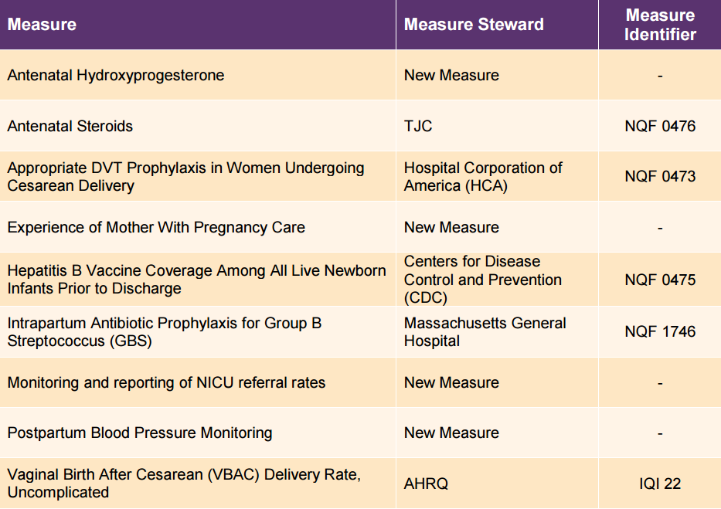
Maternity Care Arrangement Category 2 Measures

