Slide 1
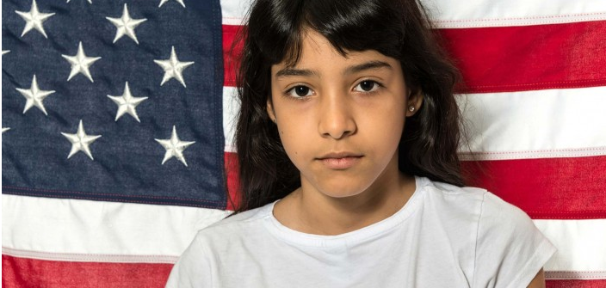
Caring for Newly-Arrived Immigrant Children and Families in Challenging Times
New York State Perinatal Association
2018 Annual Conference
Alan Shapiro, MD, FAAP
Clinical Assistant Professor of Pediatrics, Albert Einstein College of Medicine
Senior Medical Director for Community Pediatric Programs
Children’s Hospital at Montefiore
Medical Director and Co-Founder, Terra Firma
https://news.law.fordham.edu/blog/2015/08/04/unaccompanied-immigrant-children-are-vulnerable-yet-resilient-new-study-finds/
Notes:
I want to thank Sharon Chesna and Dr. Heather Brumberg and all of you for inviting me today.
I am so honored to have been asked to speak today and so impressed by the interest that NSYPA is showing in caring for newly arrived immigrant children and families.

Slide 2
Disclosure
In the past 12 months, I have no relevant financial relationships with the manufacturer(s) of any commercial product(s) and/or provider(s) of commercial services discussed in this CME activity.
Notes:
No disclosures

Slide 3
Learning Objectives
Describe the current state of affairs and potential health impact on children in immigrant families
Understand the unique phases of migration that characterize newly arrived unaccompanied immigrant children (UIC) and the implications in caring for them from
a medical and legal perspective.
Learn the important healthcare considerations when caring for UIC
Understand the importance of the medical-legal nexus for UIC and how a medical-legal partnership can improve health and legal outcomes for UIC

Slide 4
A Picture Tells a Thousand Words
Notes:
There is a photograph of an adolescent boy sitting alone on railroad tracks somewhere in rural Mexico. Heightening his sense of isolation is an abandoned building directly behind him, a mountain in the far distance and one large tree nearby. There is not another human being in sight. The boy is looking away from the camera; down the tracks begging the viewer to wonder what is he thinking about - his fears, his losses, his future? Is he looking back from where he came or is he looking towards where he is going? It is an intensely evocative image that profoundly speaks to me.

Slide 5
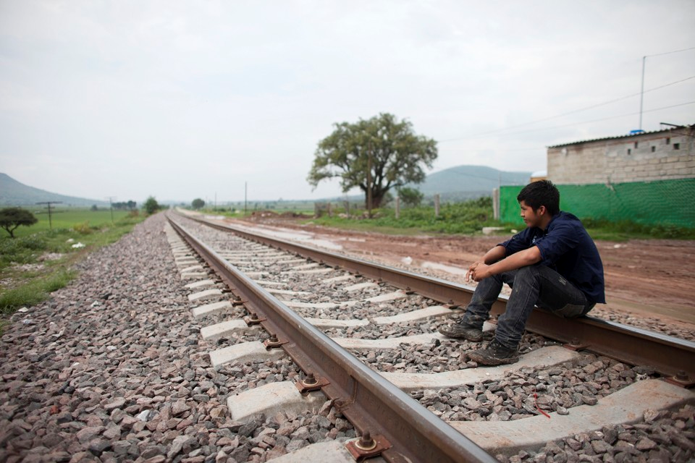
An Unaccompanied Immigrant Child?

Slide 6
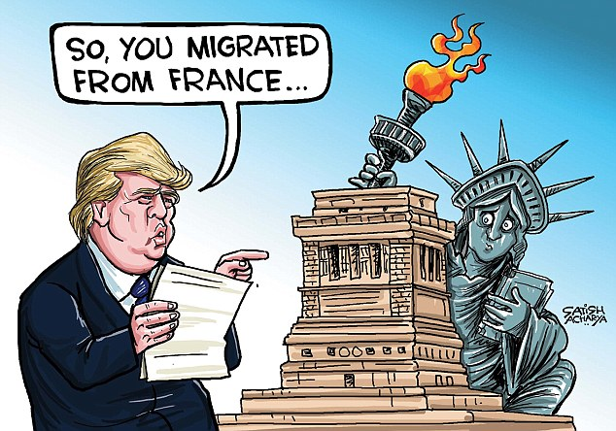
By Satish Acharya
PUBLISHED: 19:04 EDT, 5 February 2017
Notes:
If I was giving this talk 16 month ago I would have jumped right into the care of UIC.

Slide 7
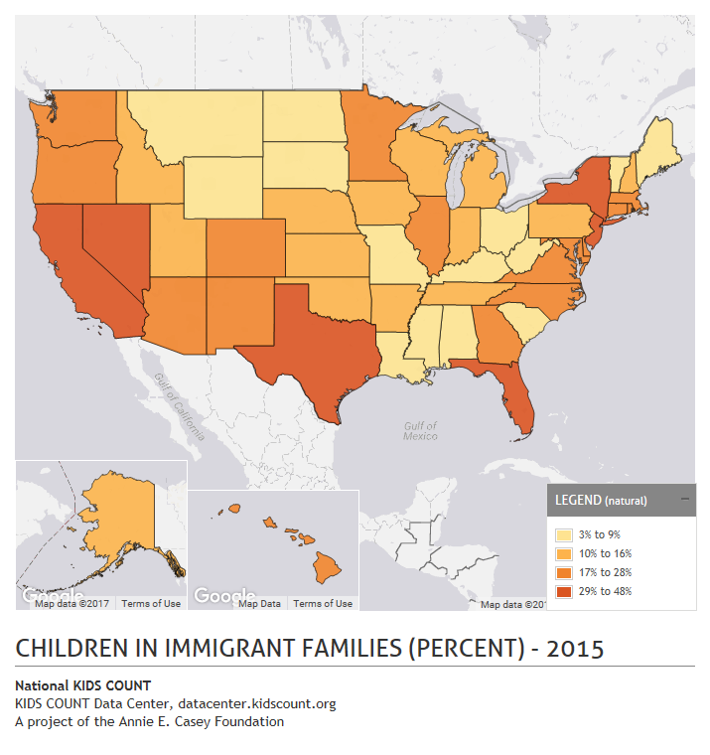
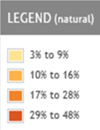
Children in Immigrant Families
2016*
1 in 4 US children (1 in 3 NY) live in an immigrant family
18 million children
  < 18 y live with at least one immigrant parent
88% (15.9 million) are US born citizens
*Migration Policy Institute; Frequently Requested Statistics on Immigrants and Immigration in the United States 2/8/18
Image reproduced from: Kids Count Data Center.
http://datacenter.kidscount.org
Notes:
Immigrant children and families make up the fabric of this country and every state as you can see.
When we talk about immigrant children and families we are not talking about a monolithic population but a diverse population with different needs and different rights. Mixed immigrant status families/refugees/dreamers/unaccompanied and accompanied children
One in four children in the United States and more than one in three children in New York lives in an immigrant family –
defined as a child, born inside or outside the country, with at least one parent born outside the country.
That parent may be undocumented or naturalized.
2016, approximately 18 million children under age 18 lived with at least one immigrant parent.
They accounted for over 25% of the 70 million children under age 18 in the United States.
And almost 90% of those children, 16 million, are us born citizens
When we talk about how hateful rhetoric and policies may affect these children we can think about this in terms of a public health crisis

Slide 8
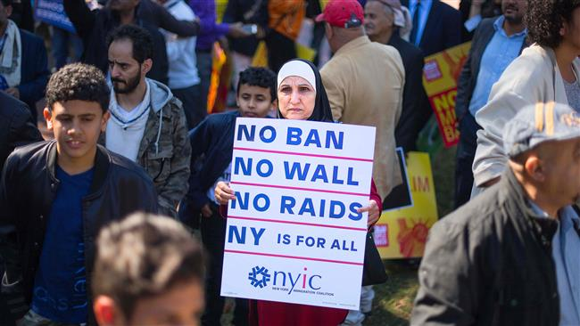
Current State of Affairs
A demonstrator holds up a placard during a #NoMuslimBanEver rally to protest
President Donald Trump’s immigration policies in Washington, DC, on October 18, 2017. (AFP photo)
Notes:
One week after the inauguration of the president we were baraged by anti-muslim and anti-immigrant executive orders and policy proposals
As pediatricians, and as citizens, We must ask ourselves What does dos this all say to our children and families:”
You are inferior and less deserving; you are a threat to us
You don’t deserve to come into this country even though through the US has ratified the Universal Declaration of Human rights which explicitly gives everyone the right to seek asylum.
The xenophobic, hateful anti-immigrant rhetoric pouring out of this current administration not only poses a real threat to the majority of hard working, law abiding immigrants in this country BUT more insidiously challenges the notion of Equality and Justice – concepts especially difficult for children to reconcile.

Slide 9
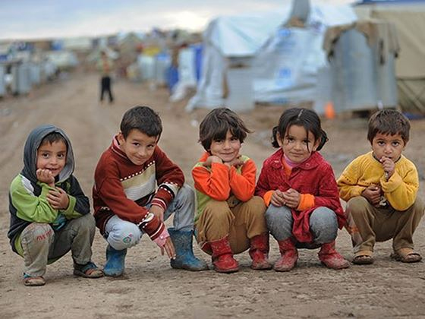
Blocking Refugee Entry
  Globally (2017)¹
    22.5 million refugees
    Over 50% are under the age of 18
  United States (2017)
    Attempted Ban from 6 majority Muslim countries
    Decrease refugee target from 110K to 45K
    29 K refugees resettled
Image: Youcaring.com
1 http://www.unhcr.org/en-us/figures-at-a-glance.html
2 http://www.pewresearch.org/fact-tank/2016/10/05/u-s-admits-record-number-of-muslim-refugees-in-2016/
3 https://www.usatoday.com/story/news/world/2018/01/03/refugee-admissions-u-s-plummet-2017/999903001/
Notes:
At a time of historically high numbers of refugees around the world , they US has decided to halve the numbers willing to resettle.
What is the message to the world; what is the message to refugee children and families in this country

Slide 10
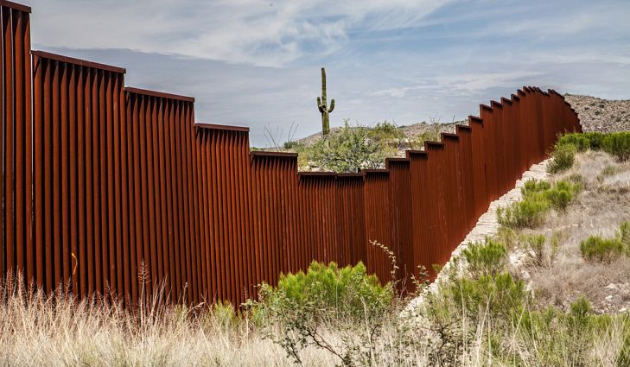
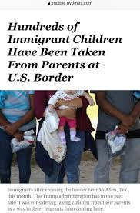
Blocking Safe Haven
Tightening Southwest Border
Increased law enforcement (2016)*
    49,000 CBP and ICE personnel
    $6.1 billion per year (ICE)
Proposed “building a wall”
Deterrence Strategies
Expand detention at border
Increase expedited removals
Family separation
Image: Worldatlas.com
* American Immigration Council https://www.americanimmigrationcouncil.org/
research/the-cost-of-immigration-enforcement-and-border-security
Image: Loren Elliot, NY Times: 4/20/18
Notes:
When I think of the hundreds of children and families we care for in our program I know that these strategies either:
Make crossing into the US more dangerous (you may have heard of the Guatemalan 20 y/o younng women just shot at the border) or
Fail (as I will show you in a few minutes)
-$263 billion on immigration enforcement since 1986 by federal govt
-”Currently, the number of border and interior enforcement personnel stands at more than 49,000. The number of U.S. Border Patrol agents nearly doubled from Fiscal Year (FY) 2003 to FY 2016. Additionally, the number of ICE agents devoted to its office of Enforcement and Removal Operations (ERO) nearly tripled from FY 2003 to FY 2016.“
”Since 1993, when the current strategy of concentrated border enforcement was first rolled out along the U.S.-Mexico border, the annual budget of the U.S. Border Patrol has increased more than ten-fold, from $363 million to more than $3.8 billion.”
“ICE spending has grown 85%, from 3.3 billion since inception to $6.1 billion today.”

Slide 11
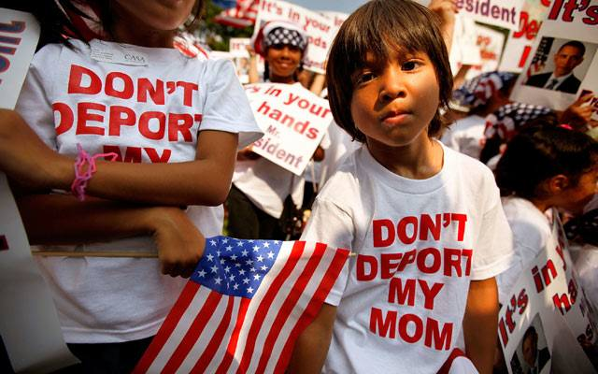
Expansion of Interior Enforcement
Notes:
We have all heard the stories of parental deportation – like the pakistani chemical engineer who was stopped by ICE, taken out of the car and arrested in front of his children.
It is no wonder there are reports from all over the country of children who are afraid to leave home fearing their parents wont be there when they return

Slide 12
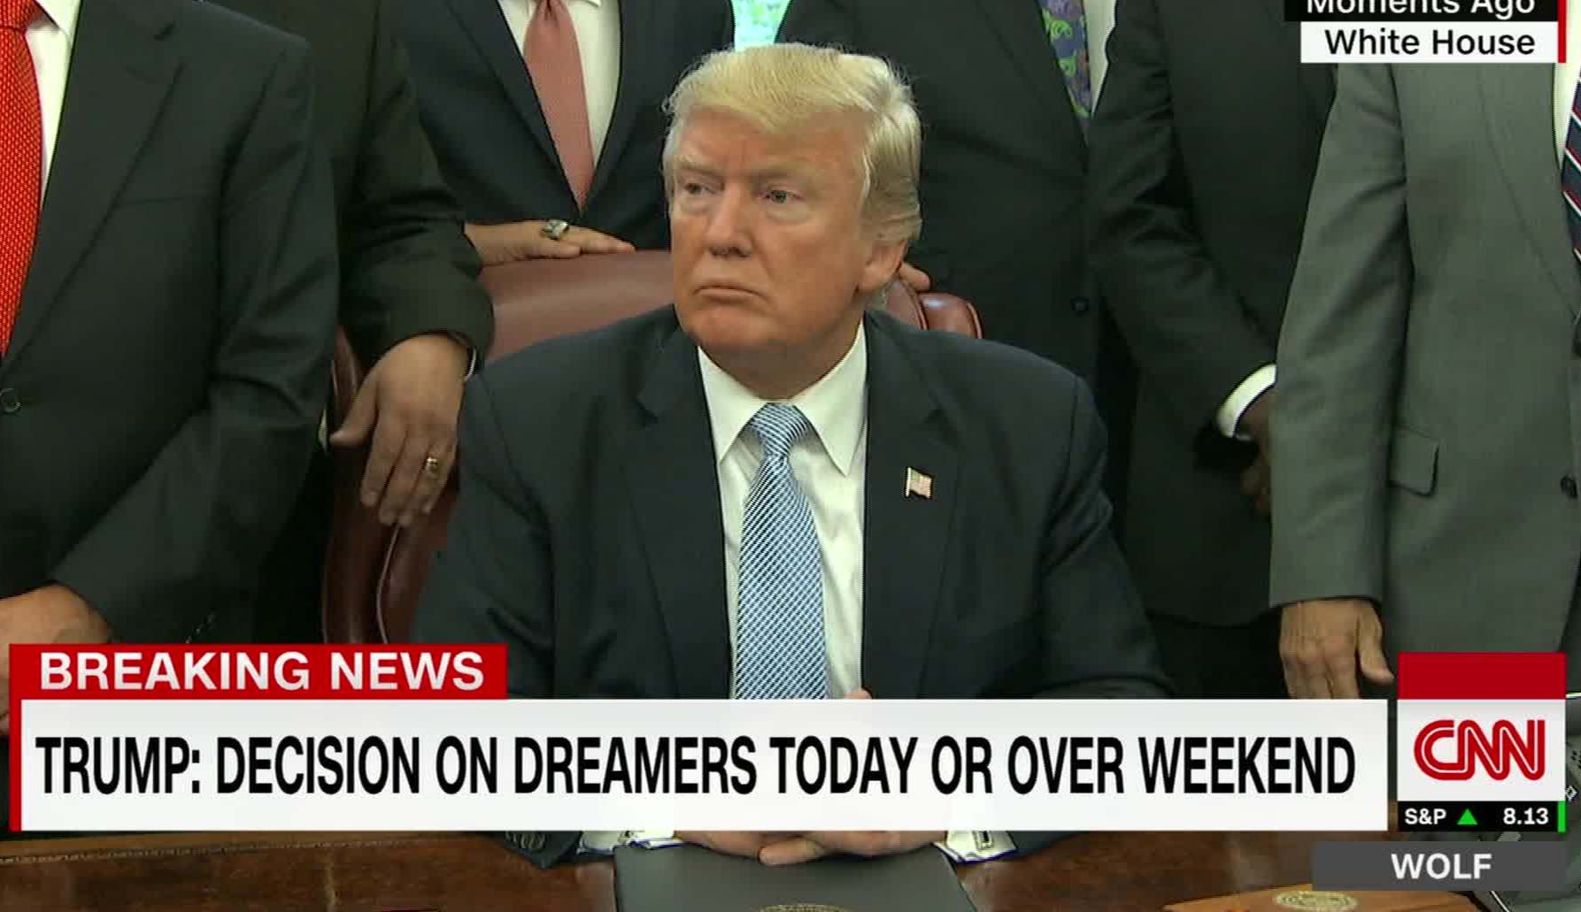
Path to Citizenship Threatened:
Trump Rescinds DACA (9/5/17)
Notes:
On Sept 2017 , president Trump haphazardly put end to DACA leaving 800,000 adolescents & young adults in legal limbo
Making DREAMERS humans pawns in failed attempts to make comprehensive immigration reform.
“DACA And the fight being waged right now on behalf of DREAMERS – And how these DACA has protected nearly 800,000 children and young adults, with another 228,000 children under 15 years who would have aged into eligibility.

Slide 13
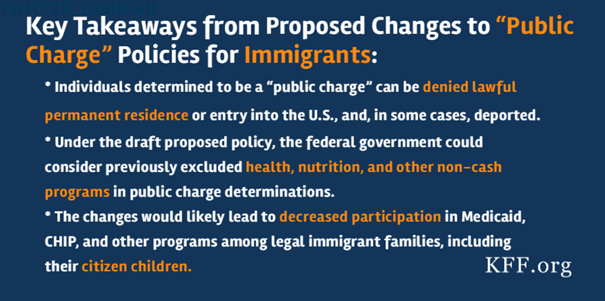
Path to Citizenship Threatened:
Penalty for Public Charge
Notes:
Next on the horizon is Proposed Change to Public Charge – those who have depended on any support of the government may find their path to legal residency denied
This might have a major chilling effect on accessing healthcare and SNAP – food stamps.
This can greatly affect how immigrant women seek prenatal care as they would be fearful of the repercussions for having public health insurance

Slide 14
Impact of Immigration Policy on Health
Effects of immigration enforcement legislation on Hispanic pediatric patient visits to the pediatric emergency department (Beniflah, 2013)
  After Georgia House Bill 87, local police officers given authority to enforce immigration laws
    Lower ED visit rates, higher rates of high acuity conditions, higher rates of hospital admission
    Lower rates of public insurance
The impact of local immigration enforcement policies on the health of immigrant Hispanics/Latinos in the United States (Rhodes, 2015)
  After Immigration and Nationality Act and Secure Communities program in NC begun:
    Hispanic women were more likely to have late entry to prenatal care as well as inadequate prenatal care compared to before section 287(g)
Change in birth outcomes among infants born to Latina mothers after major immigration raid (Novak, et al., 2017)
  2008 raid at meat-processing plant, Pottsville, Iowa; 389 employees arrested, 98% Latino
    Infants born to Latina mothers had 24% greater risk of LBW after raid; no effect on babies born to non-Latina white mothers
“Chilling Effect? Post-Election Health Care Use by Undocumented and Mixed-Status Families” (Page & Polk, NEJM, 2017)
Notes:
There is a growing body of evidence in the literature that speaks to the deleterious effects of anti-immigration policy on health outcomes
Georgia House Bill 87 : gave local police officers the authority to enforce immigration laws.
After Georgia House Bill 87, Hispanics in Georgia had:
Lower ED visit rates (18.3% vs. 17.1%, p<.01)
Lower rates of public insurance (84.2% vs. 81.4%, p <.01)
Higher rates of high acuity issues (14.3% vs. 16.3%, p<.01)
Higher hospital admission rates (8.7% vs. 10.2%, p<.01)
*Beniflah JD, Little WK, Simon HK et al. Effects of immigration enforcement legislation on Hispanic pediatric patient visits to the pediatric emergency department. Clin Pediatr (Phila) 2013;52(12):1122–126.
Hispanic/Latina women were more likely to have late entry to prenatal care (28.2% vs. 29.8%) as well as inadequate prenatal care (29.1% vs. 30.6%) compared to before section 287(g)
**Rhodes SD, Mann L, Siman FM et al. The impact of local immigration enforcement policies on the health of immigrant Hispanics/Latinos in the United States. Am J Public Health 2015;105:329–37.
*K. Page, M.D., and S. Polk, M.D., M.H.S.
new england j med 376;12 nejm.org March 23, 2017

Slide 15
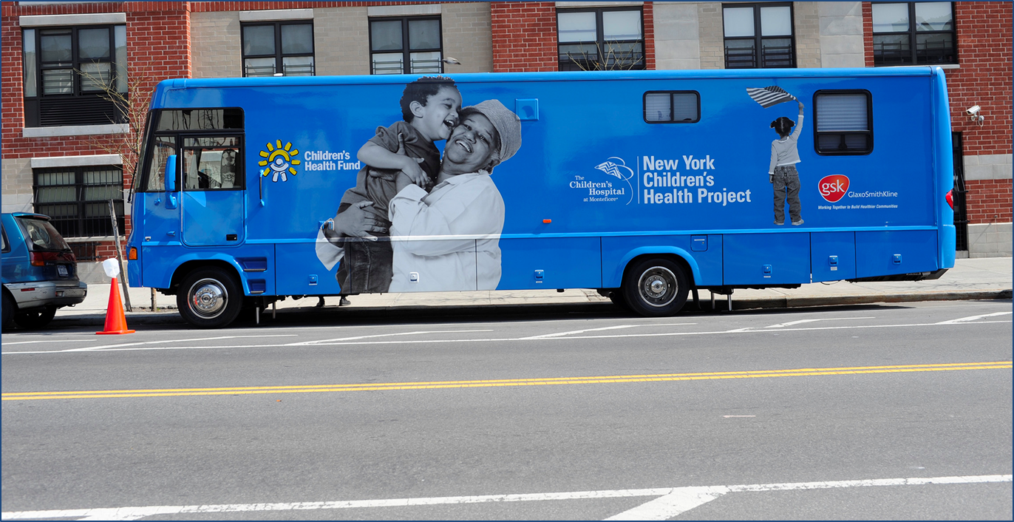

An “Unaccompanied Immigrant Child?”
Notes:
Let me pivot

Slide 16
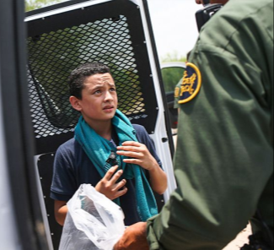
Unaccompanied Alien Children Definition
The Homeland Security Act of 2002
Under the age of 18
Without legal immigration status
Without a parent or guardian in the United States available to provide care and physical custody… at the time of apprehension
Primarily from non-contiguous countries
Image: http://www.takepart.com/article/2015/12/10/undocumented-kids-border
Notes:
Julie
SO WHO ARE WE TALKING ABOUT
BASED ON HOMELAND SECURITY ACT 2002
Bill in Congress to change definition
Complex b/c they might be in the community
Under the Homeland Security Act of 2002, Congress transferred the care and custody of these children to HHS from the former Immigration and Naturalization Service (INS) to move towards a child welfare-based-model of care for children and away from the adult detention model. In the Trafficking Victims Protection Reauthorization Act of 2008, which expanded and redefined HHS’s statutory responsibilities, Congress directed that each child must “be promptly placed in the least restrictive setting that is in the best interest of the child.” See 8 U.S.C. § 1232(b)(2).

Slide 17
Unaccompanied Immigrant Children
Apprehended Southwest Border 2012-2017
Source: US Customs and Border Patrol, 2018. https://www.cbp.gov/newsroom/stats/usbp-sw-border-apprehensions
Notes:
Julie
You probably all remember when the media was flooded with stories about the surge of UIC and families crossing the southwest border coming into the US in 2014
In the Spring of 2014, then president Obama announced a humanitarian crisis at our border
Children and families predominantly from the Northern Triangle of Central America: Honduras, El Salvador, Guatemala; with a decreasing percentage coming from Mexic

Slide 18
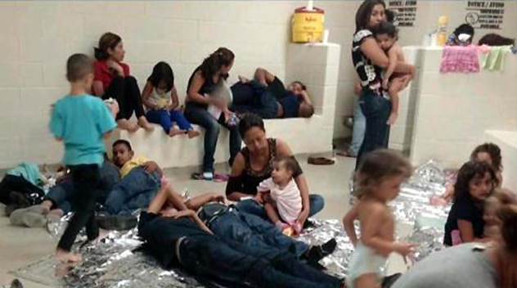
Family Units

Slide 19
Family Units Apprehended
Southwest Border FY2013-17*
Family Unit represents the number of individuals apprehended with a family member
77,674
75,622
68,455
39,838
14,855
Source: US Customs and Border Patrol, 2018. https://www.cbp.gov/newsroom/stats/usbp-sw-border-apprehensions
*Country-level data only available beginning in FY2015
Notes:
Julie
Likewise, there has been a concomitant surge of families – mostly women and children
No country breakdown available prior to 2015.
I will point out that I will not discuss this population much today but principles are the same and the situation often times more dire
Meanwhile, the demographics of illegal migration on our southern border has changed significantly over the last 15 years – far fewer Mexicans and single adults are attempting to cross the border without authorization, but more families and unaccompanied children are fleeing poverty and violence in Central America.

Slide 20
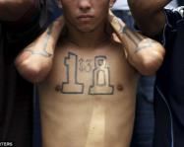
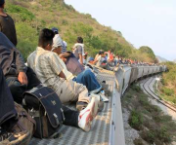
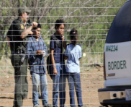
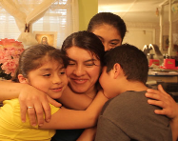
Framework for Understanding the Experience of New Immigrant Arrivals
Pre-migration/
Country of Origin
Migration/
Journey
Apprehension/
Detention
Release into community/
Reunification

Slide 21
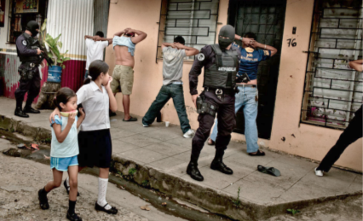
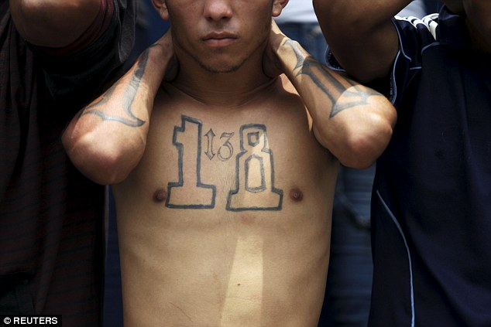
What Is Driving This Migration?
THE PUSH
Abject Poverty
Social Exclusion
Political Instability
Community Violence:
  Youth
  Ethnic Minorities
  Girls
Domestic Violence: Child Abuse
Lack of Protection and impunity
Trafficking: Labor and Sex
THE PULL
Protection
Family Reunification
Education
Economic opportunities
http://globalriskinsights.com/2015/06/the-economic
-impact-of-gang-violence-in-el-salvador/
Notes:
Alan
It is important to understand that the Northern Triangle countries are among the poorest in the hemisphere
Average salary is $13/day (El Salvador), $13.3/day (Honduras), $12.43/day (Guatemala) - tremendous economic disparities. Source: http://news.gallup.com/poll/166211/worldwide-median-household-income-000.aspx
Social exclusion: lack of health care, education, employment opps and critically protection
Furthermore, the political instability and lack of infrastructure allows for alternative power-structures to fill the vacuum, namely criminal cartels and gangs
These in turn, target the most vulnerable: Youth, ethnic minorities, girls and women
Devastating effect on children and communities – as this picture shows

Slide 22
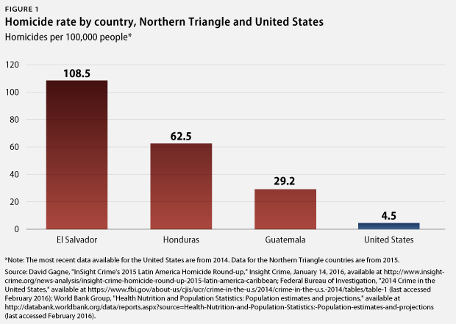
The Push: An Existential Threat
“In Guatemala, Honduras and El Salvador we have suffered an epidemic of violence for years. It has been established that if a country suffers from a disease that affects ten out of every 100,000 inhabitants, this country is experiencing an epidemic. By that standard, Central America is gravely sick.”
- Oscar Martinez
Notes:
Alan
https://www.americanprogress.org/issues/immigration/news/2016/02/24/131645/they-are-refugees-an-increasing-number-of-people-are-fleeing-violence-in-the-northern-triangle/
“In Guatemala, Honduras and El Salvador we have suffered an epidemic of violence for years. It has been established that if a country suffers from a disease that affects ten out of every 100,000 inhabitants, this country is experiencing an epidemic. By that standard, Central America is gravely sick.” Oscar Martinez
History of violence
2011 Honduras 90/100,000

Slide 23
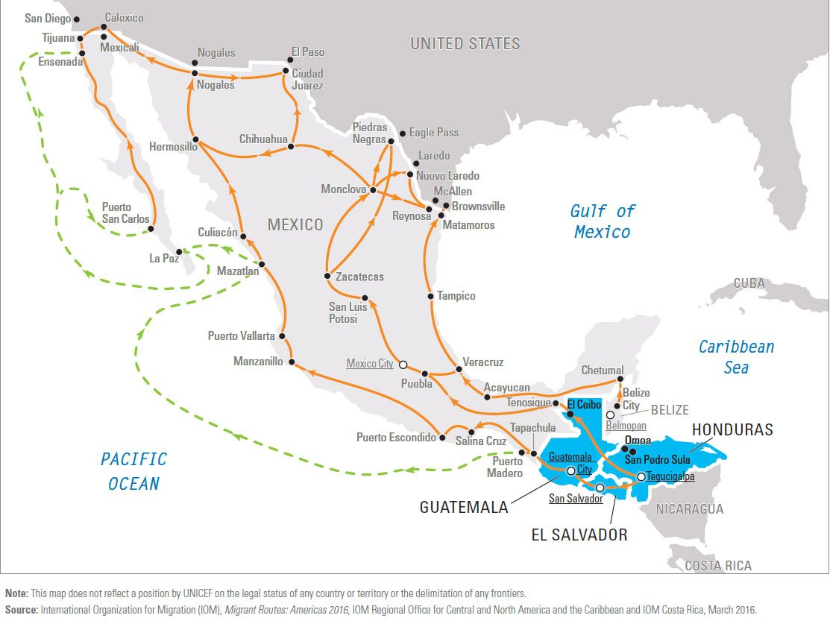
Migration Routes
Notes:
Have to make hearth brieaking decision to send their lkids alone, go with them (usually parent’s life is at danger), afraid to tell their families

Slide 24

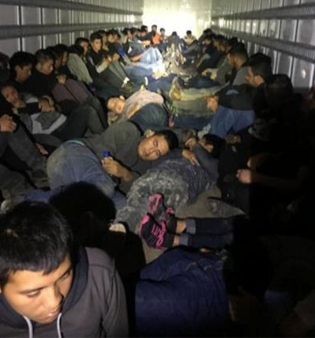
The Journey
Law enforcement busted three smuggling operations that attempted
to bring nearly 200 illegal immigrants combined into the U.S. (USBP)
Notes:
Key Questions
Did you travel alone or with a guide?
What forms of transportation taken?
What was the cost of the trip?
Did you get sick or injured?
Were you the victim of a crime?
Alan
This is to remind us of the 2000 mile journey that children make risking life and limb; how bad are things at home that children and their families are willing to take those risks for a better life…and it is easy for us to think of other historical examples where parents have sent their children away seeking safe haven
AS OUR PSYCHOLOGIST, DR MUNIZ has drilled into our heads; THE STORY OF UIC IS ONE OF COMPOUNDED TRAUMA
Part of what we have to think about in caring for these children is what happens along the way
Route and Transportation
The cost
The Experience
Exploitation
Extortion
Violence
Hunger
Exposure
OSCAR MARTINEZ BOOK THE BEAST -

Slide 25
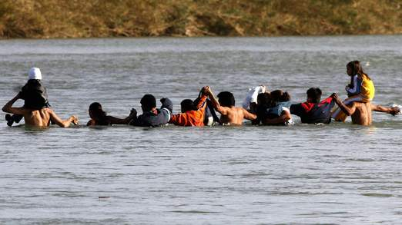
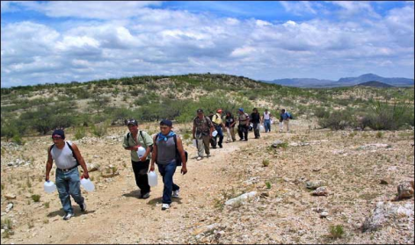
  Crossing the Border
In the Children’s Words
“I almost drowned crossing the river when the inner tube deflated.”
“We walked for six hours in the desert and ran out of water. I wasn’t sure I would survive.”
“We were kidnapped at the border by our guide and my parents couldn’t pay the ransom. I thought I was going to be killed.”
Notes:
Key Questions
Where you kept in a “safe” house?
Were you kidnapped? Did family pay for your freedom?
How did you cross into the US?
Were you injured?
With whom did you enter the US?
When were you apprehended?
alan
~ 500 deaths per year recorded by dehydration and /or drowning
Crossing the border
Smuggler “Coyote”
Self-crossing
Kidnapping
Wandering the desert
THEY CROSS THE BORDER AND IF LUCKY DON’T DIE
MORE OFTEN THAN NOT THEY ARE IMMEDIATELY APPREHENDED U.S. Customs & Border Protection
“There were 463 deaths in the past fiscal year, which ended Sept. 30 — the equivalent of about five migrants dying every four days, according to an analysis by the Washington Office on Latin America, a human rights group. “ this is from May 2013 so I’m sure it’s only increased – couldn’t find another number but I’ll look later today
(http://www.nytimes.com/2013/05/21/us/immigrant-death-rate-rises-on-illegal-crossings.html?_r=0)

Slide 26
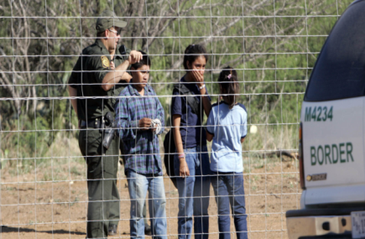
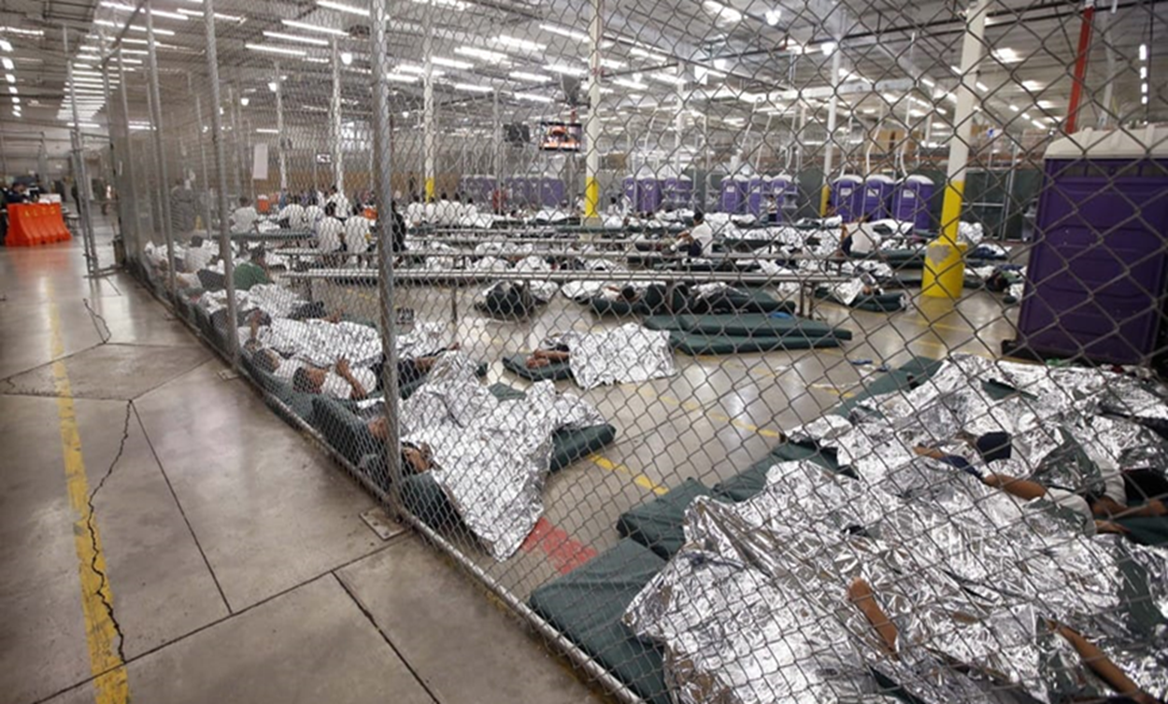
Apprehension and Detention
Step 1:
Apprehension
Step 2:
CBP Processing Centers: La Hielera
In The Children’s Words
“I was wet from crossing the river and didn’t get dry clothes until the next morning.”
“They separated me from my older sister. I thought I’d never see her again.”
Notes:
Key Questions
Upon apprehension where were you taken?
Were you separated from family?
How long were you kept in la hielera?
Describe conditions in detention?
Were you sick, injured or receive medical care?
Alan
Apprehension – many are just turning themselves in; this is especially the case of women and children
FIRST PLACEMENT AFTER APPREHENSION IN ICE DETENTION after apprehension coincidentally nicknamed la hielera or ice-box
Many advocacy group have been focusing on the conditions here
Many children report lack of food, medical attention and FREEZING COLD temps, no windows
Usual stay has been 2-4 days before transfer
THIS SUMMER A CONTIGENCY FROM AAP LEADERSHIP INCLUDING PRESIDENT AND COMMUNITY PEDIATRICS WILL VISIT THESE CENTERS

Slide 27
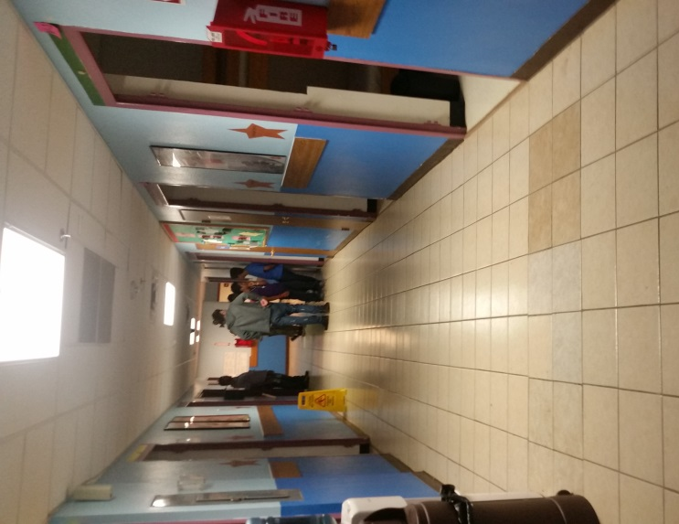

Immigration Detention
Step 3: ORR Children’s Shelters
Office Refugee Resettlement Shelters
  72 shelters; 8,000 beds US*
  Average LOS 34 days
  ORR Medical Guidelines
  In The Children’s Words
  “They treated me well, but I got too many shots.”
  “I was sent to a shelter in San Antonio and then Chicago. I thought I would never see my mother.”
*https://www.acf.hhs.gov/sites/default/files/orr/orr_uc_updated_fact_sheet_1416.pdf
Notes:
Key Questions:
How long did you stay in shelter?
Did you move to multiple shelters
Were you sick or injured?
Do you have your medical records?
UIC
Family Units:
Immigration and Customs Enforcement Family Detention Centers (3)
3, 326 Beds**US Immigration and Customs Enforcement

Slide 28
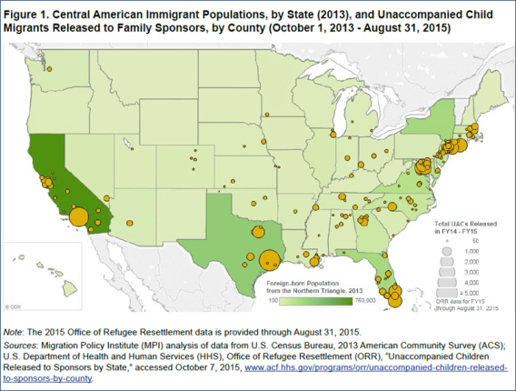
Step 4: Release to Sponsors
Notes:
Key Questions
Who were you released to?
When was the last time you saw your sponsor?
Who lives in household?
How is your relationship with your “new” family?
Do you feel safe?
Are you still living with your original sponsor?
cris
Although this has been seen as a border issue, every one of the continental US has received UIC,
%
Sponsor Population
48% Parent
24% Other adult relative
15% Adult Sibling
13% Non-relative
In the Children’s Words
“I was so nervous when I met my
mother, the last time we were
together I was 2 years old.”
“I was surprised how small the
apartment was my brother was
living in.”
“I couldn’t believe I had to go back
to 9th grade.”

Slide 29
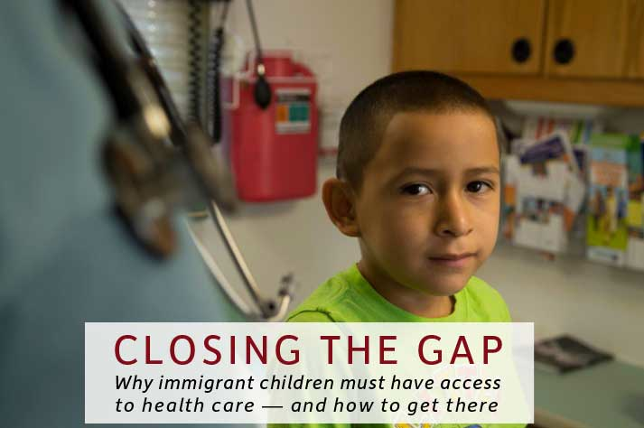
PROVIDING CARE
Notes:
Alan
SO NOW THEY ARE IN OUR COMMUNITIES AND THIS IS WHERE WE STEP IN
I WILL NOW GO THROUGH WHAT MY COLLEAGUES, ADVOCATES AND MYSELF FEEL ARE KEY CONCEPTS TO THINK ABOUT IN CARING FOR THESE CHILDREN
Why? Unique medical, psychosocial and legal needs
Where? Schools, legal offices, CBO, homeless shelters/ drop-in centers, soccer fields, houses of worship, healthcare settings
How: 3 questions
Were you caught at or near the border?
How old were you when caught?
Who were you with?
No parent/legal guardian = Unaccompanied
Parent/legal guardian= Family Unit
Corollary question: Do you have a lawyer?

Slide 30
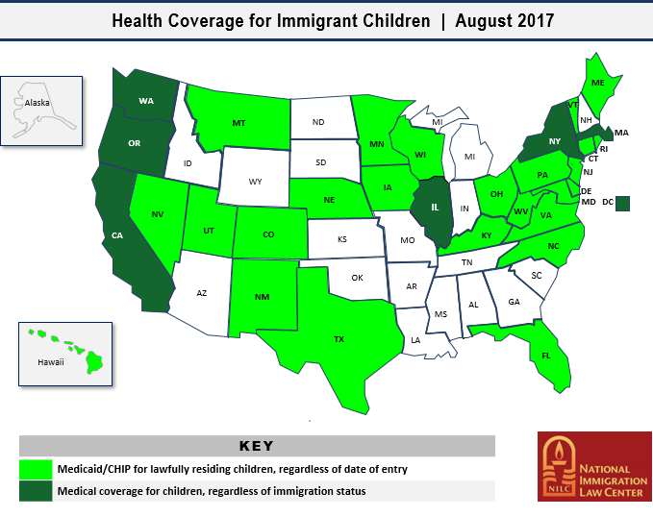
Access to Care:
Disparities in Health Coverage
Notes:
Regardless of where we are right now, we have not been a country that has embraced the idea that all children deserve access to health care
I will remind you, that all children have a legal right to free education K-12; Plyler v Doe, supreme court case, regardless of immigration status
DARK GREEN: undocumented children under the age of 19
Light Green: no 5 year waiting period for lawfully residing children
Dreamers: NO (unless under age 19 in dark green states)

Slide 31
New Immigrant Child Arrivals:
Healthcare Considerations
Introduce concept of “Medical Home”
Primary Care Naïve
New immigrant screening considerations
Unique psycho-social history
High burden of mental health conditions
Social determinants of health: Especially immigration status
Notes:
Primary Care Naïve
Need for routine screening: vision, hearing, newborn, sickle cell, developmental, reproductive health, gender and sexuality
Identification of undiagnosed or under-treated conditions
Special screening considerations:
Lead, TB, parasites, infectious disease (Zika)
Not surprising Higher prevalence of mental health conditions
PTSD vs. Complex Trauma: chronic trauma that continues or repeats for months or years at a time. E.g. sex exploitation
Importance of comprehensive assessment & treatment
4 key phases and stressors
Treatment goes beyond the therapy room
PTSD: Re-experiencing, avoidance and hyperarousal symptoms
Symptoms usually begin within 3 months of the incident but occasionally emerge years afterward. They must last more than a month to be considered PTSD.
have all of the following for at least 1 month:
At least one re-experiencing symptom
At least three avoidance symptoms
At least two hyperarousal symptoms
: easy temperament, religious beliefs, strong academic performance, family support, connected to culture and prosocial organizations (Carlson, et. al. Risk and Resilience of URM, Social Work, 2012)
Strengths and Difficulties questionnaire: pos and neg attributes re: emotional, conduct probs, hyperactive inattention, peer probs and prosocial behavs
PSC: (Spanish –PSC Cl – from chile) –good reliability; suggest lower cutoff in Mex Americans due to low sensitivity
> Y-PSC: 12 -18, internalizing, ext, inattention
Refugee Health Screener – 15; Depression, anxiety and PTSD
Childhood Post-Traumatic Stress Symptom Scale (8 – 18 y)
Strengths and Difficulties Questionnaire, 25 items (2- 17 y) - 80 langs: emotional, hyperact/inattention, int, ext, conduct, peer relations prosocial behavs
Very few studies on UIC, especially in US
Unaccompanied vs. accompanied immigrant children:
Higher prevalence and severity of PTSD, depression, anxiety
Increased risk of morbidity for those children with greater number of traumatic events and for girls
Higher exposure to physical and sexual abuse (girls > boys)
High prevalence of chronicity of symptoms at one year
Few longer term studies
Few studies on the efficacy of treatments

Slide 32
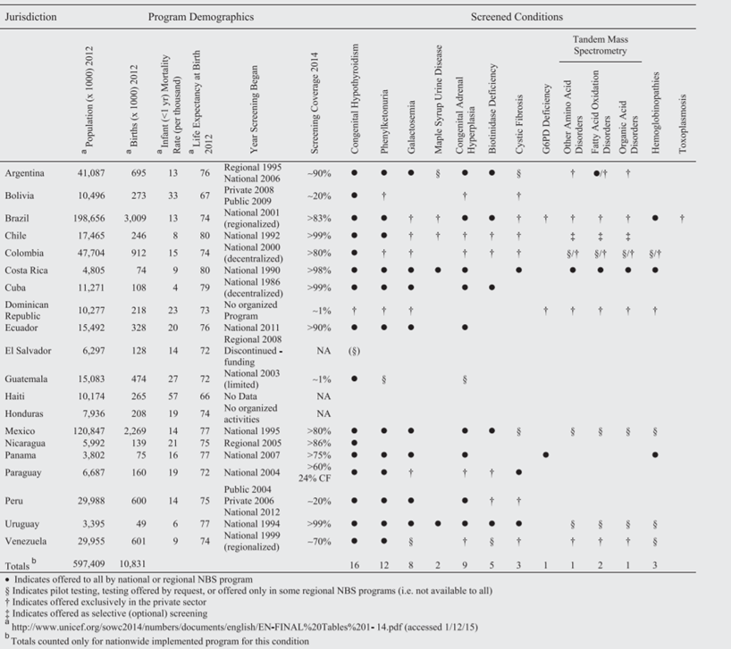
Newborn Screening in Latin America
Therrell, B. L., Padilla, C. D., Loeber, J. G., Kneisser, I., Saadallah, A., Borrajo, G. J., & Adams, J. (2015). Current status of newborn screening worldwide: 2015. Seminars in Perinatology, 39(3), 171-187.

Slide 33
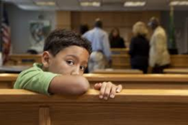
Medical-Legal Nexus
Representation improves legal outcomes
  Key forms of relief:
    Asylum, Special immigrant Juvenile Status, U-Visa, T-Visa
  Unaccompanied children have no right to government appointed counsel
  Majority without legal representation (49% FY 2016)*
    32 % in 2014
    National disparities: NYC ICARES 90% UIC represented
  Legal outcomes improved with representation
    86.6% favorable legal outcome with attorney (7/18/14 – 6/28/16)*
      *Syracuse University Transactional Records Access Clearinghouse, 2017
Notes:
It is important to think of immigration status as a critical SDH in terms of both access to health care and the effects on immigrants– first and foremost that comes to mind is the anxiety, uncertainty and depression created by the EO for children and families we see, and how Legal Status has had a chilling effect on seeking health care, other benefits such as WIC and police protection. You can all follow this trajectory to its logical conclusions
Now the Medical-legal Nexus in the crux of the work that Terra Firma does.
The most important principle for you to remember is that of Legal Representation improves immigration outcomes for children
It is our imperative to ensure that the children that come into our practices are connected with pro bono or lo bono counsel
The key forms of relief are listed here:
Asylum – Having credible fear of persecution in ones home country based on race, religion, ethnicity, particular social group or political belief
SIJS- Having been abused, abandoned or neglected by one or more parent (including death of a parent) – Important in our history taking
U – Visa: Victim of a crime in this country and willing to work with law enforcement
T- Visa: Victim of trafficking and willing to work with law enforcement

Slide 34
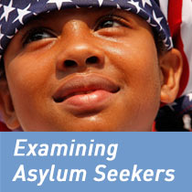
Medical-Legal Nexus
  Healthcare improves legal outcomes
Uncover histories not revealed to lawyers
Forensic exams and affidavits
Facilitate communication with attorney
Improve ability to testify in court
Improved asylum grant rate with medical evaluations
      89% with medical evaluations vs. 38% without won asylum**
  **Lustig et al. “J. Immigrant Minority Health (2008) 10:7–15”
  Physicians for Human Rights. Examining Asylum Seekers:
  A Clinician’s Guide to Physical and Psychological Evaluations of Torture and Ill Treatment.
Notes:
Mutual goal is to have best outcome for the child

Slide 35

Healthcare and Justice for Immigrant Children

Slide 36
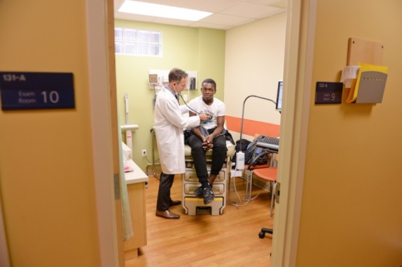
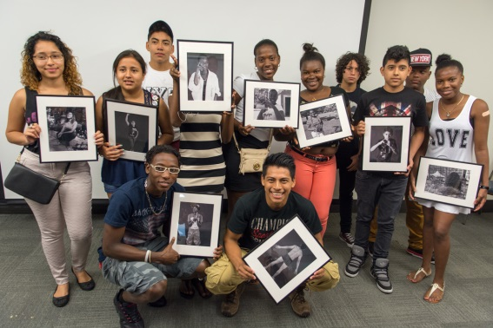
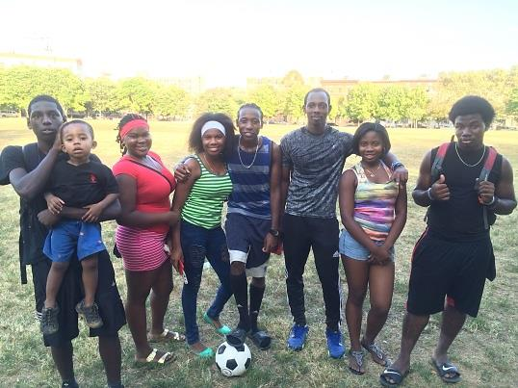
The Terra Firma Model
Model components
  Medical-Legal Partnership
  Referral-based program
  Patient Centered Medical Home
  Integrated Behavioral Health:
    Individual therapy and Trauma-informed Support Group
  Co-located Legal services
  Forensic exams, written affidavits, oral testimony
  Social services/case management
  Youth Enrichment

Slide 37
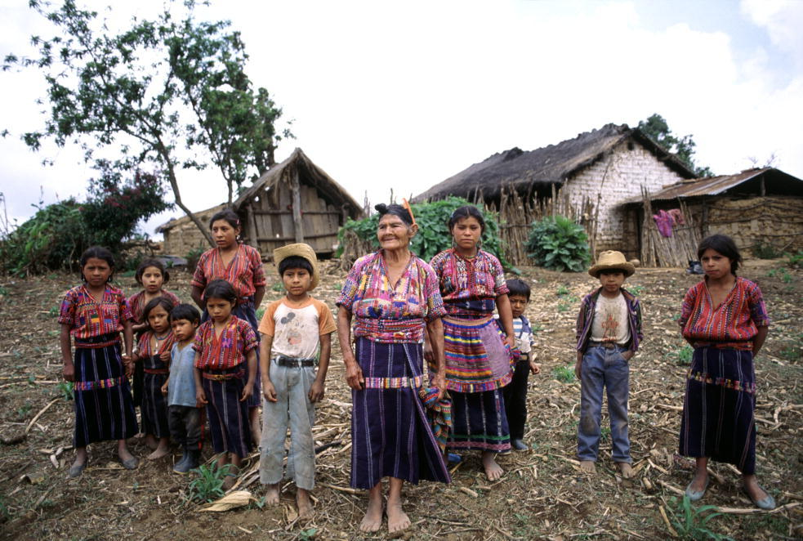
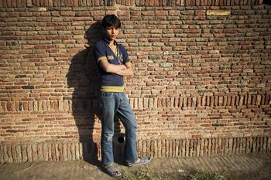
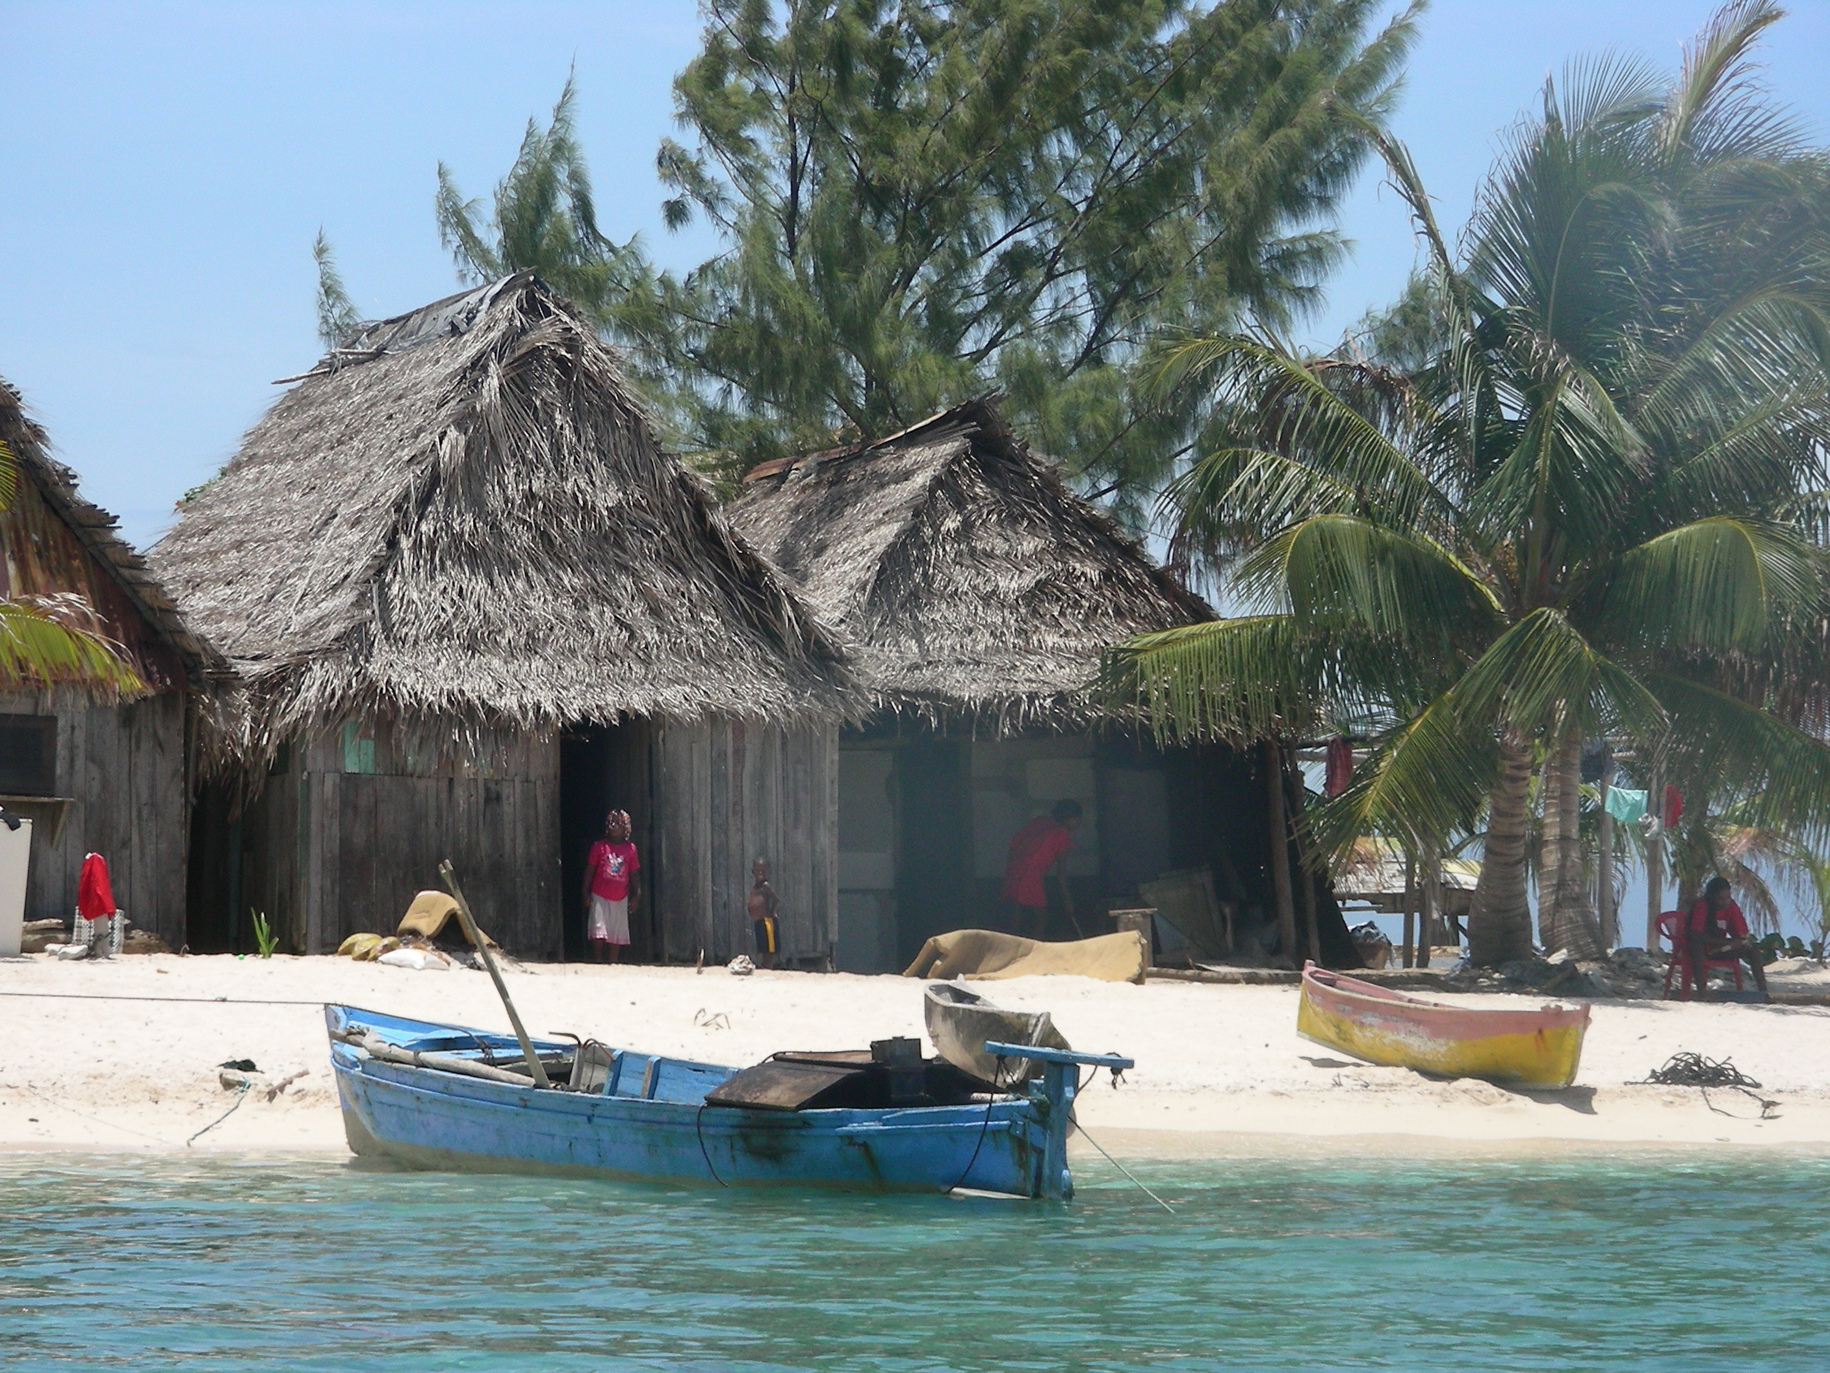
The Human Side: Tell the Story
18 y/o male youth from Guatemalan Mam village, enslaved > 1 year; fled plantation, owners came to his village seeking to kill him, escaped to US. Severe PTSD, seeking asylum
17 y/o girl fled El Salvador after 8 months of sexual abuse by uncle. She left with m/aunt to reunite with mother living in US for 14 years. Applying for SIJS
19 y/o Garifuna male fled Honduras after release fearing gang retribution. Intentionally run over by a car by gangs when he refused to be recruited; sent to an ICU in coma x 1 month; broken right tib fib and left femur. Seeking asylum.
Dateigröße: 2,88 MB, MIME-Typ: image/jpeg
© UNICEF/NYHQ2012-0094/Asad Zaid
Andy Palacio
Notes:
These are just some of the cases of the children I have seen in the Terra Firma Clinic

Slide 38
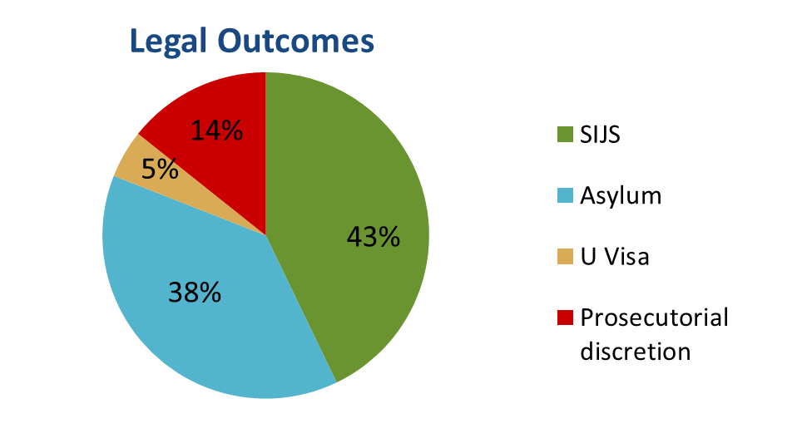
Medical-Legal Partnership Outcomes
1/1/2014 – 12/31/2017
87 affidavits submitted
No case lost at trial
42 (48%)
pending
45 (52%) won legal relief
Notes:
Providers asked to write an affidavit % cases
58.6% MH
41.4 % Medical

Slide 39
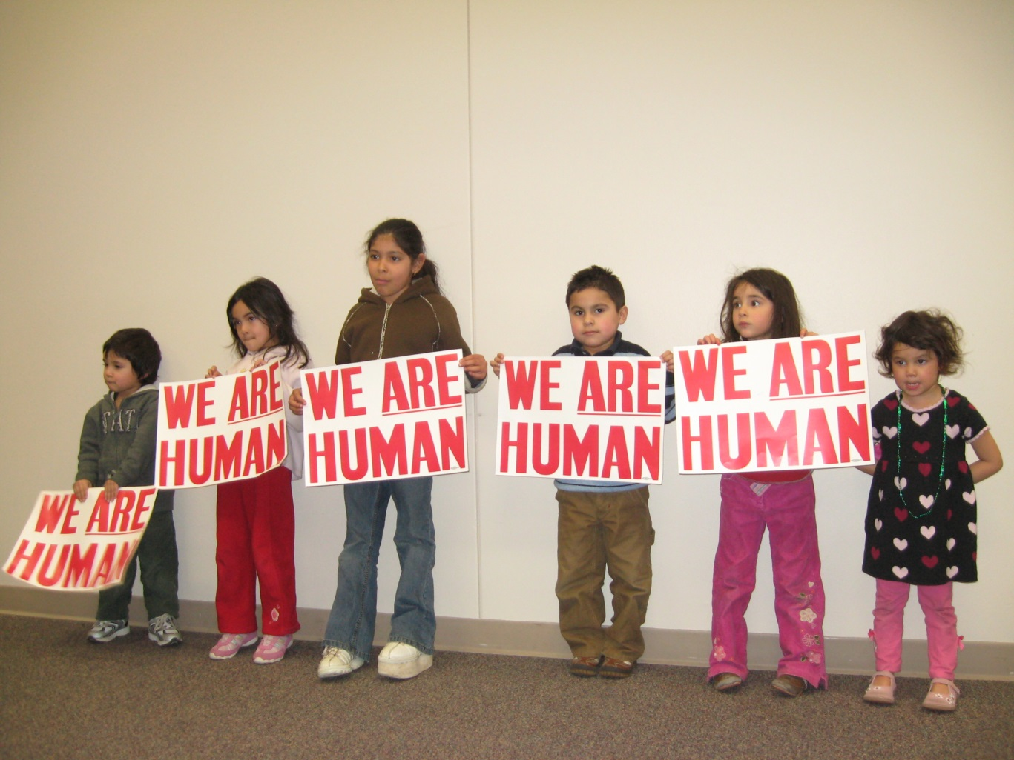
Be an Advocate
Healthcare Setting:
  Make your center immigrant friendly
  Educate staff
  Medical-Legal Partnership
  Know your rights:
    National Immigration Law Center (NILC) Toolkit: https://healthtoolkit.nilc.org/login/
Community-level:
  Know Your Rights presentations to your community
Professional-level:
  Join AAP Immigrant Health SIG
  Research: Immigrant focused, legal status as a SDH
Government-level
  Write letters, call, visit representatives offices (attend “advocacy days”)
  VOTE
Media: Influence the public:
  Data and Patient Stories
  Op-eds, TV, radio, social media (e.g. AAP’s Tweetiatricians)

Slide 40

Stay Positive

Slide 41
Resources
AAP Council on Community Pediatrics Immigrant Health Toolkit, http://bit.ly/1y6HR1D.
AAP Council on Community Pediatrics. Community pediatrics: navigating the intersection of medicine, public health, and social determinants of children’s health. Pediatrics 2013; 131(3): 623-628.
AAP Council on Community Pediatrics. Providing Care for Immigrant, Migrant, and Border Children Pediatrics, 2013, 131(6): e2028-34.
AAP. Trauma toolbox for primary care. M. D. Dowd, Editor. www.aap.org/traumaguide
CDC: Guidelines for the U.S. Domestic Medical Examination for Newly Arriving Refugees https://www.cdc.gov/immigrantrefugeehealth/guidelines/domestic/domestic-guidelines.html
Linton JM, Griffin M, Shapiro A. Detention of Immigrant Children. Pediatrics, May 2017, DOI: 10.1542/peds.2017-0483.
Lustig et al. J. Immigrant Minority Health; 2008; 10:7–15.
Physicians for Human Rights. Examining Asylum Seekers: A Clinicians Guide to Physical and Psychological Evaluations of Torture and Ill Treatment.
National Center for Medical-Legal Partnership http://medical-legalpartnership.org/
National Immigration Law Center (NILC) Toolkit: https://healthtoolkit.nilc.org/login/
KIND (Kids in Need of Defense): https://supportkind.org/resources/knowrights-information-ice-raids-parentscommunityattorneys/
US Customs and Border Patrol, 2018. https://www.cbp.gov/newsroom/stats/usbp-sw-border-apprehensions
Women’s Refugee Commission, Lutheran Immigration and Refugee Service, Kids in Need of Defense. Betraying Family Values: How Immigration Policy at the United States Border is Separating Families. Available at: https://www.womensrefugeecommission.org/rights/gbv/resources/1450-betraying-family-values

Slide 42
Patient/Family Resources
Immigrant Defense Project at 212-725-6422 (arrested or convicted).
Case Status Information Line at 1-800-898-7180 (to see if final order of removal)
New Americans Hotline at 800-566-7636 (Mon-Fri 9 am – 8 pm):referrals to low-cost and free immigration legal service providers
Finding a a private immigration attorney: http://www.ailalawyer.com
Online Ice Locator: locator.ice.gov or contact local ICE office to find family/friends: A# and country of birth OR Exact name, country of birth and date of birth
For step-by-step support during a live raid: United We Dream Hotline 844-363-1423.
Notes:
The online ICE locator (ODLS):
- What information does ICE collect about me when I use the ODLS website?
ODLS collects limited information about you when you use the system. You do not need to set up an account, provide any information about yourself, or get special permission to use the system. When you visit the website, the system does collect limited technical information including your Internet domain, Internet Protocol (IP) address, and the Internet address of the website from which you linked directly to the ODLS website. This information is collected to allow ICE to troubleshoot issues with the system and to monitor and protect the system from cyber-attacks. It is not used to identify people who use ODLS, to track what they search in the system, or to assist with immigration enforcement activities.
- Does ODLS have information about all persons in ICE custody?
No. ODLS does not contain information about all persons in ICE custody. For example, juveniles (detainees under the age of 18) and persons released from ICE custody more than 60 days ago are not in the system. The ODLS contains information about current adult detainees and persons released from detention (for any reason, including removal) within the last 60 days.
- Can I use ODLS to find out if an immigration detainer has issued for a person in local custody? No. Local ERO should have that info.
- What does the response "not in custody" mean? It means the person was released from ICE custody within the last 60 days for any of the following reasons:
Removed from or voluntarily departed the United States,
Released from custody pending the outcome of their case,
Released into the US due to the resolution of the immigration case (e.g., grant of an immigration benefit that permits the person to remain in the country), or
Transferred into the custody of another law enforcement or custodial agency.
To obtain more info, contact the ERO office responsible for that person's immigration case.
- How current is the information in ODLS? Anywhere from 20 minutes to eight hours old. ICE policy requires that its systems be updated within eight hours of the release, removal, or transfer of detainees.
- Does ODLS show when a detainee is being transferred between facilities? No. For security reasons, ODLS does not provide information about transfers that are planned or in progress. Once a person is transferred and booked into another ICE detention facility, ODLS will be updated with that information.
How do I find out if a person was removed from the United States? ODLS does not reveal whether a person was removed. The system will only reveal if a person is currently in ICE custody or was released from ICE custody within the last 60 days. You’ll need to contact the ERO office responsible for that persons immigration case.
What type of information will I need to visit a detainee in a detention facility? A government-issued photo identification or other identification when photo identification is unavailable for religious reasons is required to visit a detention facility. However, you should contact the detention facility you plan to visit in order to find out what their policies and regulations are regarding visitation.
If the status of the detainee shows "In Custody," select the "Current Detention Facility" link which will provide the contact information for the detention facility where the detainee is being held. Contact the detention facility to confirm the detainee is still at that location prior to visiting.

Slide 43
HEALTHCARE AND JUSTICE FOR IMMIGRANT CHILDREN
www.terrafirma.org
THANK YOU!
Notes:
All of us

