Slide 1
Reproductive Health Justice
Every mother, Every baby
Well Babies Start With Equity
June 2018

Slide 2
Reproductive Health Equity
Describes an affirmative social reality of economic opportunity, educational attainment, and meaningful health choices for women and girls

Slide 3
A Human Rights Framework
The right to decide whether and when to become a parent, the right to dignity in care, and the right to parent one’s child in safety and dignity
Health Education
Access to Care
Freedom from Coercion
Reproductive Health Justice

Slide 4
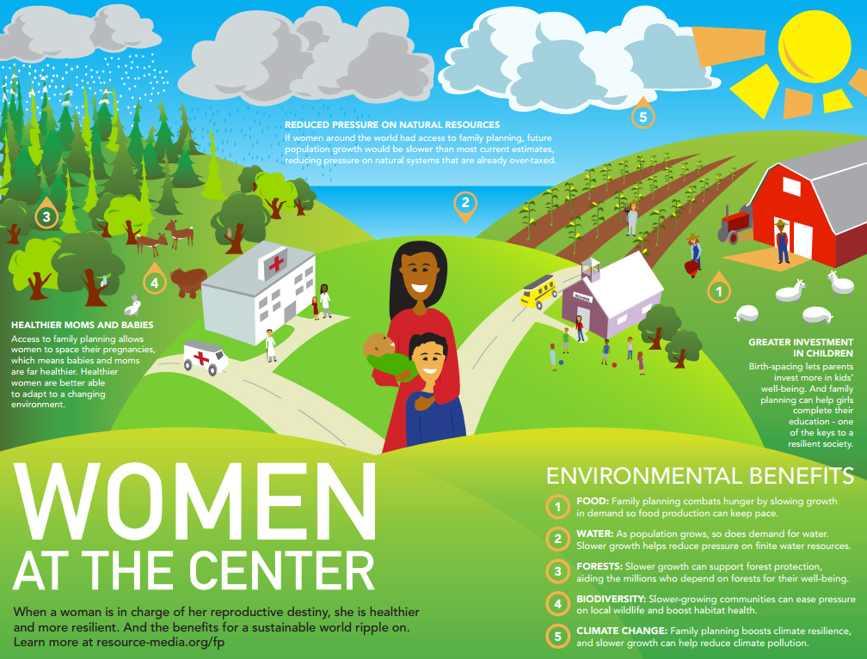
Creating an affirmative culture
Notes:
When you center women, informed empowered women with healthcare access choose their pregnancies, and earn more money on average and achieve higher educational levels. This benefits her and the next generation, who are more likely to be parented by income secure empowered parents. When the next generation thrives, society benefits.

Slide 5
There was a mom…
Denied housing
Experiencing Structural Racism
Prosecuted for addiction
Notes:
Story of incarcerated woman who became pregnant and had tox positive baby
Jessy’s story
45 states have prosecuted women for substance abuse during pregnancy

Slide 6
Black Maternal Mortality
3 of 4 black mothers deliver in ~25% quarter of the country’s hospitals.
SMM for Black women was 3 times that of white women.
SMM for women with Medicaid or Family Plus was higher than women with private insurance (261.1 v 168.2 per 10,000 deliveries.)
SMM was highest among women living in high poverty zip codes with 30% and more living below FPL, excluding Black women, whose SMM rate are high, regardless.
Brookedale University Hospital Medical Center
– Low income, un-gentrified areas of Brooklyn have 4x the complication rates of nearby neighborhoods
– More than half of mothers who hemorrhaged during delivery experienced complications at
– ~65% of all SMM cases needed a blood transfusion

Slide 7
Structural Racism is a Reproductive Health Crisis
FORCED PREGNANCY
Lack of meaningful access to abortion care via restrictions that disproportionately impact women of color
nearly 20 million American women ages 13-44 in need of publicly funded birth control lack access to clinics that provide it
Cultural practices relating to discussing sex and reproductive health create barriers, especially with a lack of provider/patient cultural parity

Slide 8
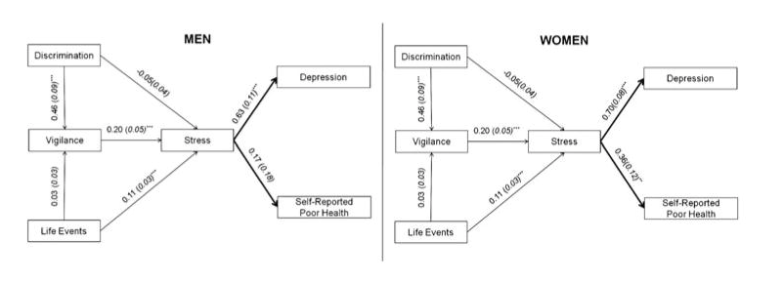
Vigilance is a racism induced stress response
Discrimination-related vigilance: a coping mechanism characterized by attempting to protect oneself from anticipated discrimination by continuously monitoring and modifying one’s behavior and surroundings. (Hicken, Lee, Ailshire, Burgard, & Williams) 2013

Slide 9
Socioecological model of African American women and sexual and reproductive health influences and outcomes.

Slide 10
Who are Women?
A. 47 % of the US Workforce
B. 80% of single parents and 50% of two parent families
C. A group who earn 78% of the salary their male counterparts earn and are more likely to live in poverty
D. A group less likely to have medicines appropriately tested for them and more likely to have their pain ignored
E. ALL OF THE ABOVE

Slide 11
Gender and Poverty
men
women

Slide 12
Women Work Harder to be Poorer
In Rochester:
Nationally:

Slide 13
“40 to 50 % of the gender gap can be explained by the impact of parental & marital status on ♂’s and ♀’s earnings. While the gender pay gap has been decreasing, the pay gap related to parenthood is increasing”
While women pay a lifetime earnings penalty of 4% per child…
Men’s wages actually INCREASE with parenthood
In 2010, ♀ accounted for 47% of the US work force
In 2013, 69.9 % of ♀ in the work force had children under 18
Fatherhood increases men’s earnings by over 6%. (Using the 1979-2006 waves of the National Longitudinal Survey of Youth 1979 (NLSY79))
This effect is strongest for white men in high education/high earning professions

Slide 14
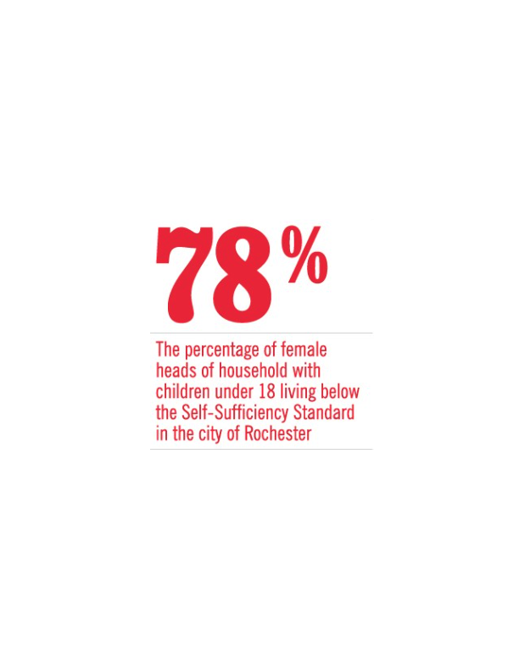
Women Bear the Economic Burden of Child bearing
In lost wages due to hours of work missed for maternity or childcare needs
In medical cost
In average wage reduction per child for women who become mothers
This hits women with low SES and women of color the hardest
At 48% of all homes with children, single female heads of household with children under 18 are the largest demographic group in Rochester

Slide 15
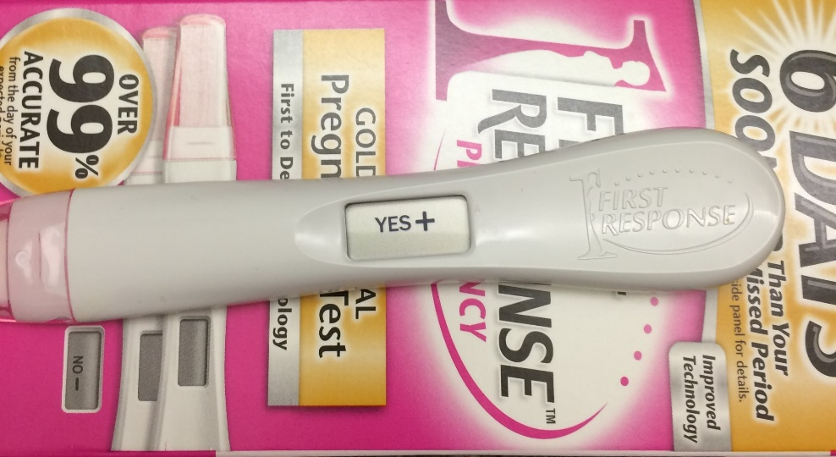
Reproductive Justice is about who decides
The decision to become:
&
The decision to stay:
Is one of the most profound life choices a woman can make;
Financially
Professionally
Emotionally
Physically
PREGNANT / NOT PREGNANT
PREGNANT / NOT PREGNANT

Slide 16
Takeaways…
Cultural parity matters
The culture of healthcare matters
Seeing the whole patient in context is essential
Poverty is fundamentally entwined with gender equity
Reproductive Health and economic empowerment go hand in hand
Notes:
Never tell a mom to stop drinking or abusing substances without asking WHY she is drinking or abusing substances. Never prescribe bed rest without asking how a mom’s childcare/economic security, etc. might be affected…

Slide 17
The future is female
Every mother, Every baby
Let’s nurture it!

Slide 18
My Blueberry

